Slide 1
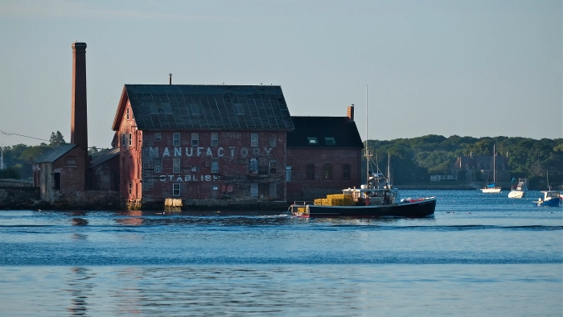
Strahan v. Massachusetts
Assault on the Working Waterfront

Slide 2
New England Coastal Lobstermen
Coastal lobstermen in New England support their families and feed the nation using traditional buoys with vertical lines.
Traditionally, commercial lobstermen have self regulated, and have enacted reasonable measures such as size restrictions, prohibitions on landing egg bearing and fertile females, and trap limits.
Commercial lobstering is the most sustainable New England fishery.
Virtually all coastal commercial lobstermen are small business owners and operate their own boats.
Today, lobstermen are regulated by both states and the National Marine Fisheries Service.

Slide 3
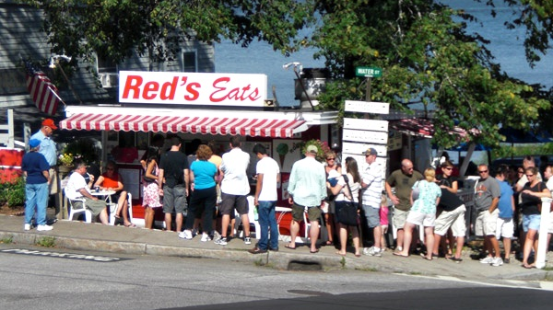
Lobstering is essential to the New England economy

Slide 4
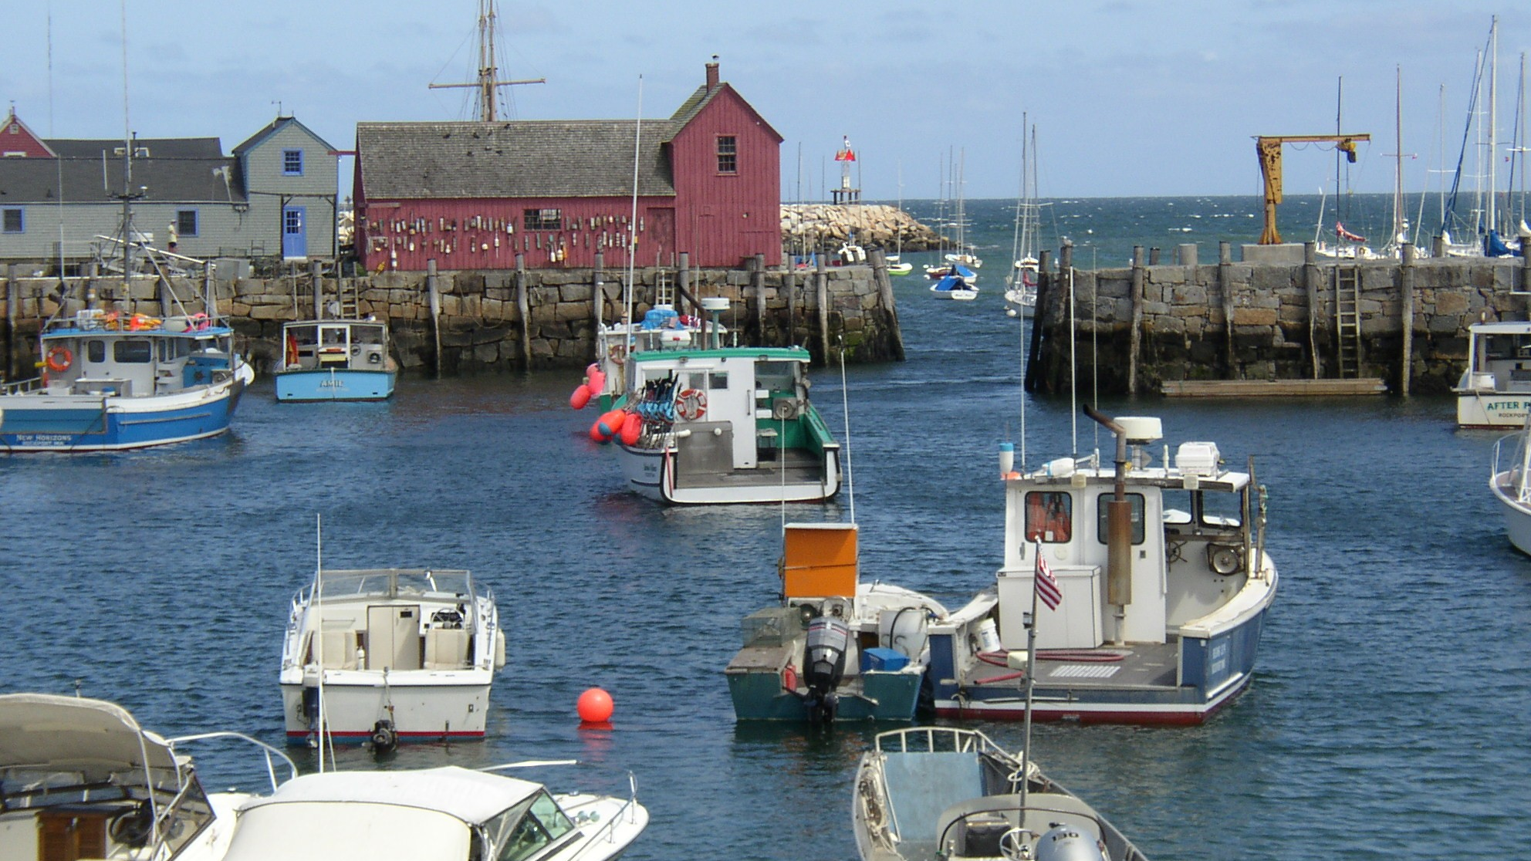
It is unique to our New England culture

Slide 5
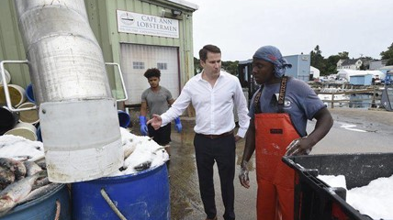
It provides high paying jobs

Slide 6
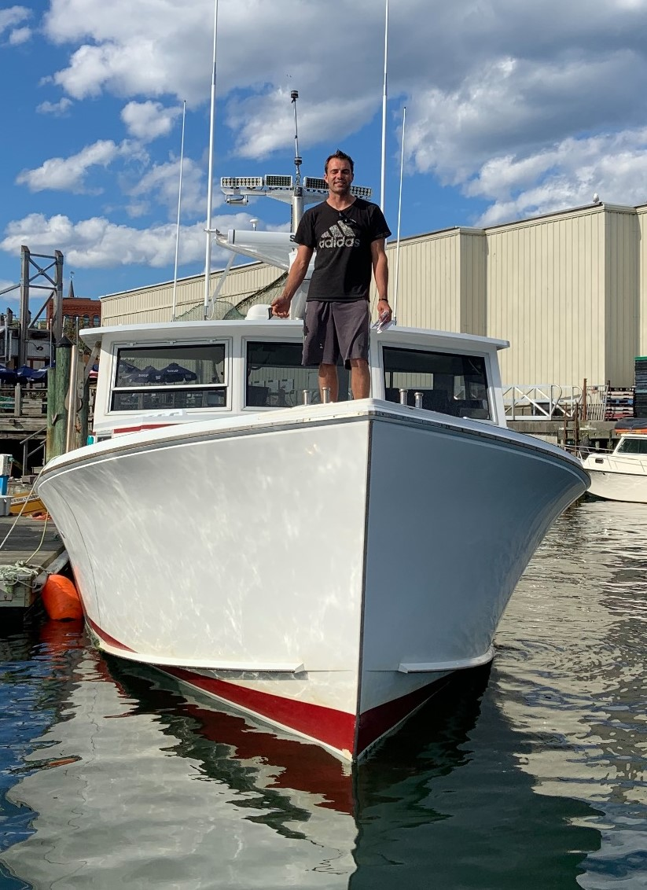
It promotes a “Virtuous Cycle” with a locally harvested resource

Slide 7
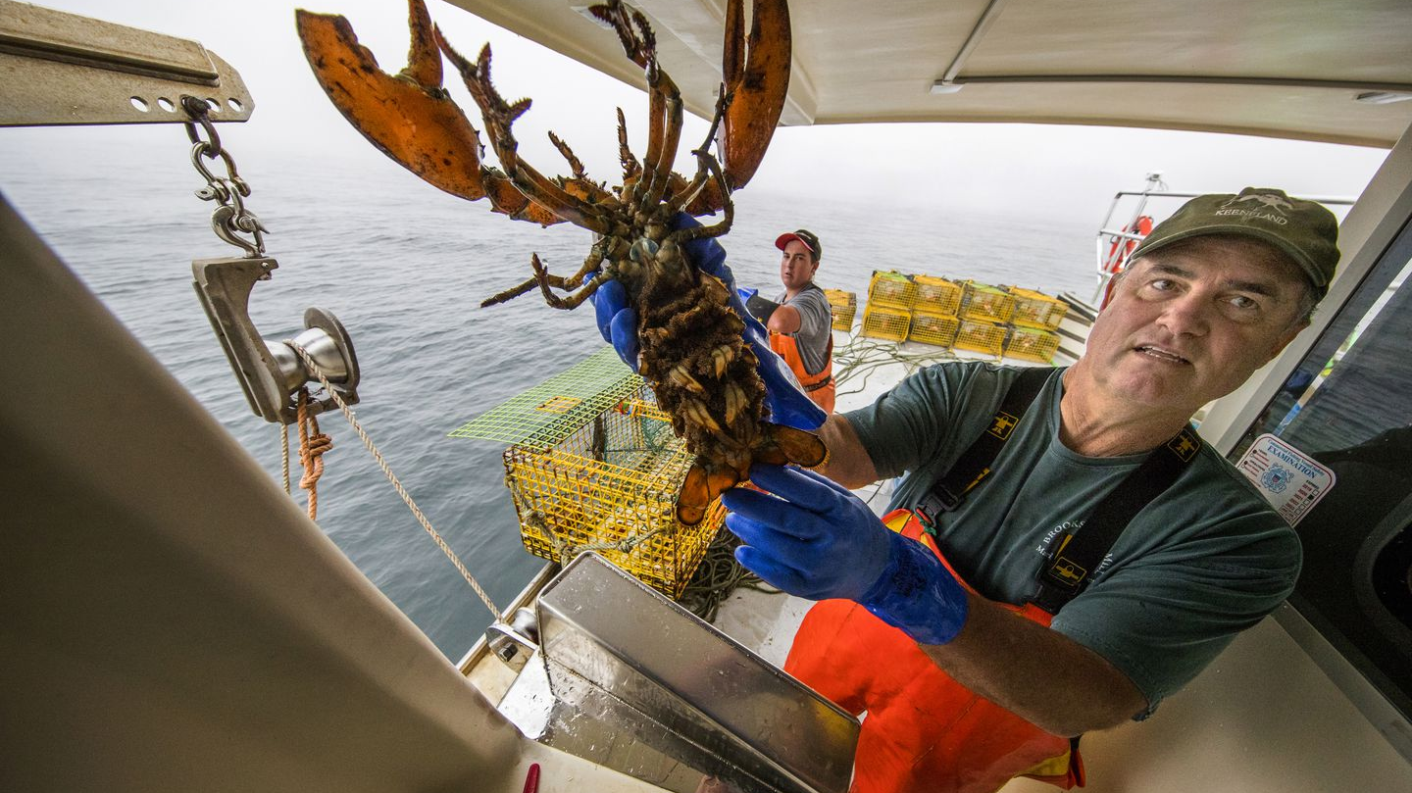
Lobstermen love what they do!

Slide 8
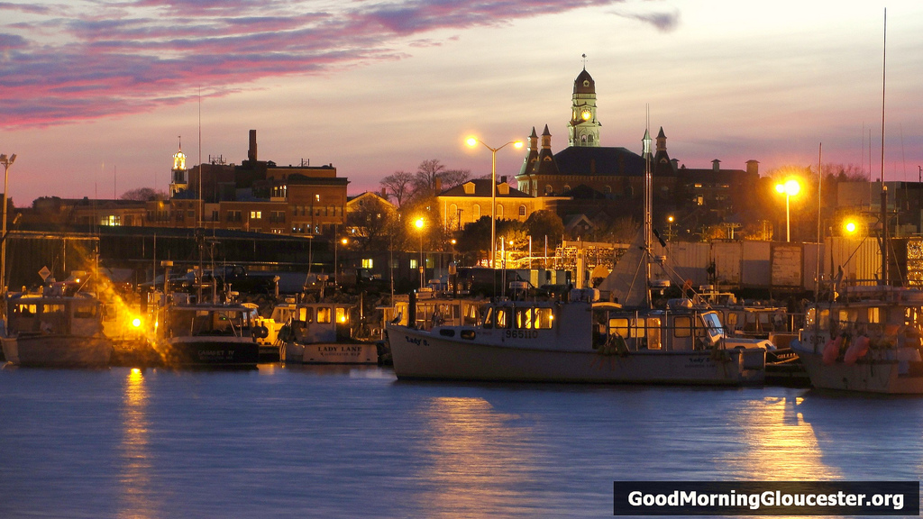
Communities depend on it

Slide 9
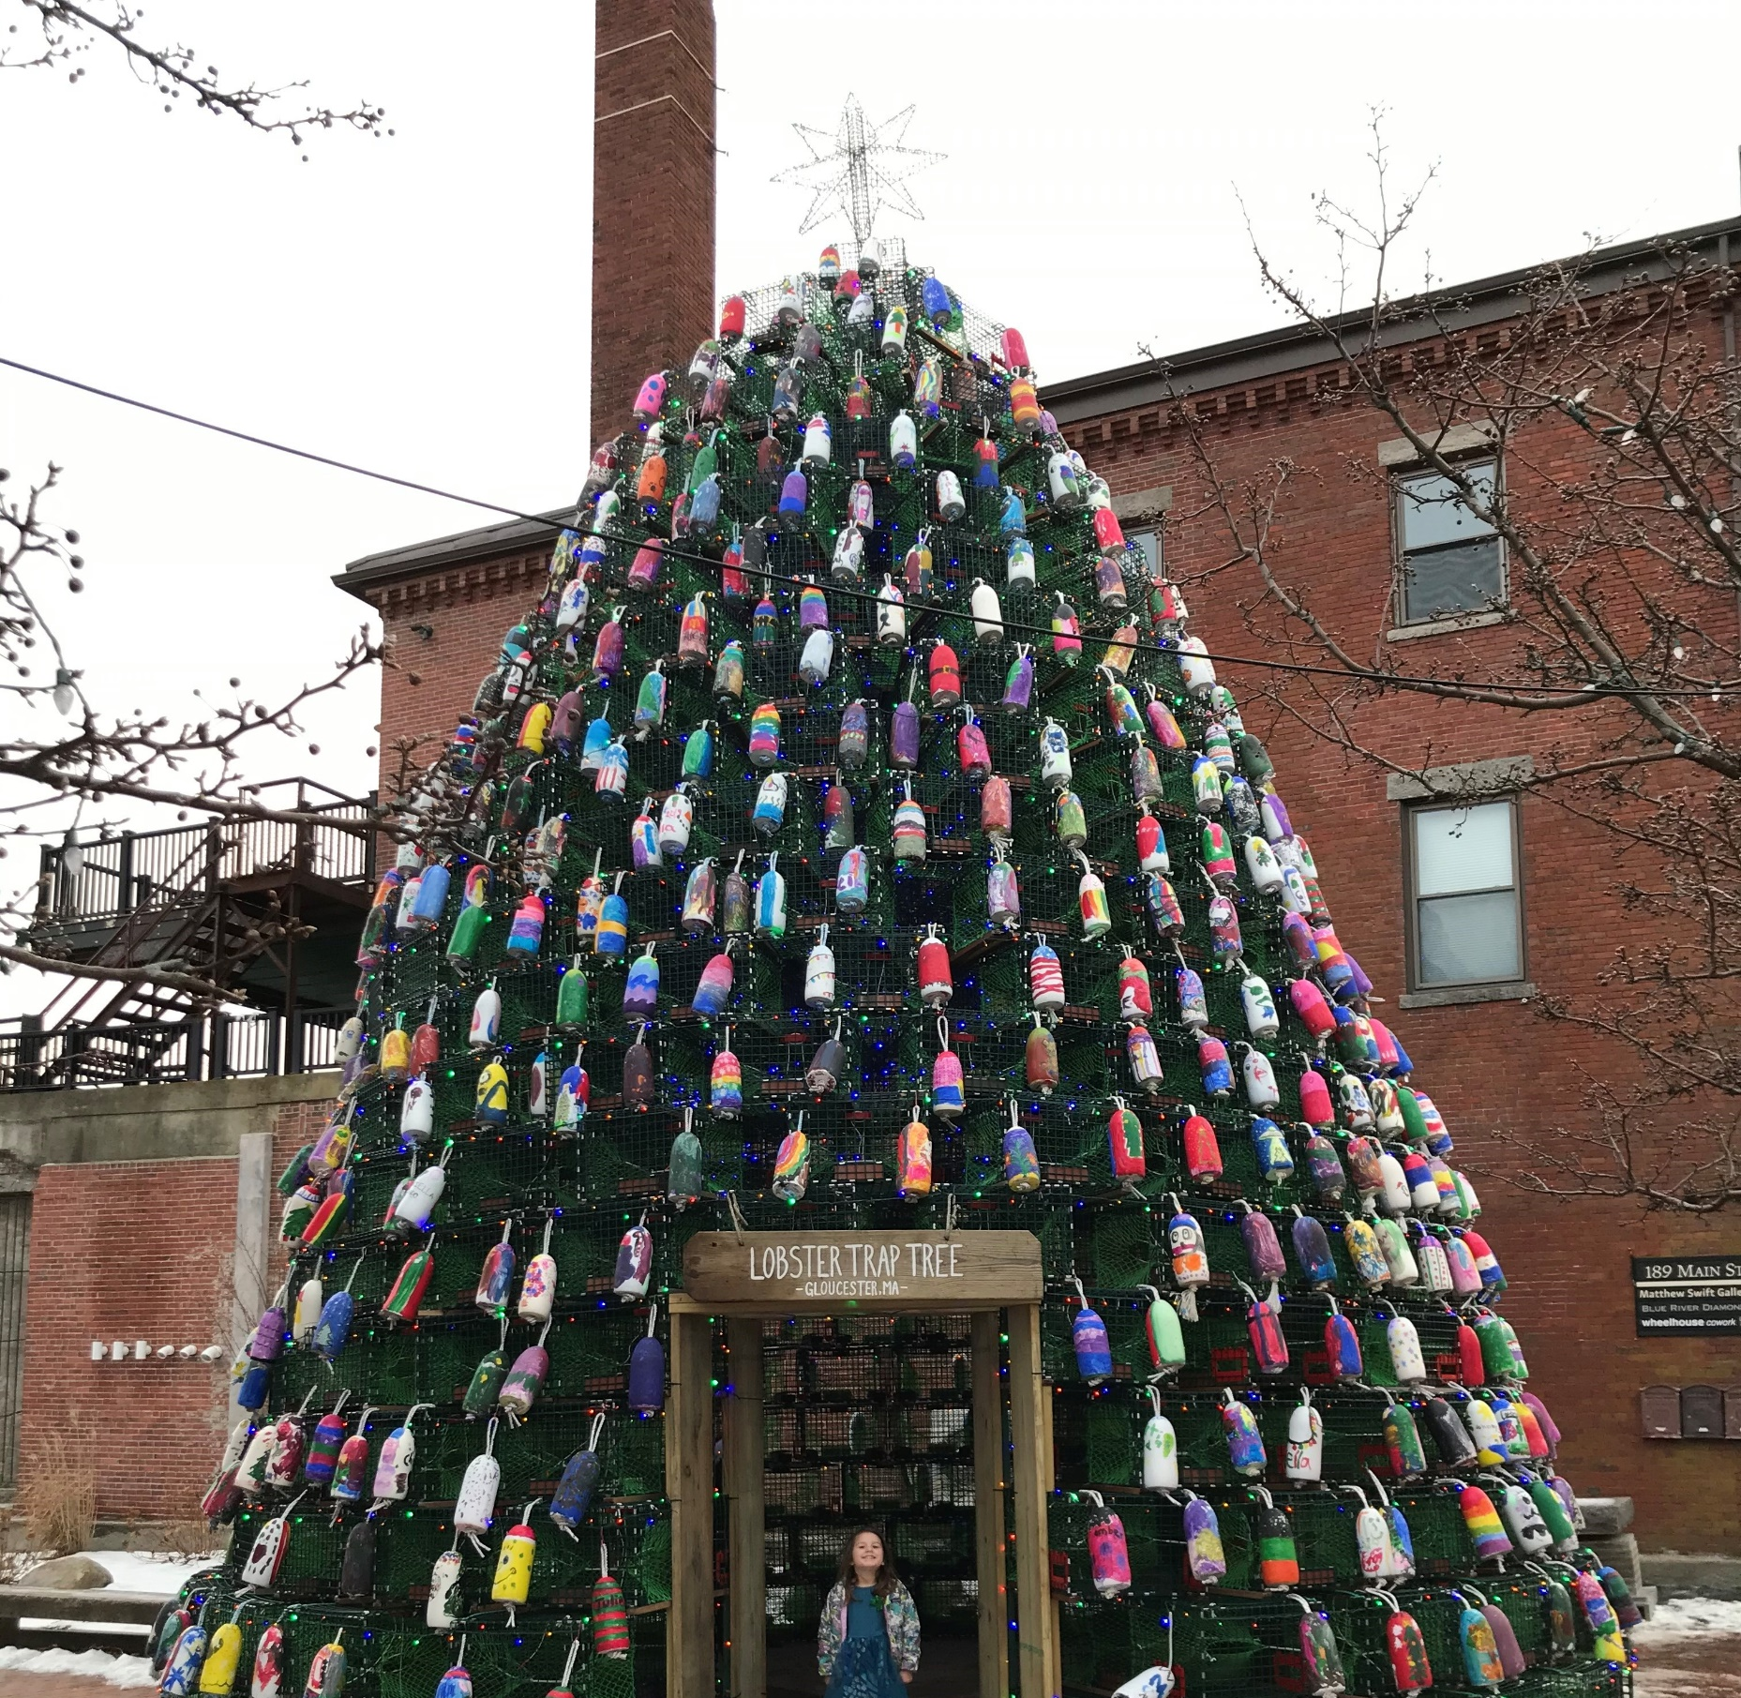
The children depend on it!

Slide 10

But some environmentalists want to shut it down.

Slide 11
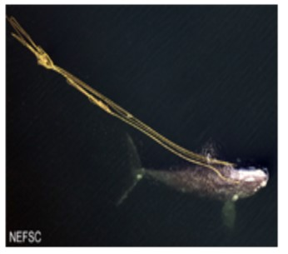
They say coastal lobster gear tends to entangle the North Atlantic Right Whale
NOT coastal lobster gear!

Slide 12
Under the Endangered Species Act, taking North Atlantic Right Whales is Prohibited
ESA § 9 prohibits the “taking” of any endangered species. 16 U.S.C. 1538.
No coastal lobsterman has ever been held liable for taking a North Atlantic Right Whale under ESA § 9.
Instead, environmentalists claim an “end run” that the overall regulatory scheme licensing the Massachusetts coastal lobster fishery tends to entangle (and therefore “take”) the North Atlantic Right Whale. Strahan v. Coxe, 127 F.3d 155 (1st Cir. 1997).
In Coxe, the First Circuit held that such a regulatory scheme can violate ESA § 9 if it likely will proximately cause a “take” of the NARW.

Slide 13
The environmentalists are wrong!
Other than a single non-lethal and non-serious entanglement in 2016, there has never been a NARW entanglement sourced to U.S. coastal lobstering gear since before 2010.
Since 2004, all confirmed gear retrieved from dead NARWs has been Canadian Snow Crab gear deployed primarily in the Gulf of St. Lawrence (Canada), which uses very thick, floating, polypropylene line prohibited from use in the U.S. Coastal Lobster fishery.
Not coincidentally, in approximately 2010 NARWs began migrating to the Gulf of St. Lawrence to chase their food source, copepods, which have changed their migration because of climate change.

Slide 14
NARWs used to migrate between Florida and the Bay of Fundy, but since 2010 they ventured northward to the Gulf of St. Lawrence on account of warming temperatures
Gulf of St. Lawrence (New Summer Feeding)
Bay of Fundy
(Old Summer Feeding)
Cape Cod Bay
(Spring Feeding)

Slide 15
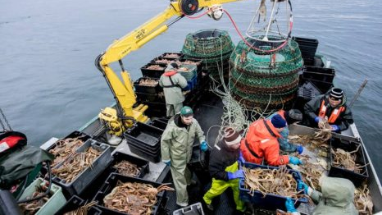
Unregulated Canadian Snow Crab gear is the only gear confirmed to have killed Right Whales since 2004

Slide 16
Massachusetts lobster fishery is heavily regulated by both the Commonwealth and NMFS
The Massachusetts Division of Marine Fisheries (“DMF”) regulates Massachusetts lobstermen within Massachusetts territorial waters (3 nautical miles). Title 322 of the Code of Massachusetts Regulations.
NMFS regulates lobstermen in the Exclusive Economic Zone (“EEZ”) under the Atlantic Coastal Fisheries Cooperative Management Act. 16 U.S.C. 5101 et seq.; 50 CFR Part 697.
NMFS also regulates lobstermen in both state and federal waters under the Marine Mammal Protection Act and specifically the Atlantic Large Whale Take Reduction Plan (“ALWTRP”). 16 U.S.C. § 1387; 50 C.F.R. Part 229.

Slide 17
Regulations make entanglement virtually impossible in Massachusetts
Dynamic Seasonal Closures. Lobstering is closed in almost all Massachusetts waters between February 1 and May 15 when NARWs are known to aggregate in Massachusetts for their spring feeding.
Weak Rope. Buoy lines have breaking contrivances (600 lbs.) at the buoy and “weak rope” inserts throughout the buoy line (1,700 lbs.) in case stray whales enter Massachusetts at other times.
Thin Rope. Lobstermen do not and cannot use buoy lines more than 3/8” thick.
Entanglement Impossible. Amy Knowlton of the New England Aquarium testified that an entanglement causing severe injury or death is virtually impossible using the weak rope inserts.

Slide 19
Strahan v. Massachusetts, Case No. 19-10639-IT
Plaintiff seeking to ban all vertical buoy lines in Massachusetts at all times, claiming NARWs are present in Massachusetts year round.
In April 2020 Judge Talwani granted Plaintiff’s motion for preliminary injunction, but did not ban vertical buoy lines. She ordered DMF to apply for an ESA § 10 Incidental Take Permit (“ITP”).
Full bench trial occurred in June with closing arguments on September 2, 2021. Final decision is pending.
Meanwhile, NMFS is presently proposing to recategorize the Massachusetts lobster fishery from Category I (frequent entanglement) to Category II (moderate entanglement) on account of DMF’s progressive regulations.

Slide 20
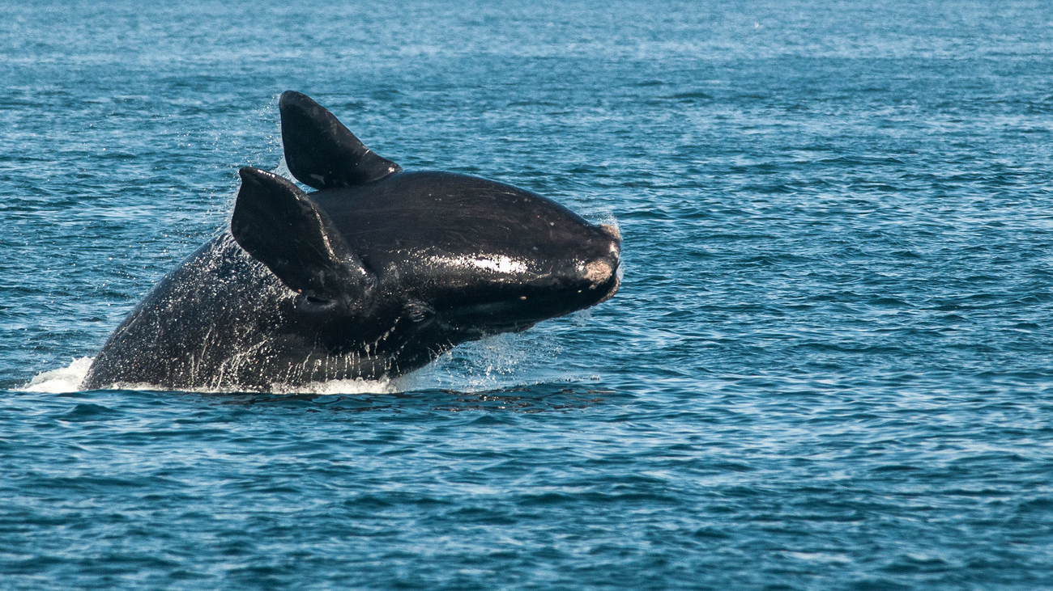
The weak rope works!

Slide 21
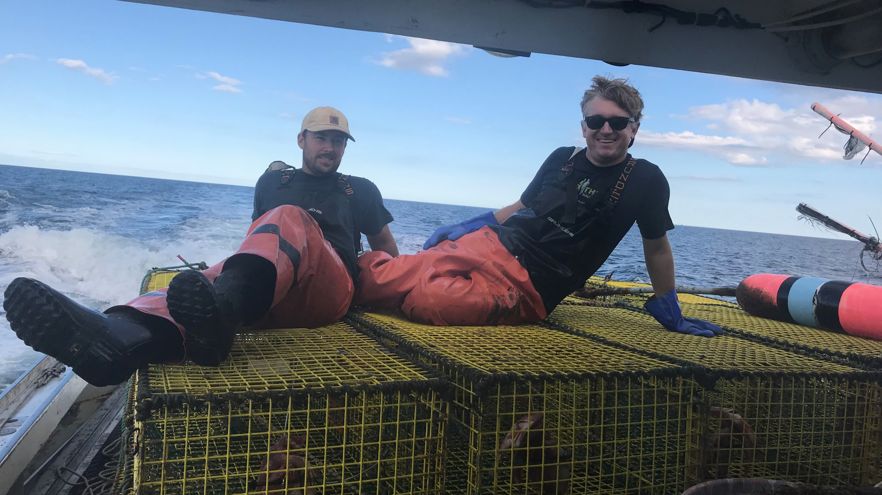
Questions?

