Slide 1
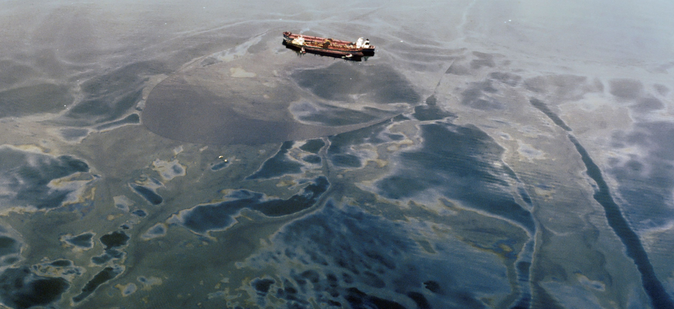
OPA 90 Forum Introduction
Douglas Martin
May 4, 2023
MLA Salvage Committee (NY)

Slide 2
History
Founded in 2021, membership is open to any entity or individual concerned with preparedness, prevention, and response pursuant to OPA 90.

Slide 3
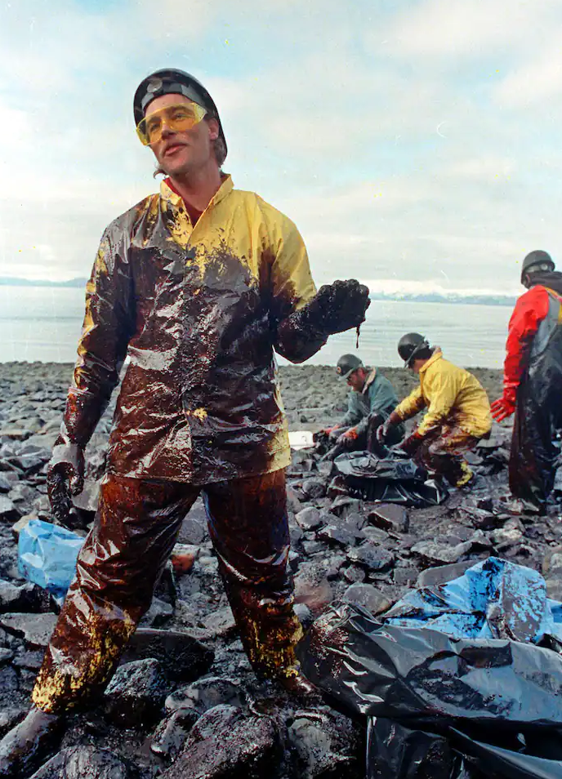
Our Vision
The vision of the OPA 90 Forum is to preserve and enhance the intent of the Oil Pollution Act of 1990

Slide 4
Our Mission
Provide a forum for those concerned with OPA 90 preparedness, prevention, and response to identify issues, with the goal of reducing the number and severity of incidents and increasing the effectiveness of response. The Forum, as a nonprofit corporation, shall, in furtherance of this mission, have the following objectives:
Provide a forum for the robust exchange of concerns and ideas regarding pollution preparedness, prevention, and response under OPA 90 and related federal, state and local laws;
Represent and serve as spokesperson for the environmental services, pollution prevention and preparedness industries, and other response interests, throughout the U. S. and its possessions;
Provide and stimulate an authoritative and organized research, education and information exchange with the interests of the Forum and others, including governmental bodies and concerned organizations; and
Liaise, as appropriate, with governmental agencies as well as allied trade and professional associations within the U. S. in other countries.

Slide 5
What We Are Doing
Establishing Government and Organization Quality Partnerships
Providing and facilitating Government and Industry interfaces
Cybersecurity (see our website for initial session)
Salvage and Marine Firefighting – Geographic Specific Annex verification clarification.
Committed to pursuing the best OPA90 environmental and safety practices for a threat involving marine and transportation industries.
Connecticut Maritime Association Panel 2023

Slide 6
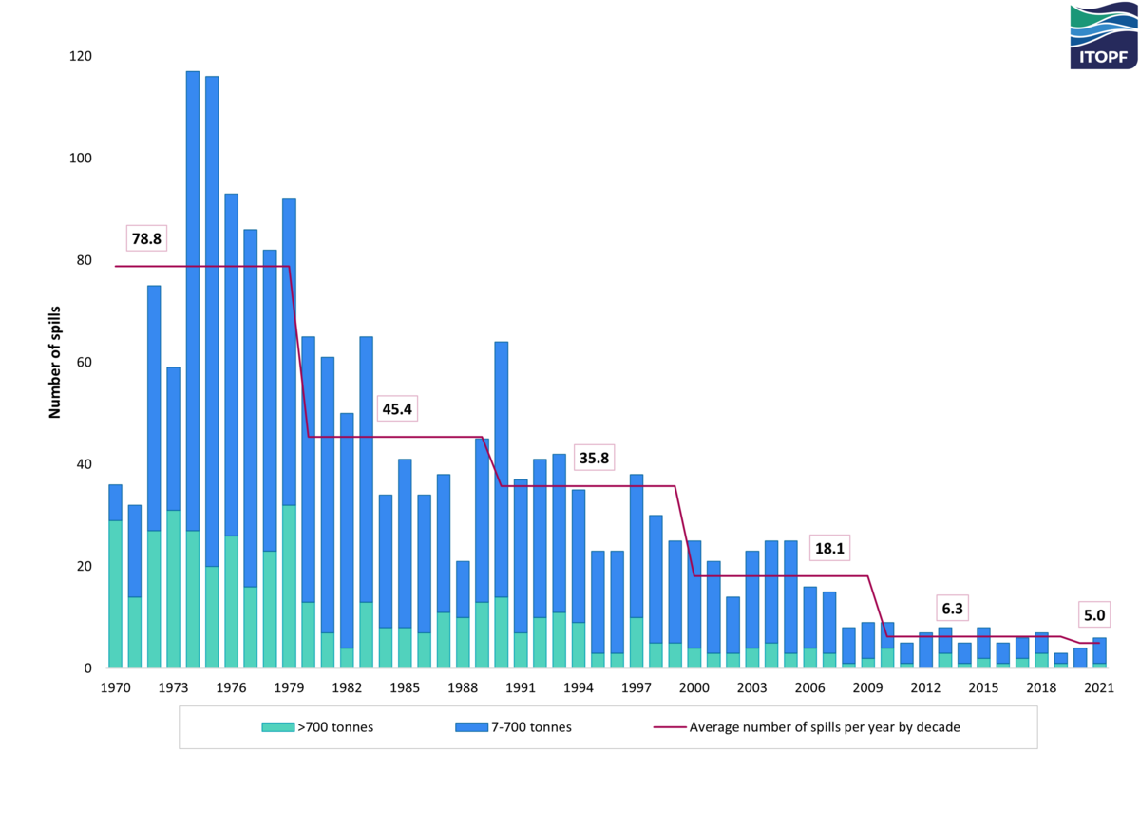
Coming Soon- Outreach Programs
Training and Education
Emergency Response Incident Command Critical Thinking
Prevention and Safety
Science and technology advancements
Cybersecurity
Understanding Cyber Risk
Prevention and Safety
Part 2 Webinar (see our website for Part 1)
Impediments to Response
Responder Immunity and Responder Liability
The past, present and future objectives.
Technical Programs/ Review
Pollution Prevention
Response Techniques and Equipment
Arctic and Cold Climates
Knowledge and Data Sharing

Slide 7
Our Board of Directors
John Allen
Dennis Bryant
Joseph Cox (ex- Chair)
Michael Gallagher
Susan Inman
Alfred Kuffler
James Lawrence
Douglas Martin
Judith Roos
Timothy Williamson

Slide 8
Our Leadership Team
Douglas Martin, Chair
Michael Gallagher, Vice Chair
Timothy Williamson, Treasurer
Susan Inman, Secretary

Slide 9
Join Us
Contact Information
www.opa90forum.org
Richard Fredricks Executive Director 1455 Pennsylvania Avenue NW, Suite 400 Washington, DC 20004 USA
Email: rfredricks@opa90forum.org

Slide 10
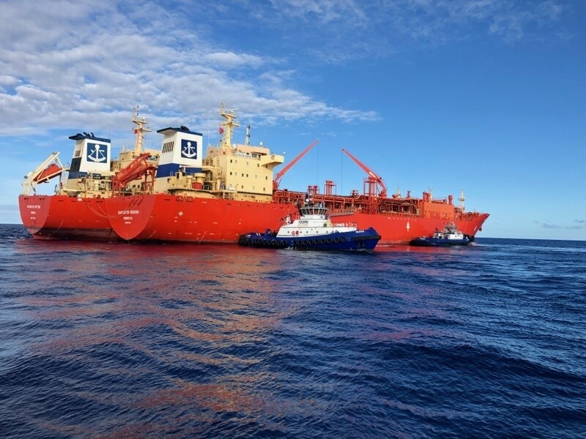
Thank you!
Questions?

