Slide 1
MLAUS Marine Insurance Committee - CMI update
Presented by
Joseph G. Grasso, Esq., Partner, Wiggin & Dana, and Chair of the CMI Standing Committee on Marine Insurance
Jonathan S. Spencer, Average Adjuster, The Spencer Company, and member of the CMI Standing Committee on Marine Insurance and Standing Committee on General Average
May 3, 2023

Slide 2
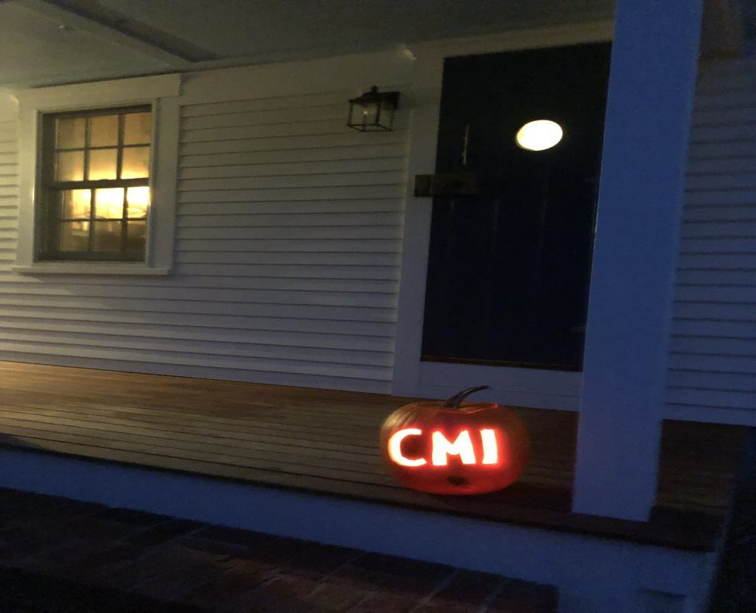
The CMI (The Comité Maritime International)

Slide 3
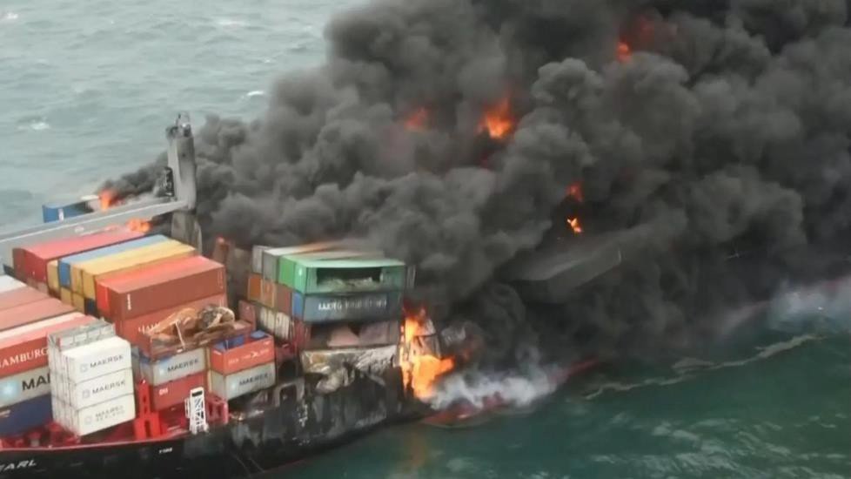
The CMI
Founded in 1897
SC on GA

Slide 4
SC on GA
Nick Coleman – IUMI Kiran Khosla⁺ – International Chamber of Shipping
Paula Bäckdén*⁺ – Sweden Richard Cornah* – UK
Jörn Groninger*⁺ – Germany Michael Harvey* – UK
Jiro Kubo – Japan Sveinung Måkestad – Norway
Karen Schandy – Uruguay Dieter Schwampe⁺ – Germany
Jonathan Spencer* – USA Esteban Vivanco* – Argentina
⁺ attorney * average adjuster

Slide 5
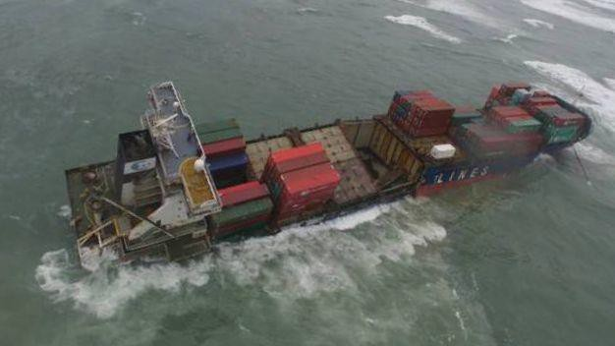
New GA Guidelines and Security Documents
Work began in 2016
Approved by ICS and IUMI 2021
Approved by CMI Assembly on
10/21/22 in Antwerp

Slide 6
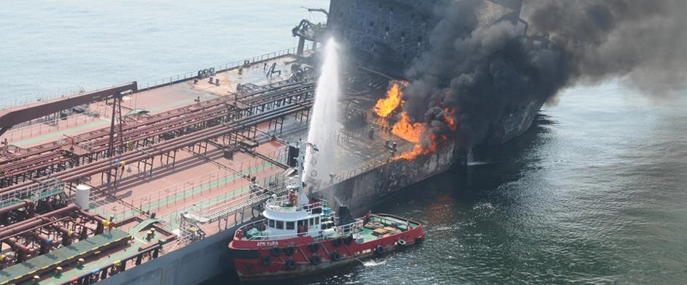
Guidelines
Prepared for commercial parties to assist with understanding basic principles of GA
Six sections
Non-binding and do not override YAR

Slide 7
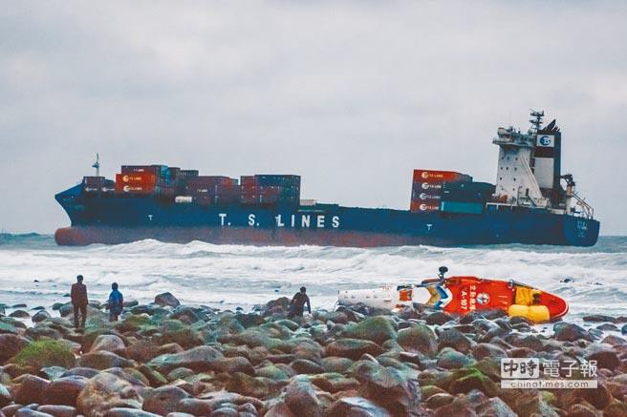
Interest Rates
Amendment and unification of interest provisions in YAR 2004 and 2016

Slide 8
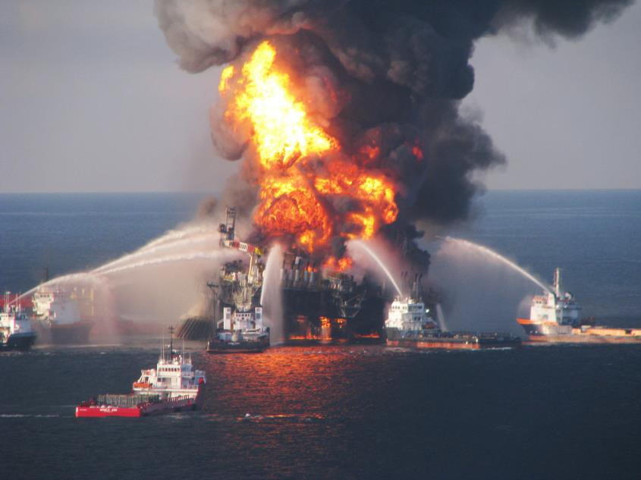
Security Documents
Intended to reduce delays caused by varying wordings
New form devised for interests other than cargo – i.e. time charterers’ bunkers, freight at risk

Slide 9
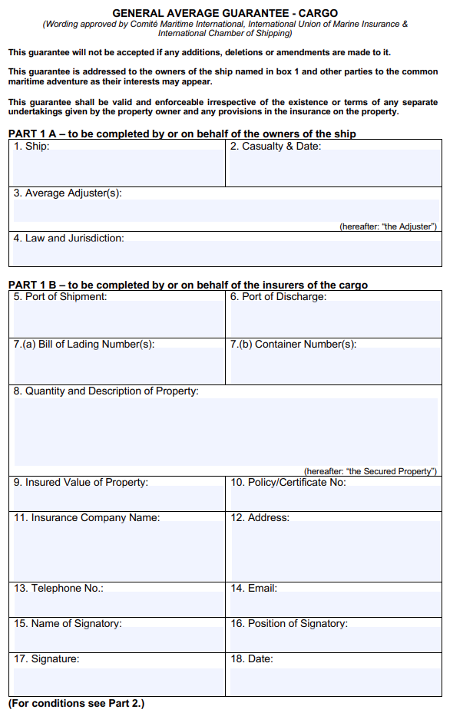
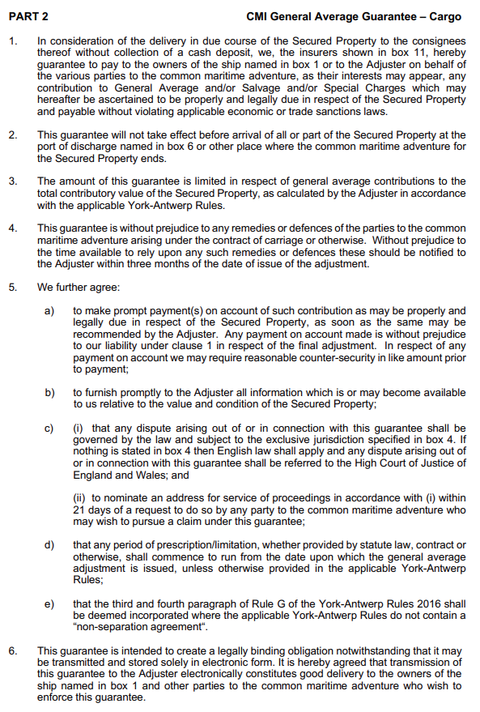
General Average Guarantee

Slide 10
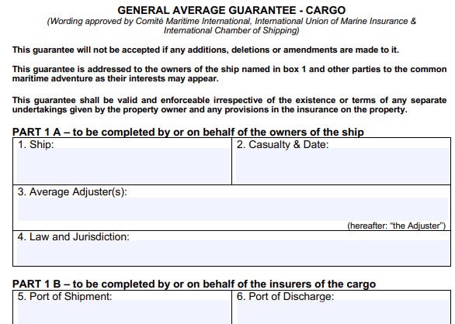
General Average Guarantee
Agreed by major industry stakeholders
Simplified format, separating data supplied by
average adjusters / ship interests and by cargo
interests
Given in respect of contributions “properly and legally
due”
Takes effect on arrival at the port of discharge
Limited to total contributory value of the property
Provides for “prompt payment(s) on account of such contribution as
may be properly and legally due”
Contains jurisdiction provision - High Court of Justice of England and
Wales is the default
Time bar runs from date of issue of the general average adjustment
Includes non-separation agreement

