Slide 1
The US Carriage Of Goods By Sea Act: R.I.P.?
An Urgent Request To Resuscitate An 86 Year Old And Dying Statute
David Maloof, Esq.
Maloof & Browne LLC

Slide 2
DAVID MALOOF, SENIOR PARTNER MALOOF & BROWNE LLC
B.A. Degree in History and English at Columbia University, magna cum laude and phi beta kappa.
J.D. degree from the University of Virginia School of Law.
Practice Areas: complex international and interstate transportation litigation, insurance coverage disputes, product liability and large catastrophic losses.
Adjunct professor at both Roger Williams Law School and St. John’s University.
Martindale-Hubbel’s highest rating for skill and integrity.
Named “Super Lawyer” 2012-2021 and one of the “Top Attorneys in New York.”
Previously worked as an award-winning investigative television reporter, seen on PBS.
2
Prior results do not guarantee a similar outcome. Presentations are not to be construed as legal advice.

Slide 3
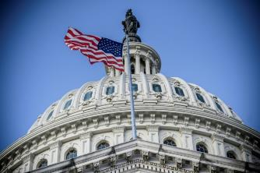
COGSA Background
Regulates the duties, responsibilities and liabilities of carriers and shippers in regard to the transportation of goods to or from United States Ports in foreign trade.
Invalidates bill of lading terms to the extent in conflict with COGSA requirements.
Governs as a matter of law while cargo is on vessel only (from “tackle to tackle”).
Can be contractually extended to apply before loading and after discharge from the vessel.
Can be contractually extended to cover inland component of intermodal shipment and private carriage (charter parties).
[Enacted into law in 1936 as 49 Stat. 1207, now contained in a “note” to 46 U.S.C. § 30701.]
3
The Carriage of Goods by Sea Act: RIP? An Urgent Request to Resuscitate An 86 Year Old And Dying Statute – By: David Maloof, Esq. MLA COG Committee Fall Meeting 2022
Prior results do not guarantee a similar outcome. Presentations are not to be construed as legal advice.

Slide 4
Just How Archaic Is COGSA?
In 1936, when the Carriage of Goods by Sea Act was enacted, this was the state of the world:
Charlie Chaplin’s silent movie “Modern Times” was released.
The US Rural Electrification Act was enacted, since most of the US at that time did not even have electrical power.
Adolph Hitler opened the Summer Olympics Games in Berlin; Nazi Germany reoccupied the Rhineland.
The first Prefrontal Lobotomy was performed, in a procedure then considered innovative and now universally recognized to be a horrible abomination.
The last public execution in the US (by hanging) was performed in Owensboro, Kentucky.
4
The Carriage of Goods by Sea Act: RIP? An Urgent Request to Resuscitate An 86 Year Old And Dying Statute – By: David Maloof, Esq. MLA COG Committee Fall Meeting 2022
Prior results do not guarantee a similar outcome. Presentations are not to be construed as legal advice.

Slide 5
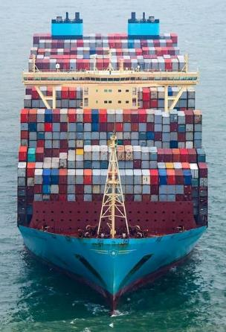
US COGSA Case Filings Summary
Average of Marine Contract
Actions Filed in US Federal Courts
Referencing COGSA by 5 Year Time Intervals
Time Interval | Average Number of Actions Per Year
1990-1995 | 269
1996-2000 | 165
2001-2005 | 100
2006-2010 | 57
2011-2015 | 26
2016-2020 | 26
2021 (total) | 28
Search included 46 U.S.C. 1300 – 1315 or 30701 – 30707.
Source: Federal Judicial Center. This chart does not capture filings in which no marine statute was referenced.
5
Prior results do not guarantee a similar outcome. Presentations are not to be construed as legal advice.
The Carriage of Goods by Sea Act: RIP? An Urgent Request to Resuscitate An 86 Year Old And Dying Statute – By: David Maloof, Esq. MLA COG Committee Fall Meeting 2022
The Carriage of Goods by Sea Act: RIP? An Urgent Request to Resuscitate an 86 Year Old and Dying Statute – By: David Maloof, Esq. MLA COG Committee Fall Meeting 2022

Slide 6
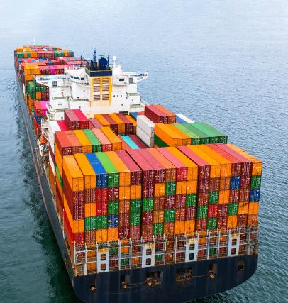
US COGSA Court Decisions Summary
Annual Average Number of Federal COGSA Decisions
(with and without maritime jurisdictional limitations)
Time Interval | Annual Average Number of Decisions (with maritime limitation) | Annual Average Number of Decisions (without maritime limitation)
1990 - 1995 | 53 | 67
1996 - 2000 | 50 | 67
2001 - 2005 | 37 | 53
2006 - 2010 | 33 | 57
2011 - 2015 | 22 | 36
2016 - 2020 | 13 | 22
2021 (total) | 11 | 20
*Source for Column 2: Westlaw. Number of Admiralty & Maritime Decisions by Year.
*Source for Column 3: Westlaw. COGSA search without maritime jurisdictional limitation.
6
The Carriage of Goods by Sea Act: RIP? An Urgent Request to Resuscitate An 86 Year Old And Dying Statute – By: David Maloof, Esq. MLA COG Committee Fall Meeting 2022
The Carriage of Goods by Sea Act: RIP? An Urgent Request to Resuscitate an 86 Year Old and Dying Statute – By: David Maloof, Esq. MLA COG Committee Fall Meeting 2022
Prior results do not guarantee a similar outcome. Presentations are not to be construed as legal advice.

Slide 7
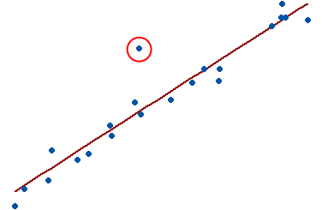
The Fatal Blow To The Rights Of Cargo Interests Under COGSA
The Limitation of Liability in US COGSA was never
tied to inflation.
Average Prices in 1936 | Average Prices in 2022
Gas – 19¢ | Gas – $3.44
Car - $1,605 | Car - $47,000
Salary - $1,160 | Salary - $53,490
Home - $6,300 | Home - $358,000
Cargo loss - $500 per package | Cargo loss - $500 per package
7
Prior results do not guarantee a similar outcome. Presentations are not to be construed as legal advice.
The Carriage of Goods by Sea Act: RIP? An Urgent Request to Resuscitate An 86 Year Old And Dying Statute – By: David Maloof, Esq. MLA COG Committee Fall Meeting 2022
The Carriage of Goods by Sea Act: RIP? An Urgent Request to Resuscitate an 86 Year Old and Dying Statute – By: David Maloof, Esq. MLA COG Committee Fall Meeting 2022

Slide 8
2. The Adoption Of Hague-Visby By Our Principal Trading Partners Has Created Massive Inequity For American Shipping And Insuring Interests
The bottom line then is the following comparison as to the liability of ocean carriers when a large loss occurs – say an actual damaged shipment weighing 49,870 kilograms – to a U.S. importer versus an importer to one of the following countries:
Comparison of Cargo Recovery Limits by Country 49,870 Kg Machine Packaged in 40 Foot Shipping Container
Nation | Legal Limit | Limit of Liability
USA | $500 per package | $500.00
Australia | 2 SDR per Kilogram | $136,643.80
Austria | 2.5 SDR per Kilogram | $170,804.75
Barbados | 2.5 SDR per Kilogram | $170,804.75
Belgium | 2 SDR per Kilogram | $136,643.80
Botswana | 2.5 SDR per Kilogram | $170,804.75
Cameroon | 2.5 SDR per Kilogram | $170,804.75
Canada | 2 SDR per Kilogram | $136,643.80
Chile | 2.5 SDR per Kilogram | $170,804.75
China (PRC) | 2 SDR per Kilogram | $136,643.80
Croatia | 2 SDR per Kilogram | $136,643.80
Denmark | 2 SDR per Kilogram | $136,643.80
Egypt | 2.5 SDR per Kilogram | $170,804.75
Finland | 2 SDR per Kilogram | $136,643.80
France | 2 SDR per Kilogram | $136,643.80
Germany | 2 SDR per Kilogram | $136,643.80
Greece | 2 SDR per Kilogram | $136,643.80
Guinea | 2.5 SDR per Kilogram | $170,804.75
Hong Kong | 2 SDR per Kilogram | $136,643.80
Nation | Legal Limit | Limit of Liability
Nation | Legal Limit | Limit of Liability
Iceland | 2 SDR per Kilogram | $136,643.80
India | 2 SDR per Kilogram | $136,643.80
Ireland | 2 SDR per Kilogram | $136,643.80
Israel | 2 SDR per Kilogram | $136,643.80
Italy | 2 SDR per Kilogram | $136,643.80
Japan | 2 SDR per Kilogram | $136,643.80
Kenya | 2.5 SDR per Kilogram | $170,804.75
Latvia | 2 SDR per Kilogram | $136,643.80
Lebanon | 2.5 SDR per Kilogram | $170,804.75
Liberia | 2 SDR per Kilogram | $136,643.80
Luxembourg | 2 SDR per Kilogram | $136,643.80
Senegal | 2.5 SDR per Kilogram | $170,804.75
Sierra Leone | 2.5 SDR per Kilogram | $170,804.75
Singapore | $4.69 SGD per Kilogram | $171,303.45
South Africa | 2 SDR per Kilogram | $136,643.80
Spain | 2 SDR per Kilogram | $136,643.80
Sweden | 2 SDR per Kilogram | $136,643.80
Switzerland | 2 SDR per Kilogram | $136,643.80
Taiwan | 2 SDR per Kilogram | $136,643.80
Tanzania | 2.5 SDR per Kilogram | $170,804.75
Tunisia | 2.5 SDR per Kilogram | $170,804.75
Uganda | 2.5 SDR per Kilogram | $170,804.75
Ukraine | 2 SDR per Kilogram | $136,643.80
UAE | 30 Dirhams per Kilogram | $407,238.42
United Kingdom | 2 SDR per Kilogram | $136,643.80
Ukraine | 2 SDR per Kilogram | $136,643.80
Yugoslavia | 2 SDR per Kilogram | $136,643.80
Zambia | 2.5 SDR per Kilogram | $170,804.75
Malawi | 2.5 SDR per Kilogram | $170,804.75
Mexico | 2 SDR per Kilogram | $136,643.80
Morocco | 2.5 SDR per Kilogram | $170,804.75
Netherlands | 2 SDR per Kilogram | $136,643.80
New Zealand | 2 SDR per Kilogram | $136,643.80
Nigeria | 2.5 SDR per Kilogram | $170,804.75
Norway | 2 SDR per Kilogram | $136,643.80
Poland | 2 SDR per Kilogram | $136,643.80
Hungary | 2.5 SDR per Kilogram | $170,804.75
8
Romania | 2.5 SDR per Kilogram | $170,804.75
The Carriage of Goods by Sea Act: RIP? An Urgent Request to Resuscitate An 86 Year Old And Dying Statute – By: David Maloof, Esq. MLA COG Committee Fall Meeting 2022
The Carriage of Goods by Sea Act: RIP? An Urgent Request to Resuscitate an 86 Year Old and Dying Statute – By: David Maloof, Esq. MLA COG Committee Fall Meeting 2022
Prior results do not guarantee a similar outcome. Presentations are not to be construed as legal advice.

Slide 9
3. Since 1995, Ocean Carriers Can Unilaterally Choose Inconvenient Forums Where No Relevant Witnesses Are Located
Vimar Seguros y Reaseguros, S. A. v. M/V Sky Reefer, 515 U.S. 528 (1995).
Held: COGSA does not nullify foreign arbitration clauses contained in maritime bills of lading.
9
Prior results do not guarantee a similar outcome. Presentations are not to be construed as legal advice.
The Carriage of Goods by Sea Act: RIP? An Urgent Request to Resuscitate An 86 Year Old And Dying Statute – By: David Maloof, Esq. MLA COG Committee Fall Meeting 2022
The Carriage of Goods by Sea Act: RIP? An Urgent Request to Resuscitate an 86 Year Old and Dying Statute – By: David Maloof, Esq. MLA COG Committee Fall Meeting 2022

Slide 10
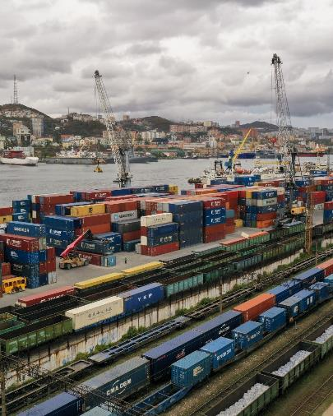
4. Since 2014, Upstream Contracting Carriers & Downstream Sub-Contractors Can Unilaterally Be Exempted From Liability
Sompo Japan Ins. Co. of Am. v. Norfolk S. Ry. Co., 762 F.3d 165 (2d Cir. 2014)
10
Prior results do not guarantee a similar outcome. Presentations are not to be construed as legal advice.
The Carriage of Goods by Sea Act: RIP? An Urgent Request to Resuscitate An 86 Year Old And Dying Statute – By: David Maloof, Esq. MLA COG Committee Fall Meeting 2022
The Carriage of Goods by Sea Act: RIP? An Urgent Request to Resuscitate an 86 Year Old and Dying Statute – By: David Maloof, Esq. MLA COG Committee Fall Meeting 2022

Slide 11
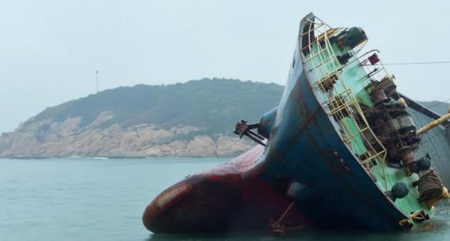
5. Since March Of 2022, NVOCCs Are Potentially Exempted From Liability
Chubb Seguros Peru S.A. v. AS Fortuna Opco B.V., No. 1:20-CV-3392, 2022 WL 973708 (S.D.N.Y. Mar. 31, 2022).
11
Prior results do not guarantee a similar outcome. Presentations are not to be construed as legal advice.
The Carriage of Goods by Sea Act: RIP? An Urgent Request to Resuscitate An 86 Year Old And Dying Statute – By: David Maloof, Esq. MLA COG Committee Fall Meeting 2022
The Carriage of Goods by Sea Act: RIP? An Urgent Request to Resuscitate an 86 Year Old and Dying Statute – By: David Maloof, Esq. MLA COG Committee Fall Meeting 2022

Slide 12
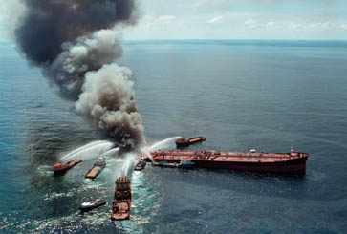
The Current Situation: We Now Have A Completely Outdated And Dysfunctional COGSA Statutory Scheme
Example: A mass shipping fire casualty at sea, to make a recovery:
You may recover only $500 per container.
You may need to sue a dozen different contracting carriers.
You may need to sue in a dozen different jurisdictions.
You may need to take assignments from most of these carriers to sue the one actual, common carrier.
You Generally Must Act Within One Year!
12
Prior results do not guarantee a similar outcome. Presentations are not to be construed as legal advice.
The Carriage of Goods by Sea Act: RIP? An Urgent Request to Resuscitate An 86 Year Old And Dying Statute – By: David Maloof, Esq. MLA COG Committee Fall Meeting 2022
The Carriage of Goods by Sea Act: RIP? An Urgent Request to Resuscitate an 86 Year Old and Dying Statute – By: David Maloof, Esq. MLA COG Committee Fall Meeting 2022

Slide 13
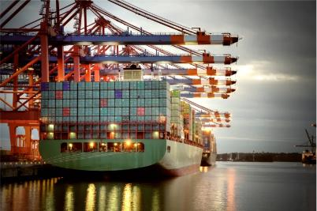
We Need An Innovative Solution
US shippers and insurers are being severely prejudiced – to the benefit of foreign shipowners – by the “slow death” since 1936 of the Carriage of Goods by Sea Act.
US manufacturers, insurers and legal interests need to press Congress to clarify the law:
Raise the COGSA limitation of liability to Hague-Visby limits.
Ban Covenants Not To Sue.
Clarify jurisdiction.
Clarify NVOCCs obligations.
13
Prior results do not guarantee a similar outcome. Presentations are not to be construed as legal advice.
The Carriage of Goods by Sea Act: RIP? An Urgent Request to Resuscitate An 86 Year Old And Dying Statute – By: David Maloof, Esq. MLA COG Committee Fall Meeting 2022
The Carriage of Goods by Sea Act: RIP? An Urgent Request to Resuscitate an 86 Year Old and Dying Statute – By: David Maloof, Esq. MLA COG Committee Fall Meeting 2022

Slide 14
AN ACT
To amend the Carriage of Goods by Sea Act, and for other purposes.
Be it enacted by the Senate and the House of Representatives of the United States of America in Congress assembled,
SECTION 1. SHORT TITLE
This Act may be cited as the “Carriage of Goods by Sea Modernization and Equity for American Shippers Act”.
SECTION 2. MODERNIZING THE CARRIAGE OF GOODS BY SEA ACT TO PROVIDE EQUITY FOR AMERICAN SHIPPERS
The Carriage of Goods by Sea Act, April 16, 1936, ch. 229, 49 Stat. 1207, as amended by Pub. L. 97–31, §12(146), Aug. 6, 1981, 95 Stat. 166, is amended–
1) by striking “$500 per package lawful money of the United States, or in case of goods not shipped in packages per customary freight unit, or the equivalent of that sum in another currency” from Title I, Sec. 4(5) and inserting “666.67 units of account (Special Drawing Rights as determined by the International Monetary Fund) per package or unit or 2 units of account per kilogram of gross weight of the goods lost or damaged, whichever is the higher” in its place.
2) by striking “the owner or the charterer” from Title I, Section 1(a) and inserting “the owner or the charterer or a Non Vessel Operating Common Carrier pursuant to 46 U.S.C. § 40102(17)(B)” in its place.
3) by striking “obligations provided in this section” from Title I, Sec. 3(1)(8) and inserting “obligations provided in this section, or otherwise requiring that claims or suits be filed against only one specific carrier and/or precluding claims or suits being filed against any other carrier or servant or subcontractor hired by the carrier, and/or precluding suit from being filed against the Carrier in the country of shipment or the country of delivery if either is the United States” in its place.
(b) Effective Date.—This Act and the amendments made by this Act take effect on January 1st on the year following enactment.
14
Prior results do not guarantee a similar outcome. Presentations are not to be construed as legal advice.
The Carriage of Goods by Sea Act: RIP? An Urgent Request to Resuscitate An 86 Year Old And Dying Statute – By: David Maloof, Esq. MLA COG Committee Fall Meeting 2022
The Carriage of Goods by Sea Act: RIP? An Urgent Request to Resuscitate an 86 Year Old and Dying Statute – By: David Maloof, Esq. MLA COG Committee Fall Meeting 2022

Slide 15
Rationale for Proposed Statutory Changes
Paragraph 1 is included in order to level the playing field for US shippers and consignees and their insurers to have the same limitations of liability as most other shippers and consignees and insurers around the world.
Paragraph 2 is included in order to ensure that non-vessel operating common carriers (NVOCCs) are liable as carriers, as has been the law nationwide up until a few rogue decisions were issued in recent years.
Paragraph 3 is included in order to prevent carriers and their carrier subcontractors from fully exonerating themselves from liability to the detriment of US shippers and consignees and their insurers, as well as to preserve the United States as the forum for COGSA claims. Requiring US shippers or consignees and their insurers to sue in remote forums around the world has in fact resulted in many claims not being pursued due to the extreme expense and inconvenience involved relative to the typically small size of such claims. This restores the interpretation of COGSA which existed for decades under Indussa Corp. v. S.S. Ranborg, 377 F.2d 200 (2d Cir. 1967), prior to the Supreme Court’s reinterpretation of the law in its decision in Vimar Seguros y Reaseguros, S.A. v. M/V Sky Reefer, 515 U.S. 528 (1995).
15
Prior results do not guarantee a similar outcome. Presentations are not to be construed as legal advice.
The Carriage of Goods by Sea Act: RIP? An Urgent Request to Resuscitate An 86 Year Old And Dying Statute – By: David Maloof, Esq. MLA COG Committee Fall Meeting 2022
The Carriage of Goods by Sea Act: RIP? An Urgent Request to Resuscitate an 86 Year Old and Dying Statute – By: David Maloof, Esq. MLA COG Committee Fall Meeting 2022

Slide 16
Submit Comments to the MLA
Please submit your comments or counter-proposals to Mr. Mark Newcomb at: newcomb.mark@us.zim.com.
Comments must be submitted no later than November 15, 2023.
Mr. Newcomb will assemble those comments and circulate them to the Committee by December 15, 2023.
16
Prior results do not guarantee a similar outcome. Presentations are not to be construed as legal advice.
The Carriage of Goods by Sea Act: RIP? An Urgent Request to Resuscitate An 86 Year Old And Dying Statute – By: David Maloof, Esq. MLA COG Committee Fall Meeting 2022
The Carriage of Goods by Sea Act: RIP? An Urgent Request to Resuscitate an 86 Year Old and Dying Statute – By: David Maloof, Esq. MLA COG Committee Fall Meeting 2022

Slide 17
17
Prior results do not guarantee a similar outcome. Presentations are not to be construed as legal advice.
The Carriage of Goods by Sea Act: RIP? An Urgent Request to Resuscitate An 86 Year Old And Dying Statute – By: David Maloof, Esq. MLA COG Committee Fall Meeting 2022
The Carriage of Goods by Sea Act: RIP? An Urgent Request to Resuscitate an 86 Year Old and Dying Statute – By: David Maloof, Esq. MLA COG Committee Fall Meeting 2022

