Slide 1
The New MARPOL ANNEX VI Regulations: Requirements, Issues and Challenges Barry M. Hartman Michael G. Chalos K&L Gates, LLP Maritime Lawyers Association, CLE Program April 29, 2015

Slide 2
Overview
Brief background to new rules
Are waivers still possible?
What you must do to comply?
What are the consequences for not complying?
What happens when EPA sends a request for information, or the Coast Guard boards the vessel looking for evidence of non-compliance?
Is there a business case for proactive planning to avoid/limit liability?

Slide 3
BRIEF BACKGROUND
MARPOL: International Convention for the Prevention of Pollution from Ships (1973) as modified by the 1978 Protocol thereto.
MARPOL Annex I, “Regulations for the Prevention of Pollution by Oil”
Entered into force, 2 October 1983.
Ratified by the United States, August 1980.
MARPOL Annex VI, “Regulations for the Prevention of Air Pollution from Ships”
Entered into force, 19 May 2005.
Ratified by the United States, October 2008.

Slide 4
The Act to Prevent Pollution From Ships (“APPS”) – An Overview
Enacted in 1980
Implements MARPOL Annex VI (and all of MARPOL) into U.S. domestic law.
Creates comprehensive administration, inspection and enforcement regime.
Provides authority to U.S. Coast Guard and EPA with respect to enforcement of international environmental laws and treaties (MARPOL).
Criminal and civil penalties for violations.
Notes:
The U.S. Act to Prevent Pollution from Ships (commonly referred to as the “APPS”) implements all of the international MARPOL treaty and its Protocol, including Annex VI, and outlines among other things the administration and enforcement of MARPOL, issuance of certificates, reporting requirements, violations, and penalties for violations of the APPS. The APPS provides for both civil and criminal penalties. Criminally, a knowing violation of the APPS constitutes a Class D felony.
The APPS, for the most part, provides inspection, examination and investigation authority for suspected violations of the Act to two agencies: the U.S. Coast Guard, and the EPA.

Slide 5
MARPOL ANNEX VI More Than Just Sulfur…
Regulation 12 - Ozone Depleting Substances
Regulation 13 - Nitrogen Oxides (NOx)
Regulation 14 - Sulfur Oxides (SOx)*
Regulation 15 - Volatile Organic Compounds (VOCs)
Regulation 16 - Shipboard Incineration
Regulation 18 – Fuel Oil Availability & Quality Control*
* Addressed In This Presentation
Notes:
The implementation of MARPOL Annex VI has resulted in numerous additional requirements and risks for shipowners and operators. Although MARPOL Annex VI became effective in the US on January 9, 2009, the North American Emissions Control Area (ECA) became effective August 1, 2012. Because the ECA low sulpher fuel and associated recordkeeping requirements pose the greatest challenges and risks for shipowners (at least in terms of potential enforcement actions in the U.S.) that is the focus of this presentation. Because these ECA requirements are addressed mostly in regulations 14 and 18, those are highlighted in red to focus our discussion.

Slide 6
THE TWO SETS OF ENGINE EMISSIONS STANDARDS
The “global” standards for the minimum sulfur content of fuel and nitrogen oxides (NOx) emissions from engines apply to ships at all times; and
The “geographic” based standards that require ships operating in designated Emission Control Areas (ECAs) to comply with more stringent fuel sulfur and engine NOx limits.
Notes:
Discussion of the two different lower sulfur emission standards. The first is a “blanket” standards that applies to virtually all oceangoing vessels all the time, requiring such vessels to burn progressively lower sulfur content fuel over the next 7 years (shown on next slide). The second standard allows parties who have ratified MARPOL Annex VI to apply to the IMO for designation of an Emissions Control Area to combat sulfur emissions that have a harmful effect on their populations. The ECA’s require virtually all vessels transiting the designated area to burn lower sulfur content fuel and keep detailed records and receipts regarding the same. The North American ECA recently went into effect last August and enforcement of this ECA, as opposed to the global sulfur cap, is the primary focus of this discussion.

Slide 7
Applicability of Annex VI Low Sulfur Fuel Requirements IN GENERAL…
Global Standards Commercial Vessels Greater than 400 Gross Tons Engaged in International Voyage.
Geographic (North American Emissions Control Area (ECA) With limited exceptions, all vessels operating within the ECA.

Slide 8
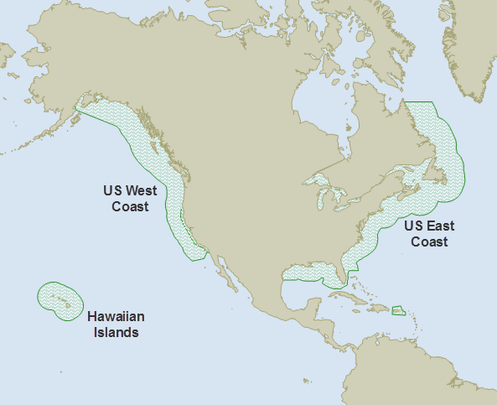
The North American ECA (Enforced as of August 1, 2012)
Notes:
The North American ECA extends 200 miles off the coastline as depicted in this slide. Ships operating in the ECA are required to use fuel with a sulfur content not exceeding 10,000 ppm; in 2015, this would be reduced to 1,000 ppm. In most cases, ships already have the capability to store two or more fuels. However, to meet the 2015 requirement of 1,000 ppm fuel sulfur, some vessels may need to be modified for additional distillate fuel storage capacity, imposing additional costs on the shipping industry. As you can see, the ECA also covers Alaska, Hawaii and Puerto Rico.

Slide 9
The Phased Standards By the Numbers
Standard | Year | Fuel Sulfur Content (parts per million)
Geographic Emission Control Area Standard | Pre 2012 2012 2015 | 15,000 ppm 10,000 ppm 1,000 ppm
Global Standard | Pre Jan 2012 2012-2020 As of 01 Jan 2020 | 45,000 ppm 35,000 ppm 5,000 ppm
Notes:
Beginning in August, 2012, ships subject to MARPOL regulations transiting the North American ECA, which extends 200 nautical miles from a substantial portion of both the American and Canadian coastlines, must burn low sulfur fuel oil (not exceeding one percent or 10,000 “parts per million.”). In addition to the new North American ECA and existing ECA’s in the Baltic and North Seas, another ECA in the Caribbean Sea is slated to enter into force in January 2013 and take effect in 2014 and 2015. In general, by 2015 most ships will have to cut their fuel sulfur standard and by 2020, all ships will have to meet the lowest fuel standard of .5 percent or 5,000 ppm.
Also, beginning in 2016 new ships operating in ECAs must also have advanced-technology engines designed to cut emissions of ozone-forming oxides of nitrogen (NOx) by roughly 80%.

Slide 10
WHAT MUST YOU DO TO COMPLY WITH LOW SULfUR FUEL REQUIREMENTS?
Implement the procedures and maintain the records to prove compliance;
Consume low sulfur fuel when in the North American and Caribbean ECAs; and
When low sulfur fuel is not available, submit a fuel oil non-availability report (FONAR) at least 96 hours prior to the vessel entering the ECA.

Slide 11
Key Annex VI/ECA Recordkeeping Requirements
Bunker delivery notes - Regulation 18.5 and 40 C.F.R. § 1043.70. (Maintained for 3 years).
Maintain Representative fuel oil samples, taken at the time of fuel oil delivery, sealed/signed by Master or Officer In Charge. Regulation 18.8.1 and 40 C.F.R. § 1043.70. (Maintained for 1 year).
Written fuel oil changeover procedures, which show how and when the fuel oil changeover is performed to ensure that only compliant fuel oil is burned within the ECA. Regulation 14.6 and 40 C.F.R. § 1043.70.
Notes:
Due to the new ECA requirements, vessels will typically need to switch to a fuel source with a sulphur content of less than 1% as they enter the ECA. Many owners/operators who are trying to do this have encountered operational problems. When a ship arrives in U.S. port, the vessel will be required to maintain and have available for examination all of the records which document this transition, and other associated documentation.
Bunker Delivery Notes: the bunker delivery note must contain the following: (1) The name and IMO number of the receiving vessel.
(2) Port (or other description of the location, if the delivery does not take place at a port). (3) Date the fuel is delivered to the vessel (or date on which the delivery begins where the delivery begins on one day and ends on a later day). (4) Name, address, and telephone number of fuel supplier. (5) Fuel type and designation under 40 CFR part 80. (6) Quantity in metric tons. (7) Density at 15 °C, in kg/m 3. (8) Sulfur content in weight percent. (9) A signed statement by an authorized representative of fuel supplier certifying that the fuel supplied conforms to Regulations 14 and 18 of Annex VI consistent with it designation, intended use, and the date on which it is to be used.
Representative Fuel Oil Samples – Must be sealed and signed by the Suppliers Rep and Master.

Slide 12
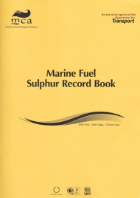
Key Annex VI/ECA Recordkeeping Requirements (cont’d)
Fuel Oil Changeover Logbook (a.k.a. Sulphur Record Book)
- See Annex VI Regulation 14.6 and 40 C.F.R. §§ 1043.70.
Vessels Must Log/Document:
Fuel changeover procedures
Vessel’s position/date/time at entrance/exit from ECA
Volume of low sulfur fuel onboard
Position, date and time of any fuel-oil-change-over operation prior to entering and after exiting an ECA
MUST BE COMPLETE, ACCURATE & TRUTHFUL
Notes:
It is critical that this record, like all other ship records, be accurate, truthful and complete. As long as there is a good faith effort to comply, transparency and truthfulness in the records will likely prevent serious enforcement actions.

Slide 13
Demonstration of inability to obtain fuel
The Fuel Oil Non-Availability Report
FONAR

Slide 14
FONAR
Report of Non-Availability
Allows vessels without compliant fuel to enter U.S.
Submitted to EPA > 96 hours before entering ECA.
Not a “Get Out of Jail Free” card.
FONAR amounts to permission to ask for leniency.
Must demonstrate that the company made “best
efforts” to obtain compliant low sulfur fuel.
Must be signed “under penalty of law.”
Must be accurate and truthful.
Legal Minefield
Notes:
Report of Non-Availability - On June 26, 2012, just prior to the ECA taking effect, the EPA acknowledged that it’s possible some shipowners may not be able to meet the new requirements on August 1, 2012– due to the apparent unavailability of adequate supply chains of ECA compliant fuel. In “interim guidance” to the maritime industry, which is still now in effect, the EPA states that it “anticipates the possibility that despite your best efforts to obtain compliant fuel oil, you may be unable to do so, and the United States has the authority to take into account all relevant circumstances to determine the appropriate action to take, including not taking control measures…” In essence, owners and operators who fail to meet the new fuel oil requirements are required to provide information and documentation to persuade the government to refrain from taking enforcement action. Unfortunately, the standards set forth in this EPA interim guidance are fairly subjective, and it is unpredictable how individual EPA and Coast Guard offices around the country will treat companies asserting that they have demonstrated that the ECA compliant fuels are unavailable.
Under this interim guidance, for vessels arriving in the North American ECA without compliant fuel, the government will conduct an inquiry into the company’s “best efforts” to procure ECA compliant fuel oil. This will include, among other things, an examination of the voyage plan, and a general inquiry as to whether the company investigated and sought out alternate sources of fuel oil prior to commencing the voyage or enroute prior to entering the North American ECA. The company is expected to notify the U.S. and flag administration no later than 96 hours before entering the North American ECA, and submit a Fuel Oil Non Availability Report (sworn to under penalty of law).
This is fraught with legal peril for a variety of reasons:
You are required to disclose that the vessel does not comply if you want to come to the U.S. You will likely be targeted for other things.
b. There are little standards put forth as to what constitutes “best efforts”; the vessel may well be penalized regardless. One thing is clear: under the guidance, excessive cost (i.e. price gouging) of the fuel is not an excuse.
c. Any material falsity/omission in the report itself by the vessel’s crew could be a serious violation of other U.S. laws, and vicariously imputed to the company.
Entering the ECA and knowingly violating Annex VI is a felony under US law – and you are required to confess before you arrive!
The EPA has historically not had a good appreciation for the maritime industry and how it works.
Bottom line: Do your absolute best to get adequate supplies of ECA compliant fuel onboard, and maintain accurate records, prior to entering 200 mile ECA.

Slide 15
EPA GUIDANCE
June 26, 2012 – EPA Interim Guidance on the Non-Availability of Compliant Fuel
Online Reporting: https://cdx.epa.gov/
Must be submitted NLT 96 hours prior to entering the North American ECA
Cost - Not a valid basis for asserting non-availability
FONAR must include:
record of actions taken in an attempt to achieve compliance; and
evidence that, despite the vessel’s “best efforts,” the vessel was unable to purchase compliant fuel from primary and alternative sources. See EPA Interim Guidance at pages 4-5.
Annex VI Reg 18.2.2 – Vessel is not expected to deviate from intended voyage/incur undue delay.
As of January 1, 2015, if distillates are the only compliant fuel available, vessels will be expected to purchase and burn distillates in the ECA. See EPA Notice – November 2014.

Slide 16
Are EXEMPTIONS still possible?
Yes, but existing vessels operating in the ECA would have to comply with sulfur limits while waiting for exemption application approval.
MARPOL Annex VI provides two alternatives for obtaining an exemption:
Regulation 3: Trials for Ship Emission Reduction and Control Technology Research
Regulation 4: Equivalent Emission Reduction Through Another Means

Slide 17
REGULATION 3 Exemption
For the purpose of continuing ongoing trials for the development of ship emission reduction and control technologies and engine design programs beyond compliance date.
Exemption only allowed for minimum number of ships needed for research impeded by SOx & NOx limits
18-month exemption for diesel engines with up to 30 liter cylinder displacement, with one 18-month extension.
5-year exemption for diesel engines with > 30 liter cylinder displacement, with one 5-year extension.
Would be difficult to initiate post January 2015.

Slide 18
REGULATION 4 EXEMPTION
Allows vessel material or equipment modification or other procedures, alternative fuels, or alternative compliance methods. Approving State informs IMO of all exemptions.
Must be at least as effective in reducing emissions as required by the use of ultra-low sulfur fuel.
Examples include combining some of the below options to average equivalent emissions reductions in ECA:
Operate exhaust stack scrubbers when using non-qualifying fuel (must be an approved type)
Partial use of CNG or LNG as fuel
Cold-ironing in port
Partial use of ultra-low sulfur fuel

Slide 19
Exemptions granted so far
TOTE
Norwegian Cruise Lines
Matson Navigation
Royal Caribbean Cruise Line
U.S. exemption process is lengthy, not well-defined, and difficult.
Notes:
There are some exceptions, codified in Part 1043 of Title 40, Code of Federal Regulations, to the low sulfur fuel burning requirement. For example, ships can use alternative means of complying with lower emissions standards such as exhaust gas cleaning systems or by retrofitting existing systems with the ability to burn very “clean” fuel, such as Liquefied Natural Gas, if the alternative system is approved by the EPA as an equivalent. Some types of vessels, such as steamships, are categorically exempt from the requirements, but generally the new requirements apply to all vessel types, including recreational vessels.
Moreover, interim guidance published by the EPA attempts to take into account supply issues and the difficulty some vessels will face in obtaining compliant low sulphur fuel by providing the ability to file a “non-availability report” with the vessel’s flag administration and the “competent authority” in the port of destination (which in the U.S. is the EPA) no later than 96 hours prior to entering the ECA.[i] As the EPA notes in its guidance for fuel non-availability, filing such a report does not render a vessel “compliant” or otherwise exclude it from criminal or civil liability – it merely documents the non-availability of compliant fuel as a factor to be taken into consideration by the enforcing agency.

Slide 20
WHAT ARE THE CONSEQUENCES FOR NOT COMPLYING?
Commercial
Increased Inspections/Targeting
Vessel Delays
Business Reputation
Regulatory
Civil Penalties
Criminal Penalties

Slide 21
CRIMINAL PENALTIES
APPS, 33 U.S.C. §1908(a), provides that:
“[a] person who knowingly violates MARPOL…or the regulations thereunder commits a Class D felony”
$500,000 per count for corporations such as owners and operators
Corporate vessel interests can be charged for the acts of their employees, even if acting contrary to written company policy.
Source: U.S. Coast Guard
Notes:
Jurisdictional and other legal issues associated with enforcing MARPOL Annex VI and the new ECA requirements bear some resemblance to those encountered with oily water separator (OWS) and Oil Record Book violations (commonly referred to as “magic pipe” cases), which the U.S. Department of Justice continues to aggressively investigate and prosecute. Namely, substantive violations of MARPOL and APPS onboard foreign flagged vessels are subject to U.S. enforcement only if the violation is committed inside waters subject to U.S. jurisdiction. As a result, most APPS violations are prosecuted as felony federal recordkeeping offenses in which the criminal offense is the physical act of presenting an altered or materially false record to U.S. authorities inside U.S. waters or at a U.S. port. The charging provision frequently used under APPS is 33 USC 1908, which criminalizes violation of regulations promulgated by an agency pursuant to MARPOL. Thus, a knowing violation of the U.S. federal regulations requiring vessels to properly maintain an Oil Record Book onboard is a federal U.S. felony offense.
The stakes in such cases are high, as corporate entities such as vessel owners and technical managers face large corporate criminal fines (up to $500,000 per count proven or plead to) for the unlawful acts of their employees, and individual crewmembers face the prospect of jail and other penalties (such as fines of up to $250,000 per count proven or plead to) for substantive violations of APPS and related U.S. criminal laws.

Slide 22
Potential criminal exposure – like Magic Pipe Cases
DOJ “Toolkit”
The False Statement Act (18 U.S.C. § 1001)
Conspiracy (18 U.S.C. § 371)
Obstruction of Justice (18 U.S.C. §1505)
Tampering with Witnesses (18 U.S.C. § 1512)
Sarbanes Oxley (18 U.S.C. § 1519)

Slide 23
Civil/Administrative PENALTIES
B. Civil Liability
33 U.S.C. §1908(b), provides that:
“[a] person who…violate[s] MARPOL…or the regulations thereunder…[is] liable…for a civil penalty…”
Control of NOX, SOX, AND PM emissions, 40 CFR Part 1043
Statutory maximum civil penalty set by APPS at $25,000 -U.S. Coast Guard has indexed this amount to inflation for a maximum civil penalty of $40,000 per violation.
Each day of a continuing violation constitutes a separate violation.
Notes:
Jurisdictional and other legal issues associated with enforcing MARPOL Annex VI and the new ECA requirements bear some resemblance to those encountered with oily water separator (OWS) and Oil Record Book violations (commonly referred to as “magic pipe” cases), which the U.S. Department of Justice continues to aggressively investigate and prosecute. Namely, substantive violations of MARPOL and APPS onboard foreign flagged vessels are subject to U.S. enforcement only if the violation is committed inside waters subject to U.S. jurisdiction. As a result, most APPS violations are prosecuted as felony federal recordkeeping offenses in which the criminal offense is the physical act of presenting an altered or materially false record to U.S. authorities inside U.S. waters or at a U.S. port. The charging provision frequently used under APPS is 33 USC 1908, which criminalizes violation of regulations promulgated by an agency pursuant to MARPOL. Thus, a knowing violation of the U.S. federal regulations requiring vessels to properly maintain an Oil Record Book onboard is a federal U.S. felony offense.
The stakes in such cases are high, as corporate entities such as vessel owners and technical managers face large corporate criminal fines (up to $500,000 per count proven or plead to) for the unlawful acts of their employees, and individual crewmembers face the prospect of jail and other penalties (such as fines of up to $250,000 per count proven or plead to) for substantive violations of APPS and related U.S. criminal laws.

Slide 24
EPA’S NEW CIVIL PENALTY POLICY
Released January 15, 2015
Describes the methods by which the EPA will initially assess civil penalties for ECA violations.
Similar to approach used by EPA under other environmental statutes
EPA Air Enforcement Office
http://www2.epa.gov/sites/production/files/2015-03/documents/marinepenaltypolicy.pdf

Slide 25
EPA’S NEW PENALTY POLICY OVERVIEW
Determine “Preliminary Deterrence Amount
Economic Benefit of Non-compliance +
Gravity
“Adjust” based on
Degree of willfulness/negligence
Cooperation
History of non compliance
Litigation risk/unique factors
Ability to pay
Supplemental Environmental Projects

Slide 26
EPA’S NEW PENALTY POLICY Preliminary Deterrence Amount
Economic Benefit + Gravity
Economic benefit:
Mathematical formula = price difference between compliant and non-compliant fuel and the amount of noncompliant fuel used while within the ECA.
Burden on company to show EPA assumptions are incorrect
Caveat: EPA has argued the economic benefit can be the profit realized from violating the law, not just the cost differential.
Gravity:
Actual sulphur content of the fuel
Burning fuel with a .5% fuel content presumably less serious than fuel with a 5% fuel content.

Slide 27
EPA’S NEW PENALTY POLICY “Adjustments”
Degree of willfulness/negligence
Can be adjusted upward, but maybe not downward
20% increase
Control over events
Foreseeability of events
Extent of knowledge
Individual negligence vs. corporate culture
Choosing a ship with history
Lack of policies
Failure to consider fuel availability

Slide 28
EPA’S NEW PENALTY POLICY “Adjustments”
Cooperation
Lack of efforts to come into compliance
Negotiating in ‘bad faith’
Might increase or decrease

Slide 29
EPA’S NEW PENALTY POLICY “Adjustments”
History of non compliance
Same ship or company
One prior violation – 30% increase
Two prior violations – 70% increase
“similarity” of violation
Same statute
Same standard
Similar act/omission

Slide 30
EPA’S NEW PENALTY POLICY “Adjustments”
Litigation risk/unique factors
Up to 10%
Highly discretionary
“Let’s make a deal”

Slide 31
EPA’S NEW PENALTY POLICY “Adjustments”
Ability to pay
Won’t allow financially troubled operators to use this for a competitive advantage
Involves incredibly detailed financial disclosures that often disregard corporate formalities
Ex: President/owner has vacation homes
http://www2.epa.gov/sites/production/files/documents/civilpenalty-violators.pdf

Slide 32
EPA’S NEW PENALTY POLICY “Adjustments”
Supplemental Environmental Projects
Can reduce penalty but don’t expect a 1:1 relationship.
Ex: technology to monitory emissions
Highly, highly discretionary
http://www2.epa.gov/sites/production/files/documents/fnlsup-hermn-mem.pdf

Slide 33
Issues Relating to Civil Penalties
Unlike Magic Pipe cases, the presence of civil and criminal remedies creates parallel proceedings issues
Economic Benefit component not actually authorized in statute
Not actually authorized in APPS (though it is in other laws)
It’s a policy used at agency’s discretion

Slide 34
Other Consequences
Prosecutors’ tools to leverage companies - focus on crewmembers, owning and managing corporations, and individuals in such corporations once a vessel is merely “suspected” of violating MARPOL and the APPS.
Examples:
Arrest, detain and/or confiscate vessels to obtain security and/or collect fines/penalties based on whistleblower allegation alone;
Criminally charge and/or hold vessel personnel as “material witnesses” for an indefinite period of time;
Criminally charge owning/operating and/or management companies; and
Criminally charge responsible corporate officers, as well as, managing company personnel.

Slide 35
Voluntary Reporting Appendix V Disclosures
The Coast Guard Environmental Crimes Voluntary Disclosure Policy http://www.uscg.mil/foia/docs/CH-4%20Appendix%20V.pdf
Applies broadly “to criminal violations under all of the Federal environmental statutes that the Coast Guard administers.”
Entities who maintain compliance management programs to prevent, detect and correct MARPOL violations and who promptly report such violations within 21 days of discovery may avoid criminal charges so long as:
Coast Guard satisfied the violation is not part of a pattern or broader practice;
The violation does not involve a “prevalent management philosophy or practice that conceals or condones environmental regulations;” and
The violation does not reveal conscious involvement or disregard by senior management.

Slide 36
EPA Voluntary Disclosure Policy
In existence since 2000
http://www2.epa.gov/compliance/epas-audit-policy#disclosure
Similar to CG
Could mitigate penalty BUT major issue is what constitutes ‘voluntary.’
Largely premised on existence of company audit program

Slide 37
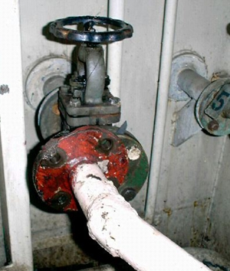
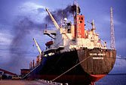
Potential Similarities with magic pipe cases?
Oily Water Separator Bypass Connection
Jurisdiction
Recordkeeping Requirements
Statutory Offense Framework
Authority to Investigate
Fines & Publicity for DOJ
Whistleblower Rewards

Slide 38
MAGIC PIPE CASES
Substantive Requirement: Annex I governs the discharge of oil and oil/water mixtures – requires use of Oily Water Separator.
Allegations usually involve the use of a pipe to bypass the vessel’s Oily Water Separator
Recordkeeping requirement: APPS requires all OWS related activity to be reported accurately
If OWS is bypassed but records don’t report it, that is the basis for enforcement- falsifying records
Maintaining false records in US waters is basis jurisdiction for environmental crimes (bypassing OWS) allegedly committed in international waters.
Hence—“Magic Pipes”

Slide 39
ECA REQUIREMENTS HAVE SIMILAR CONSTRUCT
Substantive requirement – use compliant fuel in ECA
Substantive allegations – failure to use compliant
Recordkeeping requirements

Slide 40
ECA REQUIREMENTS HAVE SIMILAR CONSTRUCT
Bunker delivery notes – Regulation 18.5 and 40 C.F.R. § 1043.70
Maintain representative fuel oil samples. Regulation 18.8.1 and 40 C.F.R. § 1043.70 (maintained for one year)
Fuel Oil Changeover Logbook (a.k.a. Sulphur Record Book) –Annex VI Regulation 14.6/ 40 C.F.R. § 1043.70
Fuel changeover procedures
Vessel’s position/date/time at entrance/exit from ECA
Volume of low sulphur fuel onboard
Position, date and time of any fuel-oil changeover operation prior to entering and after exiting an ECA
Record Book of Diesel Engine Parameters
Ozone Depleting Substances Record Book
Fuel Non-Availability Report
Fuel Oil Changeover Logbook (a.k.a. Sulphur Record Book) –Annex VI Regulation 14.6/ 40 C.F.R. § 1043.70
Vessels must log:
Fuel changeover procedures
Vessel’s position/date/time at entrance/exit from ECA
Volume of low sulphur fuel onboard
Position, date and time of any fuel-oil changeover operation prior to entering and after exiting an ECA
Other important records:
Record Book of Diesel Engine Parameters
Ozone Depleting Substances Record Book
Fuel Non-Availability Report

Slide 41
LIKE Magic pipe records
MUST BE COMPLETE, ACCURATE OR TRUTHFUL
If incorrect fuel is used but not recorded – violation
If non compliance fuel is used and is recorded – violation of substantive standard
If FONAR not done – violation
If FONAR done but not ‘good faith’ – violation
If people agree to do any of the above – violation
Recordkeeping requirements allow US to assert jurisdiction over foreign flag vessels for all violations of Annex VI on the high seas!

Slide 42
What happens when EPA sends a request for information, or the Coast Guard boards the vessel looking for evidence of non-compliance?

Slide 43
U.S. Enforcement of Annex VI Under APPS
2011 MOU Between USCG
and EPA:
Delineates responsibilities for administration and enforcement between agencies
Referral of evidence & violations
Provision of technical expertise (EPA)
Notes:
In 2011, the USCG and EPA entered into a non-binding Memorandum of Understanding to establish how they would mutually implement and enforce the newly created ECAs, including the referral of violations and evidence from one agency to another and the provision of relevant technical expertise. While the EPA has authority to issue Engine International Air Pollution Prevention (EIAPP) certificates, the Coast Guard has law enforcement authority to board ships on the high seas and waters subject to U.S. jurisdiction, as well as certain facilities ashore, including violations of the APPS. The Coast Guard is the agency most likely to detect non-compliance with the emissions control requirements because of its broad maritime law enforcement authority and Port State Control vessel safety and security program, part of which is aimed at detecting and preventing violations of MARPOL and the APPS. In 2011 the Coast Guard reported 9,326 “distinct visits” by vessels subject to its Port State Control program and close to 80,000 vessel calls in the U.S. overall. The agreement delineates the investigation and enforcement of certain types of violations based upon each agency’s expertise and authority, recognizing that the Coast Guard will be the lead for enforcing ECA related APPS violations because of its role for conducting vessel compliance inspections and surveys.
The Coast Guard has indicated that violations by foreign flagged vessels which occur seaward of waters not subject to U.S. jurisdiction will be referred to the vessel’s flag administration, but because foreign vessels visiting U.S. ports remain subject to international and U.S. laws related to recordkeeping, the Coast Guard will serve as lead agency for investigating suspected violations of such (i.e. the falsification of a log book). Non-criminal enforcement action will be referred to the EPA, but the Coast Guard noted that it reserves the right to process non-criminal violations under its own policies and penalty procedures as well.

Slide 44
COAST GUARD ENFORCEMENT What the Inspectors Will Look At
Basic Inspection
Review IAPP Certificate
Review the EIAPP Certificate
Review Exhaust Cleaning Systems Documentation (If Fitted) for each engine
Review Type Approval Certificate for Incinerator
Examine the Vessel’s Incinerator
Review Bunker Delivery Notes (spot check) for each fuel delivery
Verify Fuel Samples Onboard (spot check) for each fuel delivery
Verify vessel is utilizing low sulfur fuel oil*
Examine Any Alternative Compliance Methods used (if applicable)
* Will entail review of logbook, sounding records, changeover procedures, and informal queries of crew to ensure they understand the policies
“Expanded” Exam
Might include…
Review Technical File
Review Record Books
Review Reports of Non-Compliance provided to Flag
Sound Tanks and Compare With Shipboard Annex VI Records
Examine/Test Equipment Used to Switch Over to ECA Compliant Fuel
Review any Report of Non-Availability
Inspect potential sources of Ozone Depleting Substances
Test Incinerator
Notes:
Coast Guard marine inspectors and “Port State Control” officers will be conducting inspections and examinations to determine whether U.S. and foreign flagged vessels are in compliance with Annex VI and the North American AND Caribbean Sea ECA requirements (although the Caribbean Sea ECA does not come into effect until January 1, 2014.
The Coast Guard has the authority to issue deficiencies and/or detain a vessel for MARPOL Annex VI violations, and therefore it is very important for vessels and vessel interests to understand what the USCG will be looking at during these inspections and examinations, and to pay particular attention to vessels’ Safety Management Systems to ensure the vessel meets the requirements for compliance with the ECA. Vessels that have “major discrepancies” in their logbooks should expect to be detained by the Coast Guard. Specifically, as part of a BASIC EXAM USCG inspector boarding teams will:
BASIC PORT STATE EXAM:
Review IAPP Certificate for validity and to verify ship equipment corresponds with particulars listed on the certificate
Review the EIAPP Certificate (spot check)
Review Exhaust Cleaning Systems Documentation (If Fitted) for each engine
Review Type Approval Certificate for Incinerator for incinerators installed after 1 January 2000 for compliance with MEPC regulations
Examine the Vessel’s Incinerator including a spot check to determine proper functionality
Review Bunker Delivery Notes (spot check) for each fuel delivery, ensure the notes are maintained onboard for at least 3 years and have requisite info
Verify Fuel Samples Onboard (spot check) for each fuel delivery and correspond with bunker delivery note
Vessel is Utilizing Low Sulfur Fuel Oil for Compliance with ECA by reviewing the logbook for entries, doing a spot check of written procedures and ensuring the crewmembers responsible for fuel changeover understand the procedures as written
Examine Any Alternative Compliance Methods used for compliance with the ECA to determine whether the method is approved
Determine Whether the Vessel was Issue the Proper Exemption/Exception for ECA compliance if applicable
”EXPANDED EXAM” UNDER MARPOL (If the USCG has reason to believe a violation of MARPOL exists):
Review Technical File for Each Diesel Engine to ensure technical code compliance
Review Record Book of Diesel Engine Parameters to ensure technical code compliance
Review Reports of Non-Compliance for MARPOL ANNEX VI Fuel Delivery if such reports were provided to Flag
Review Evidence and Records (obtain copies of IAPP, bunker delivery notes, voyage plan, changeover procedures, logs, etc.)
SOURCE: U.S. Coast Guard Office of Commercial Vessel Compliance, ECA Job Aid for Foreign & Domestic Vessels (7/24/12)

Slide 45
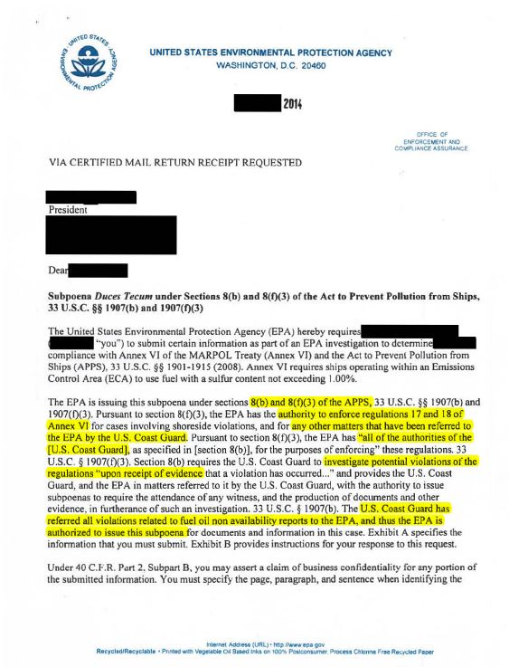
8(b) and 8(f)(3) of the APPS
Authority to enforce regulations 17
and 18 of Annex VI
Any other matters that have been
Referred to the EPA by the U.S. Coast
Guard.
“all of the authorities of the [U.S. Coast Guard]”
U.S. Coast Guard has referred all
Violations related to fuel oil non
Availability reports to the EPA, and
thus the EPA is authorized to issue
this subpoena.

Slide 46
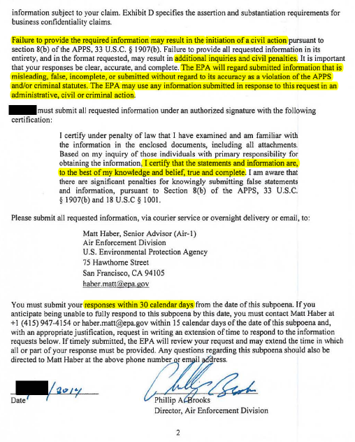
Failure to provide the required
information may result in the initiation of a civil action.
Additional inquiries and civil penalties.
The EPA will regard submitted
information that is misleading, false, incomplete, or submitted without regard to its accuracy as a violation of the APPS and/or criminal statutes. The EPA may
use any information submitted in response to this request in an administrative, civil or criminal action.
I certify that the statements and
Information are, to the best of my
knowledge and belief, true and complete.
Responses within 30 calendar days

Slide 47
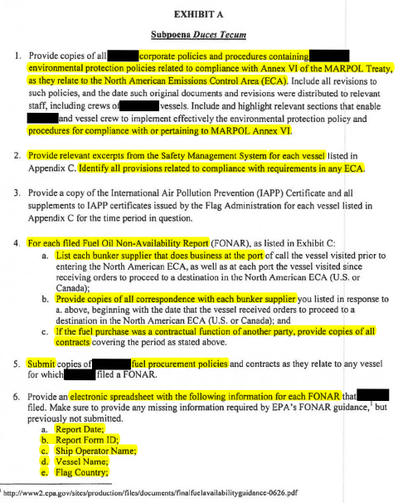
Corporate policies and procedures containing
environmental protection policies related to compliance with Annex VI of the MARPOL Treaty, as they relate to North American Emissions Control Area (ECA).
Procedures for compliance with or pertaining
to MARPOL Annex VI.
Provide relevant excerpts from the Safety
Management System for each vessel.
Identify all provisions related to compliance with requirements in any ECA.
For each filled Fuel Oil Non-Availability Report:
List each bunker supplier that does business at
the port.
Provide copies of all correspondence with each
bunker supplier.
If the fuel purchase was a contractual function
of another party, provide copies of all contracts.
Submit fuel procurement policies.

Slide 48
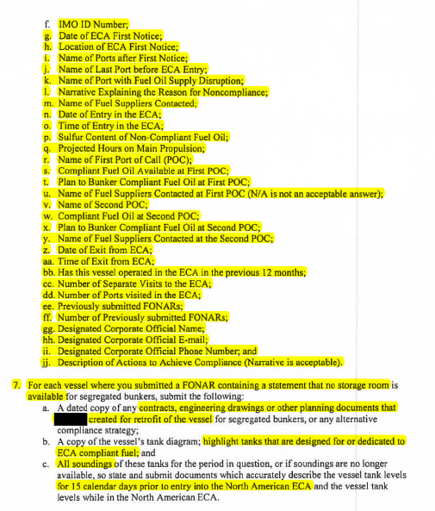
Electronic spreadsheet with the following
information for each FONAR:
Report Date
Report Form ID
Ship Operator Name
Vessel Name
Flag Country
IMO ID Number
Date of ECA First Notice
Location of ECA First Notice
Name of Ports after First notice
Name of Last Port before ECA Entry
Name of Port with Fuel Oil Supply Disruption
Narrative Explaining the Reason for Noncompliance
Name of Fuel Suppliers Contacted
Date of Entry in the ECA
Time of Entry in the ECA
Sulfur Content of Non-Compliant Fuel Oil
Projected Hours on Main Propulsion
Name of First Port of Call (POC)
Compliant Fuel Oil Available at First POC
Plan to Bunker Compliant Fuel Oil at First POC

Slide 49
Electronic spreadsheet with the following
information for each FONAR:
Name of Fuel Suppliers Contacted at First POC (N/A is not an acceptable answer)
Name of Second POC
Compliant Fuel Oil at Second POC
Plan to Bunker Compliant Fuel Oil at Second POC
Name of Fuel Suppliers Contacted at the Second POC
Date of Exit from ECA
Time of Exit from ECA
Has this vessel operated in the ECA in the previous 12 months
Number of Separate Visits to the ECA
Number of Ports visited in the ECA
Previously submitted FONARs
Number of Previously submitted FONARs
Designated Corporate Official Name
Designated Corporate Official E-mail
Designated Corporate Office Phone Number, and
Description of Actions to Achieve Compliance Narrative is acceptable)

Slide 50
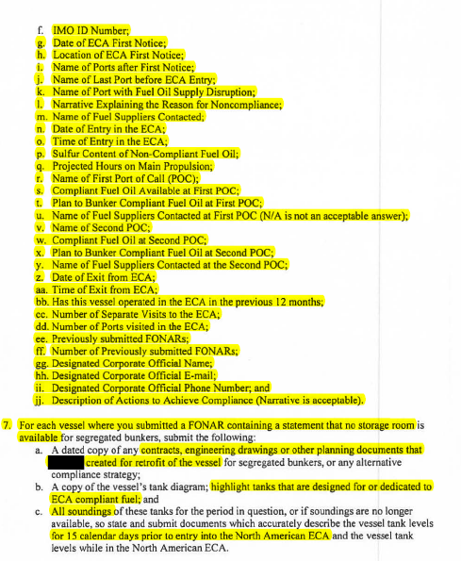
For each vessel where you submitted a FONAR
containing a statement that no storage room is available:
Contracts, engineering drawings or other planning documents that …created for retrofit of the vessel
Highlight tanks that are designed for or dedicated to ECA compliant fuel
All surroundings…for 15 calendar days prior to entry into the North American ECA

Slide 51
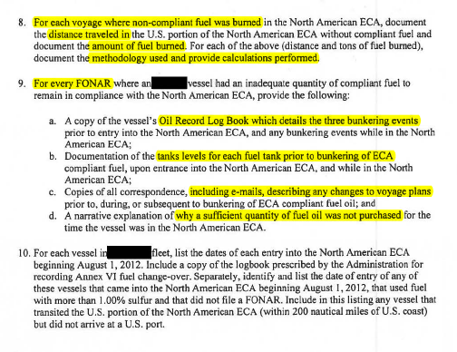
For each voyage where non-compliant
fuel was burned…distance traveled…
amount of fuel burned…methodology
used and provide calculations performed.
For every FONAR:
Oil Record Log Book which details the three bunkering events
Tanks levels for each fuel tank prior to bunkering of ECA
Including e-mails, describing any changes to voyage plans
Why a sufficient quantity of fuel oil was not purchased

Slide 52
Is there a business case for proactive planning to avoid/limit liability?

Slide 53
IS THERE A BUSINESS CASE FOR PROACTIVE PLANNING TO AVOID/LIMIT LIABILITY?
Delicate Balance
Cost of Compliance Measures vs. Potential Liability Exposure for Failure to Comply
Compliance measures don’t have to be expensive to be effective.
Benefits
Fuel Efficiencies For Alternative Means of Compliance (i.e. LNG)
Focus of Safety/Compliance Culture = improved risk mitigation and management
Improved Brand Reputation
Attract Investors & Talent

Slide 54
Preventative cost of compliance
Environmental Compliance Plan (ECP)
Cost of Assessing & Developing ECP
Cost of Auditing
Cost of Engineering Changes
Cost of Training Programs
Integrate Compliance Measures Into Existing Safety Management Systems Or Implement Stand-Alone Compliance Program
Key: Implement an ECP on your own terms, not the government’s terms!

Slide 55
Enforcement Costs Due to failure to comply
Defense Costs
Delayed Departure of the Vessel
Post Bond To Secure Release of Vessel
House, Feed, Pay Wages of Crewmember Witnesses While the Investigation/Prosecution Proceeds
Payment of Fines/Whistleblower Rewards
Alternative Fines Act
Lost Business/Business Reputation
Government Dictated ECP During Term of Probation (Could be up to 5 years)

Slide 56
Magic Pipe Penalties
Total Penalty | Date
$37 million | 05/27/07
$25 million | 04/04/05
$18 million | 04/19/02
$10.5 million | 02/01/06
$10.4 million | 06/21/13
$9 million | 09/16/98
$6.5 million | 07/10/06
$5.5 million | 08/22/02
$4.75 million | 06/19/08
$4.2 million | 04/03/04
Top 10
Penalties
Average total penalty/fine was $2.53 million.
(Based on 63 false record book cases from April 1993 to June 2014)
Notes:
Above is a listing of the highest penalties. Of the 63 false record book cases in our chart (covering April 1993 - June 2014), the average total penalty/fine was $2.53 million.
Case names are as follows:
OSG
Evergreen International
Carnival Corp.
MSC Ship Management
Columbia Ship Management
Royal Caribbean Cruises
Wallenius Ship Management
Boyang
Clipper Wonsild Tankers
OMI

Slide 57
Barry Hartman barry.hartman@klgates.com 202.778.9338 Washington, D.C.
Michael Chalos michael.chalos@klgates.com 212.536.4097 New York, NY

Slide 58
Maritime Group
Richard Arrage
April L. Boyer
Special Counsel
Partner
Sydney
Miami
richard.arrage@klgates.com
april.boyer@klgates.com
Vincent N. Avallone
Michael G. Chalos
Partner
Partner
Newark
New York
vincent.avallone@klgates.com
michael.chalos@klgates.com
Raja Bose
Darrell L. Conner
Partner
Government Affairs Counselor
Singapore
Washington, D.C.
raja.bose@klgates.com
darrell.conner@klgates.com

Slide 59
Maritime Group
Stephan H. Coonrod
Julius “Sam” Hines
Partner
Partner
Seattle
Charleston
stephen.coonrod@klgates.com
julius.hines@klgates.com
Lindsey A. Greer
A. Lee Hogewood III
Associate
Partner
Charleston
Raleigh
lindsey.greer@klgates.com
lee.hogewood@klgates.com
Barry M. Hartman
Takahiro Kawaguchi
Partner
Partner
Washington, D.C.
Tokyo
barry.hartman@klgates.com
takahiro.kawaguchi@klgates.com

Slide 60
Maritime Group
Jeffrey S. King
William N. Myhre
Partner
Partner
Boston
Washington, D.C.
jeffrey.king@klgates.com
william.myhre@klgates.com
John L. Longstreth
Michael Neylan
Partner
Partner
Washington, D.C.
Sydney
john.longstreth@klgates.com
michael.neylan@klgates.com
Robert E. Melson, Jr.
Stephen Thompson
Partner
Partner
Tokyo
Sydney
robert.melson@klgates.com
stephen.thompson@klgates.com

Slide 61
Maritime Group
Luke M. Reid
James A. Sartucci
Associate
Government Affairs Counselor
Boston
Washington, D.C.
luke.reid@klgates.com
james.sartucci@klgates.com
Emanuel L. Rouvelas
Michael F. Scanlon
Partner
Partner
Washington, D.C.
Washington, D.C.
emanuel.rouvelas@klgates.com
michael.scanlon@klgates.com
Mark Ruge
Steven C. Sparling
Partner
Partner
Washington, D.C.
Washington, D.C.
mark.ruge@klgates.com
steven.sparling@klgates.com

Slide 62
Maritime Group
Donald W. Stever
Jorge Romero
Of Counsel
Of Counsel
New York
Washington, D.C.
donald.stever@klgates.com
jorge.romero@klgates.com
Margaret R. Westbrook
J. Timothy Hobbs
Partner
Associate
Raleigh
Seattle
margaret.westbrook@klgates.com
timothy.hobbs@klgates.com
Christina M. Paul
Stephen P. Roberts
Partner
Associate
Miami
Washington, D.C.
christina.paul@klgates.com
stephen.roberts@klgates.com

Slide 63
Maritime Group
Andrew J. Newhart
Government Affairs Specialist
Washington, D.C.
andrew.newhart@klgates.com

