Slide 1
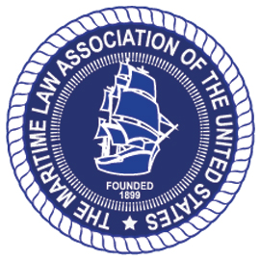
International Organizations, Conventions, and Standards Committee of the Maritime Law Association of the United States
Overview of International Criminal Enforcement of Safety and Environmental Laws
Gregory F. Linsin
April 29, 2015
Shipowners Claims Bureau Inc.
1 Battery Park Plaza
New York, NY

Slide 2
Overview
International Maritime Organization framework
Criminal Cases based on International Conventions
Involve laws implementing or similar to MARPOL and other international conventions and regulations
By region: Oceania, Europe, North America and Asia
Marine Casualties Involving Fatalities
M/V Queen of the North
M/V Sewol – Sinking of South Korean ferry
M/V Costa Concordia – Italian cruise ship disaster
Macando Well Blowout

Slide 3
International Maritime Organization
Historic tension between safety/pollution prevention and sovereignty
U.S. Port State Control regime; Paris MOU; Tokyo MOU
A.1052(27) – Procedures for Port State Control
Appendix 2 contains specific list of detainable deficiencies
A.1067(28) – Mandatory Audit Scheme
Into force in 2016
A.1068(28) – Mandatory Audit Scheme to use IMO Instruments Implementation Code

Slide 4
CRIMINAL ENFORCEMENT ACTIONS BASED
ON INTERNATIONAL CONVENTIONS

Slide 5
Oceania
Australia: Criminal Enforcement Under law Implementing MARPOL Annex V
M/V Hope Star – July 2012
Vessel discharged garbage in the Great Barrier Reef Marine Park.
Owner fined AUD$5,000; Master fined AUD$300
M/V Morning Midas – August 2012
Vessel discharged plastic mooring fine; failed to report.
Owner fined AUD$5,000
M/V Xin Tai Hai – April 2012
Fisherman spotted vessel dumping garbage; vessel tracking used
Owner fined AUD$20,000; Master fined AUD$6,000
M/V Pantanal– July 2011
Vessel discharged food waste in the Great Barrier Reef Marine Park
Owner fined AUD$5,000; master fined AUD$500

Slide 6
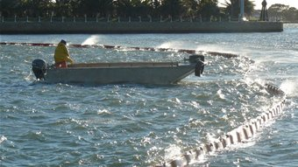
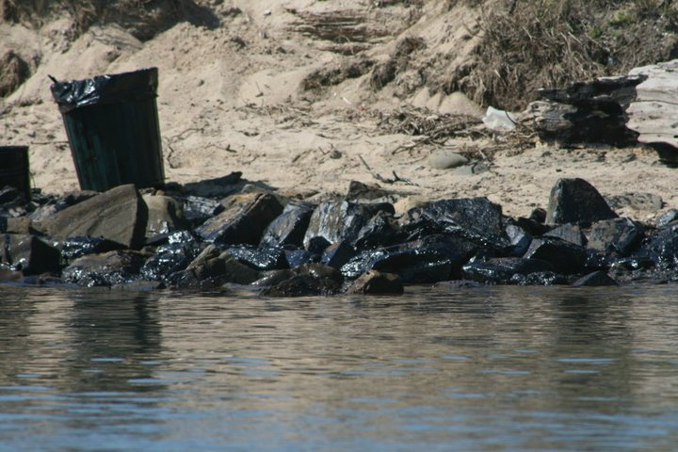
Oceania
Australia – Criminal Enforcement Under Law Implementing MARPOL Annex I
M/V Magdalene – August 2010
Vessel discharged mix of ballast water and HFO during deballasting
Spill significantly impacted the environment
Owner and Master pleaded guilty to violations of New South Wales’ “Marine Pollution Act”
Owner fined ASD$1.2 million plus prosecution costs
Owner also paid ASD$1.7 million in clean up costs

Slide 7
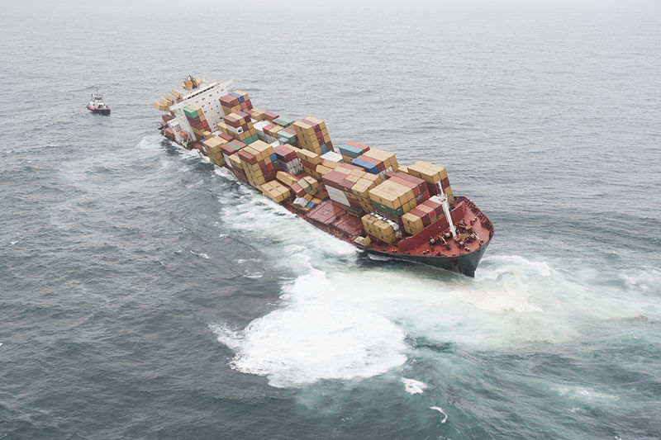
Oceania
New Zealand
M/V Oyang 75 – August 2011
Fishing vessel discharged unfiltered bilge effluent into New Zealand waters
Prosecution only brought charges for failure to notify under the Maritime Transport Act; owner was convicted and received NZD$10,500 fine
M/V Rena – October 2011
Container vessel grounded on Astrolabe Reef
Charges and convictions under Maritime Transport Act, Resource Management Act, and general criminal statute
Master and second officer sentenced to 7 months in prison
New Zealand Defense Force

Slide 8
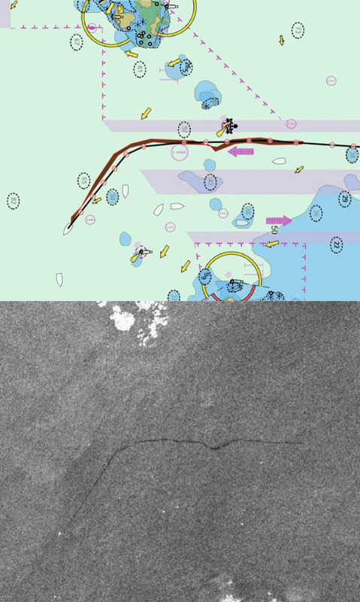
Europe
United Kingdom
M/T Maersk Kiera – February 2012
Violation of Dangerous or Noxious Liquid Substances in Bulk Regulations, which implement MARPOL Annex II
Unlawful discharge of palm oil slops and cleaning fluids within 12 nm
Owner pleaded guilty and was sentenced to fines and costs totaling approximately £22,500
M/V Ever Sigma – January 2013
Violation of Prevention of Oil Pollution Regulations, which implement MARPOL Annex I
Rare exercise of flag State jurisdiction
Vessel accidentally discharged HFO off Greek coast, but did not report the spill for 27 hours.
Owner pleaded guilty and was sentenced to fines and costs totaling approximately £17,320

Slide 9
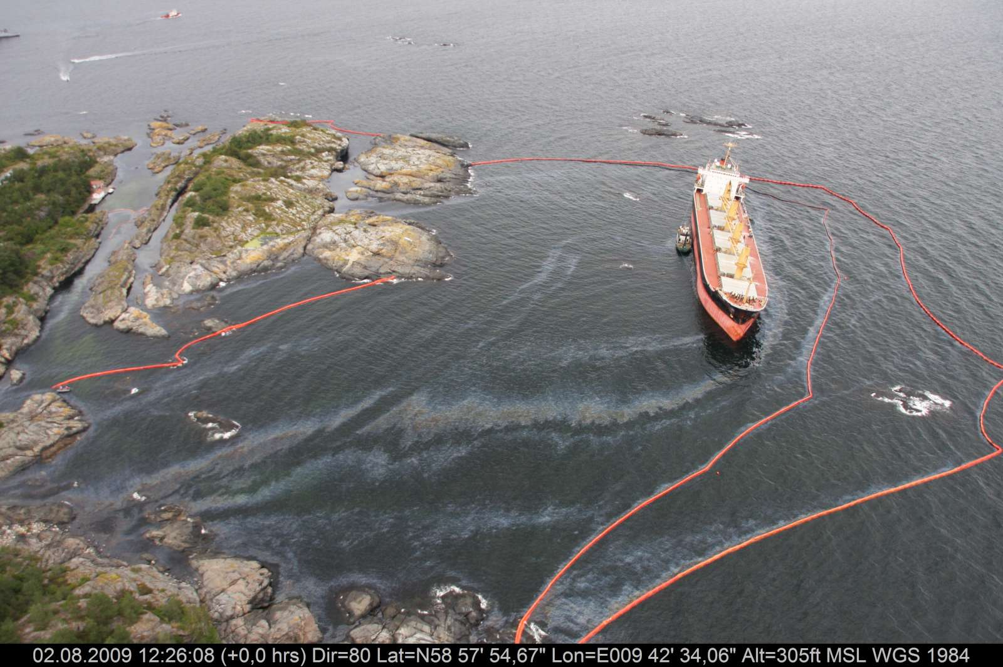
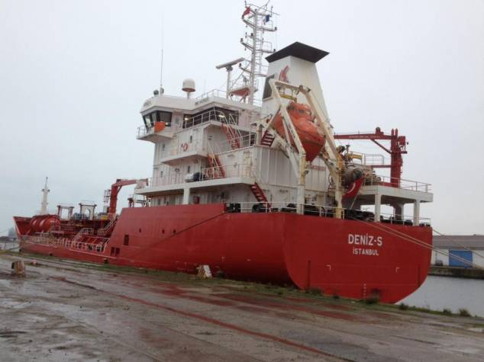
Europe
Norway – M/V Full City – July 2009
Bulk carrier owned and operated by COSCO ran aground in Norwegian waters, causing bunker oil spill
Prosecuted under Ship Safety Act and Pollution Control Act, rather than general criminal laws
Master convicted, but sentence commuted to probation; Third Officer acquitted on appeal
France – M/T Deniz-S – November 2014
Oil spill from Turkish-flag tanker near Le Havre was detected by helicopter and reported to French coast guard
French court found both Owner and Captain guilty of MARPOL violations
Owner fined €100,000 ; Captain fined €50,000
Court assessed additional fine of €27,500 for damage to the environment, payable to environmental groups

Slide 10
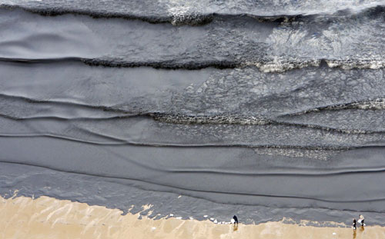
Asia
South Korea
M/T Hebei Spirit – December 2007
Crane barge being towed by tugs broke free and collided with the vessel
Collision caused spill of about 10,800 tons of crude oil; clean-up costs of $330 M
Captain and Chief Officer from the Hebei Spirit, two tug masters, and the barge captain charged with criminal negligence and causing marine pollution
Defendants convicted of criminal negligence and marine pollution
South Korean High Court overturned negligence convictions but maintained marine pollution convictions
The Two Tug masters convicted under Marine Pollution Prevention Act, sentenced ranged from 1-3 years; Crane barge master acquitted.

Slide 11
North America
United States
10 – 12 criminal MARPOL cases per year
US v. Sanford Ltd.
Prosecution of fishing vessel owner and Chief Engineer
MARPOL Annex I and obstruction of justice
US sought forfeiture and fine of $75 million dollars
$1.9 million fine; 3 months incarceration
US v. Noble Drilling (U.S.) LLC
Prosecution of operator of drill rig for MARPOL Annex I, Ports and Waterways Safety Act, and related counts
$8.2 million fine; $4 million community serv. payment

Slide 12
Marine Casualties Involving Fatalities

Slide 13
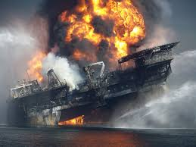
Macando Well Blowout
United States v. BP
11 seaman’s manslaughter counts
Obstruction of Congress
Clean Water Act
Migratory Bird Treaty Act
$4 billion dollar fine
United States v. Nix; United States v. Rainey
United States v. Kaluza and Vidrine
Two well site leaders; 22 manslaughter counts, one CWA
Seaman’s manslaughter statute applies only to those engaged in the marine operations, maintenance, or navigation of vessel

Slide 14
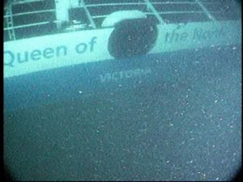
M/V Queen of the North
Canada – March 2006
Swedish flag Ro-Ro ferry vessel ran aground and sank; 2 people died
Vessel’s navigating officer charged with two counts of criminal negligence causing death.
Charged specifically with breach of Canadian Collision Regulations enacted under the Canada Shipping Act 2001, which implement and modify the International Regulations for Preventing Collisions at Sea (“COLREGS”)
Following jury trial, navigating officer was convicted and sentenced to 4 years in prison
Separate from criminal prosecution, sinking also caused spill of diesel fuel and lubricating oil, much of which was contained. Consequently, Canadian Environment Minister required Owner, BC Ferries and Canada Coast Guard to draft plan to ensure sunken vessel would not result in further unintended releases of oil.

Slide 15
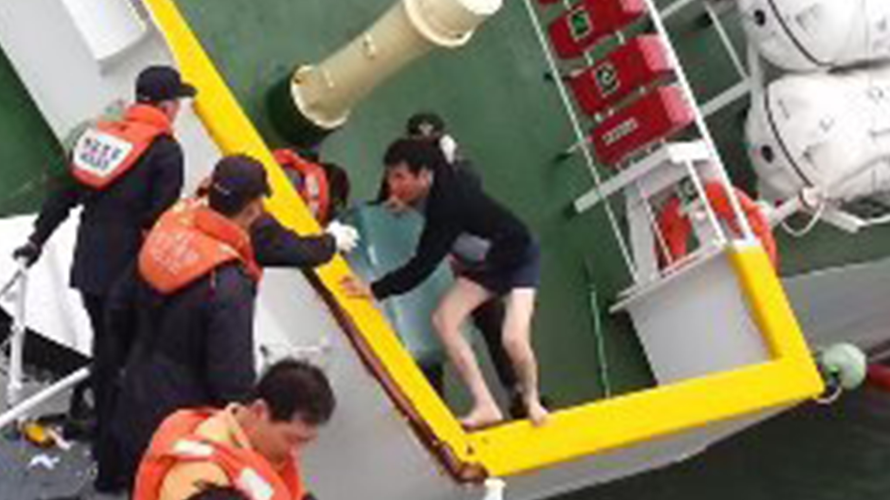
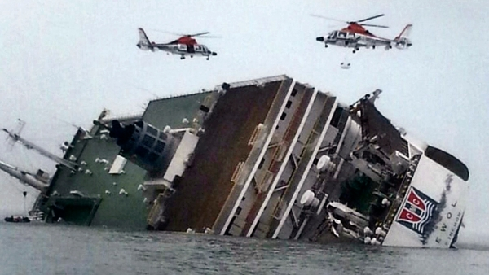
M/V Sewol – South Korea Ferry Sinking
On April 16, 2014, a South Korean ferry sank, killing 304 people, including 250 high school students
Inexperienced officers took sharp turn
Illegal redesign and failure to secure cargo
Captain and Crew failed to properly evacuate passengers (no warning, no lifejackets) and abandoned ship
5 month jury trial
Captain – guilty of murder and violation of Seafarer’s Act, which requires Captain to remain on board
C/E – guilty of murder for abandoning two injured crew
Crew members and CEO (tried separately) – guilty of accidental homicide
Port inspector and cargo company – guilty of negligence
Senior ship inspector – acquitted of obstructing justice
Sentences: Captain – 36 years; C/E – 30 years; CEO – 10 years,; others – 5-20 years. Currently on appeal.

Slide 16
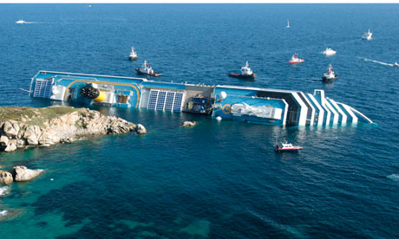
Costa Concordia – Cruise Ship Disaster
On January 13, 2012, Master of Costa Concordia navigated too close to island off W. coast of Italy
Vessel ran aground, hull flooded, drifted and grounded on island
Order to evacuate not given for 1 hour after impact, 32 people died
Italian authorities prosecuted Owner, Costa Crociere, Captain, three crew members, and two company employees
Costa settled charges in exchange for €1 million fine
Captain convicted on multiple counts of manslaughter, causing a maritime disaster, abandoning ship, and providing false information to Italian port authorities
Convicted in February 2015, Sentenced to16 years and 1 month
5 Costa employees pleaded guilty
sentences ranged from 2 years and 10 months to 1 year
Sentences likely to be appealed

Slide 17
Conclusions
The number and degree of criminal prosecutions in the U.S. premised on MARPOL and maritime safety-related statutes make it an outlier worldwide
Scope of enforcement in U.S. is increasing with Annex VI requirements, ballast water, and Vessel General Permit
Nevertheless, criminal enforcement statutes based on international environmental and safety convention are used by key port states worldwide
IMO mandatory audit program and PSC procedures may increase criminal enforcement efforts
Increased international cooperation and referrals regarding criminal MARPOL enforcement issues

Slide 18
Questions
Gregory F. Linsin Partner, Blank Rome LLP Watergate 600 New Hampshire Avenue, NW Washington, DC 20037 Phone: 202.772.5813 Email: Linsin@BlankRome.com
Winner of Lloyd's List 2015 Maritime Legal Services Award

