Slide 1
Barging of Fracking Water.
A regulatory and transportation challenge.
by Brian Buckley McAllister

Slide 2
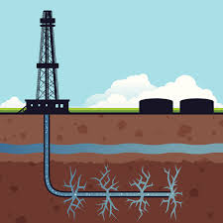
America’s energy renaissance includes a little publicized challenge: 10-30% of fresh water used in fracking returns to the surface (1.8 billion BBLs/year) along with produced brine (21 billion BBLs/year).

Slide 3
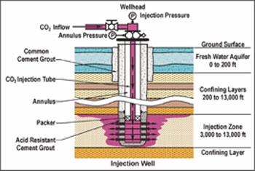
95% of U.S. produced water is reinjected.

Slide 4
Green Hunter Resources addresses market.
The Marcellus Shale formation from New York to Kentucky is generating billions of barrels of produced water with a disposal spot rate of $3-4 per BBL.
Barging is the most efficient mode of transporting bulk commodities in this region, including the crude oil produced by fracking. As a comparison, a gallon of fuel can move a ton of cargo 616 miles by barge, versus 478 miles by rail or 150 miles by truck.
A publicly traded company has sought Coast Guard approval to ship produced water by barge and invested in river side salt water disposal facilities.
For more information, see www.greenhunterenergy.com.

Slide 5
The Coast Guard approval has been pending since November, 2013.
Under 46 C.F.R. 153.900(a) and (c), bulk liquid hazardous materials are generally transported by a tank vessel when approved by the Coast Guard as a “listed cargo”. “Shale gas extraction waste water” (“SGEWW”) was not listed because its composition is different from well to well and may contain radium, requiring different handling under 46 C.F.R. 153.2. Similar regulations already permit the carriage of fracking crude oil or radioactive material.
Under 46 C.F.R. 153, the Coast Guard issued a proposed policy letter setting forth the conditions under which Certificate of Inspection endorsements would be granted allowing transportation of shale gas extraction waste water in bulk. See, 78 F.R. 64905 Oct. 30, 2013. The policy letter contained additional requirements for cargo analysis, recordkeeping, surveys, and venting.
A substantial amount of negative feedback was received in the public docket. http://www.regulations.gov, docket folder ‘‘USCG–2013–0915’’.

Slide 6
Trucking regulations are left to states
The oil and gas waste exemption of RCRA denies the USEPA from jurisdiction over land transportation of waste water. Regulation of trucking hazardous cargoes is generally left to states.
Trucking of produced water is generally treated like any other waste product.
Arkansas, Colorado, New York, North Dakota, Pennsylvania, and Texas impose basic permitting, operating, and recordkeeping requirements on trucking of oil and gas waste.
Specific regulation of trucking produced water has been primarily limited to efforts to ban out-of-state water for disposal (Vermont/Connecticut/New Jersey).

Slide 7
Possible paths forward:
The Coast Guard may move ahead with the policy letter set forth at 78 F.R. 64905 Oct. 30, 2013.
Application to Coast Guard for a vessel specific permit endorsing a vessel’s Certificate of Inspection with the cargo’s name. 46 C.F.R. 153.900(c)&(d).
Application to Coast Guard to have produced water established as a “listed cargo” under 46 C.F.R. 153.900.
Transportation of produced water as a “listed cargo” under 46 C.F.R. 153.900.

