Slide 1
The Marine Law Association of the United States
2015 Fall Meeting
Bermuda, October 22, 2015
Protection & Indemnity insurance: Past, present & future
Joseph Hughes
Shipowners Claims Bureau, Inc.
Managers of
The American Club
`

Slide 2
Overview
1980 and 2015 – the geopolitical landscape
1980 and 2015 – the economic landscape
1980 and 2015 – the P&I landscape
Changing times, an enduring business model
The future contours of the P&I landscape
Conclusion

Slide 3
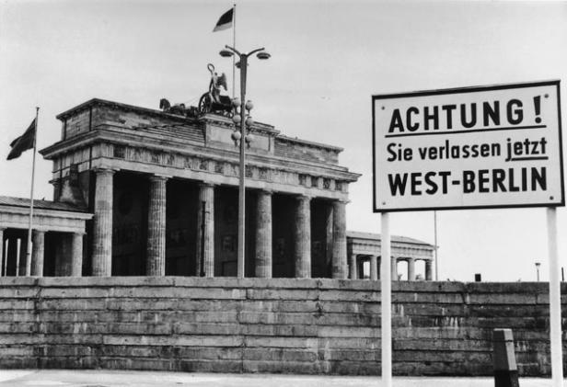
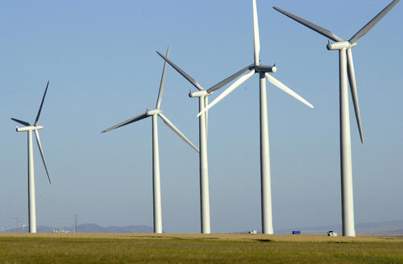
1980 – the geopolitical landscape
Cold War continues to condition global alignments
Europe divided: EEC/EFTA vs. Comecon, NATO vs. Warsaw Pact
Regional tensions and extremism grow in Mid-East and South Asia
Iran/Iraq war begins following 1979 Iranian revolution
US boycotts Moscow Olympics after Soviet invasion of Afghanistan
Conservative ascendancy in US and UK begins
EEC has nine members, multiple currencies and polities
China begins program of economic reform
Global shipping an invisible industry, lightly regulated
Environmental protection is fringe geopolitical issue

Slide 4
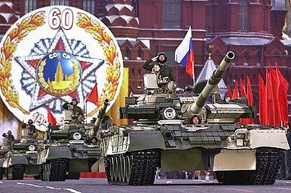
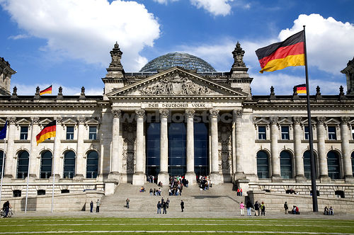
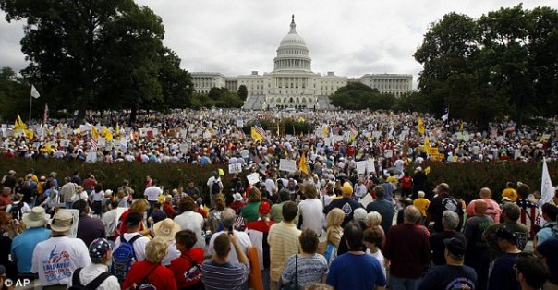
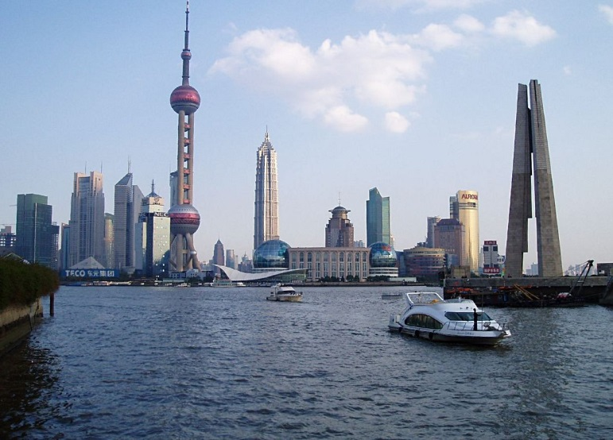
2015 – the geopolitical landscape
Cold War over: Soviet empire dissolved: Russian nationalism persists
Germany reunited: former Soviet client states now part of EU
NATO continues: Warsaw Pact long disbanded
Ungoverned spaces and non-state actors challenge global security
Conservative/Socialist/“Third-way” political agendas in flux
EU has 28 members: convergence threatened by Eurozone crisis, etc.
China major power: slowdown/shifting priorities suggest inflection point
Encouragement of free markets belies creeping “statism”
Global shipping still an invisible industry, but more heavily regulated
Environmental protection is central geopolitical issue

Slide 5
1980 – the economic landscape
Global GDP c. $22 trillion
US economy largest by far: 26% of global GDP
BRICs minor component of global GDP (7%)
US creditor rather than debtor nation (7% of GDP in credit)
Domestic and cross-border money/credit supply constrained
World trade (merchandise) c. $3 trillion (14% of global GDP)
World fleet size 420 million GT
10 year US Treasury yield 11.78% (October 1, 1980)
DOW 939 NASDAQ 190 OIL $36 GOLD $682 (October 1, 1980)

Slide 6
2015 – the economic landscape
Global GDP $80 trillion
US economy still largest (23%), but multiplying polarities
BRICs major component of global economy (20%)
US debtor rather than creditor nation (101% of GDP in deficit)
Domestic and cross-border money/credit supply abundant
Debt, deleveraging, deflation and demographics challenge
World trade (merchandise) c. $20 trillion (25% of global GDP)
World fleet size 1.1 billion GT
10 year US Treasury yield 2.04% (October 1, 2015)
DOW 16,272 NASDAQ 4,627 OIL $45 GOLD $1,114 (October 1, 2015)

Slide 7
1980 – the P&I landscape
14 members of “London Group” including reinsured clubs
90%+ of world blue-water fleet
“Gentlemen's Agreement”, not IGA. Incipient engagement with EEC
Part-time Secretariat. Modest consultative infrastructure
Clubs have few regional offices
Club retention $0.75 million : Pool retention $6 million: simple design
1980 then worst Pool year ever: $225 million
No Hydra
“Unlimited liability” defines Club cover for non-OP claims

Slide 8
1980 – the P&I landscape (cont’d.)
Paper-based technology prevails
Rule Book/Certificate of Entry format as evidence of cover
Club financial disclosure/operational commentary modest
Unsophisticated risk control/educational initiatives
Limited regulatory/political interventionism
Rating agencies absent from market
Specialist broker involvement growing
Distinct “First World”/“Second World” paradigm of cover
Virtually no product-line diversification
Clubs elicit intermittent media interest

Slide 9
2015 – the P&I landscape
13 members of International Group of P&I Clubs
90%+ of world’s blue-water fleet
IGA and Pooling Agreement formal, EU-approved documents
Full-time, highly active Secretariat. Large consultative infrastructure
Clubs have many regional offices
Club retention $9 million : Pool retention $80 million: complex design
2011 and 2012 among worst Pool years ever: $507 million and $481 million
Hydra
Club cover limited to prescribed amounts

Slide 10
2015 – the P&I landscape (cont’d.)
Electronic technology prevails
Rule Book/Certificate of Entry format as evidence of cover
Club financial disclosure/management commentary extensive
Sophisticated risk control/educational initiatives
Widespread regulatory/political interventionism
Rating agencies present in market
Specialist broker involvement ubiquitous and mature
Significant amount of product-line diversification
P&I the darling of the media!

Slide 11
Changing times, an enduring business model
Changing times……
Massive growth in scale of P&I universe
Greater demands of political and regulatory establishment
Greater transparency/depth in financial and management reporting
Greater focus on investment strategies and fiscal efficiencies
Enlargement and consolidation of Group intellectual resources
Greater Group involvement in shipping mainstream
Greater dialogue with media and other constituencies
Greater regionalization of service delivery
Magnification of unique advantages of Group business model

Slide 12
Changing times, an enduring business model
An enduring business model……
The culture of mutuality
The basic design of clubs in ownership and governance terms
The core elements of cover
The mechanisms of club funding
The service provider/insurance carrier balance
The collective purchase of reinsurance protection
The cooperative deployment of Group resources
The approval of the customer base
The underlying justification for the entire system

Slide 13
The future contours of the P&I landscape
Political and regulatory challenges will grow and regionalize
Member/shipping industry expectations will continue to rise
Flexibility/value of system will continue to be recognized
The Club/Group business model will endure
Group will maintain its basic shape
Cooperative deployment of Group resources will strengthen
Growing emphasis on financial modeling
Group market share will be maintained
Regionalization of service delivery will expand
Product-line diversification will continue
Specialist, fixed-premium insurers will continue to have an important role

Slide 14
Conclusion
Geopolitical and economic landscape much changed since 1980
New political/regulatory/commercial agendas changed P&I landscape
Clubs/Group have responded energetically to change
Culture of mutuality shown flexibility and resilience
Clubs’/Group’s capacity to respond to change will continue
Times change – values don’t! Or
Plus ça change, plus c'est la même chose!

Slide 15
The Marine Law Association of the United States
2015 Fall Meeting
Bermuda, October 22, 2015
Protection & Indemnity insurance: Past, present & future
Joseph Hughes
Shipowners Claims Bureau, Inc.
Managers of
The American Club
`

