Slide 1
New York 5 May 2016
Report on Legal Framework for Civil Liability for Vessel Source Oil Spills in Polar Regions
LARS ROSENBERG OVERBY

Slide 2
THE REPORT
The CMI Polar Shipping IWG decided to initiate the work in June 2014
Scope: A study of the issues that can be expected to arise following vessel source pollution damage in polar regions (the Arctic and Antarctica). All types of vessels but not E&P
The legal infrastructure in the regions including interaction of various rules
The impact of the likely high costs of response measures
The effect of limited capability to respond to oil spills; including disposal of recovered oil and other practicalities
The possibility of trans-frontier pollution
The application of certain special features in the CLC 1992 and IOPC Funds framework such as the concept of “reasonableness”

Slide 3
THE REPORT
Summary:
The report explores these issues by describing the international regimes for compensation, limitation and liability with reference to the Polar context, and applicable national law with regard to environmental protection, emergency response and liability applicable to Polar Regions. Further, the report explores any potential gaps that may exist with regard to compensation and liability regimes in the event of pollution damage and the resources needed to respond to such an event in these remote regions.

Slide 4
CONTRIBUTIONS
Certain members of the IWG and special expertise within scope
Canada
USA
Russia
Norway
Denmark (Greenland)
Antarctica

Slide 5
NEW TRADE ROUTES

Slide 6
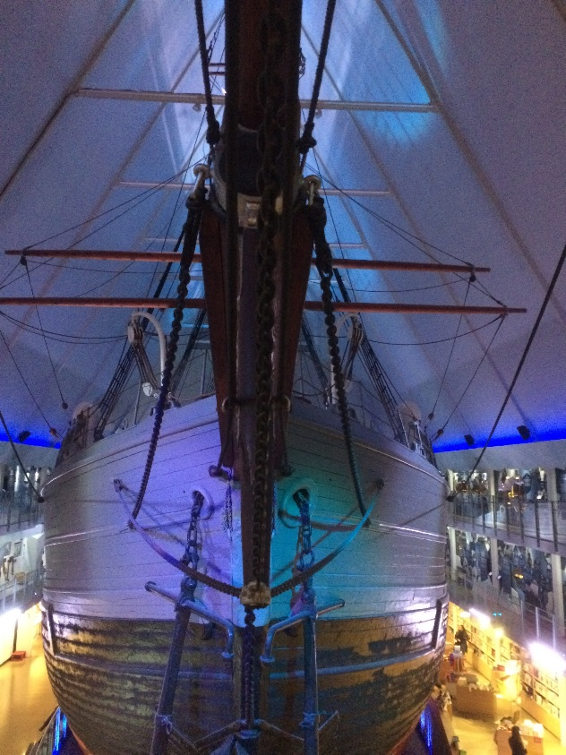
THE ROUTES

Slide 7
TERRITORIES

Slide 8
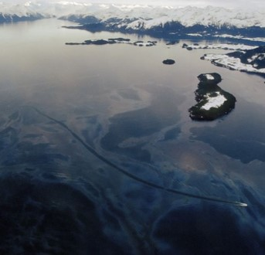
THE ARCTIC AND ANTARCTIC LEGAL REGIMES
Arctic
Denmark (Greenland), Norway and Canada CLC 1992/IOPC 2003
Russia CLC 1992/IOPC 1992
USA OPA 90
Individual national environmental protection law
Antarctica
The 1959 Antarctic Treaty
No territorial sea, EEZ or equivalent zones
International law

Slide 9
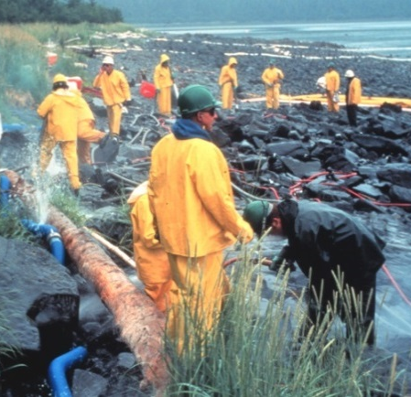
COMMON FEATURES IN THE ARCTIC COASTAL STATES
National legal regimes covering the issues at hand
Environmental protection legislation
Response and delegation of responsibility
CLC 1992 and Fund Convention (not USA)
OPA 90 in USA
LLMC 1996 limitation
Bunker Convention (not effective for Greenland)

Slide 10
GOOD TO HAVES IN THE ARCTIC
UNCLOS (except USA)
Intervention Convention (except Canada)
Oil Pollution Preparedness and Co-operation Convention
The Arctic Council 2013 Agreement on cooperation on Marine Oil Pollution Preparedness and Response in the Arctic
The Polar Code (as of 2017)
The Arctic Coast Guard Forum

Slide 11
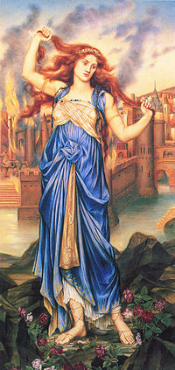
CONCLUSIONS
The legal infrastructure in the Arctic is very good technically speaking. The coastal states have in place legislation that deals with pollution, liability, calculation of losses, responsible parties and funding
The current response apparatus in the Arctic is probably inadequate although the coastal states work to improve it. The shear enormity of the area make the task difficult
A major oil spill may reveal the need for considering the current regulation of “pollution damage” in the CLC 1992 convention in terms of what measures are “reasonable” and as regards impairment of the environment
Dissenting views

Slide 12
CONCLUSIONS
It is an open question how the requirement that environmental reinstatement cost must be reasonable – in the context of the CLC and Fund Convention regime – will be applied by courts in the relevant coastal states and the IOPCF to reinstatement attempts in Arctic environment. Clarification of the recoverability of reinstatement costs under the CLC and Fund Convention regime would therefore assist the coastal States.
Dissenting views

Slide 13
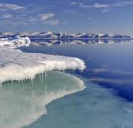
CONCLUSIONS
It is possible that a major oil spill will stress the monetary limits of the CLC and Fund Convention regime although the Supplementary Fund may be sufficient in most instances
Dissenting views
The current likely insufficient response facilities and equipment available in the Arctic enhance “reasonableness” question and the monetary limit issue

Slide 14
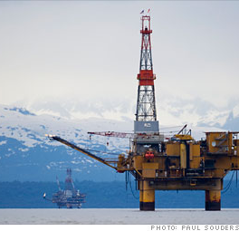
CONCLUSIONS
Russia would benefit from participating in the Supplementary Fund Protocol to the Fund Convention 1992 should a major oil pollution occur. So would Iceland
There is a gap with respect to the High Seas in the Arctic but this is not problematic at the moment. In time, the issue should be addressed in the interest of the International community
There is no indication that the United States will join the CLC and Fund Convention regime. Thus it will continue to enforce its domestic laws governing spills, including OPA 90

Slide 15
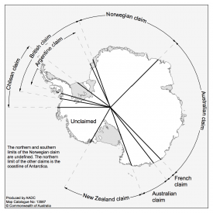
CONCLUSIONS ANTARCTICA
The Antarctica is exposed to legal uncertainty in the event that a pollution incident occurs until the liability Annex to the Protocol on Environmental Protection to the Antarctic Treaty is ratified

Slide 16
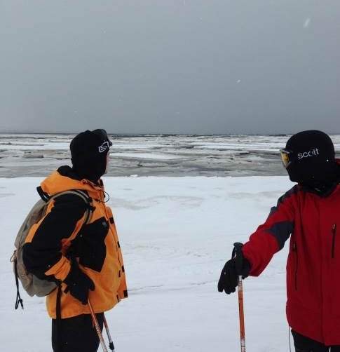
RECOMMENDATIONS
That the report is submitted to the IMO Legal Secretariat and discussions take place with the IMO Legal Secretariat to consider further
It would be natural for the coastal state IWG members to provide their competent local authorities with a copy of this report
That the Antarctic Treaty Protocol States ratify the Liability Annex to the Protocol on Environmental Protection to the Antarctic Treaty

