Slide 1
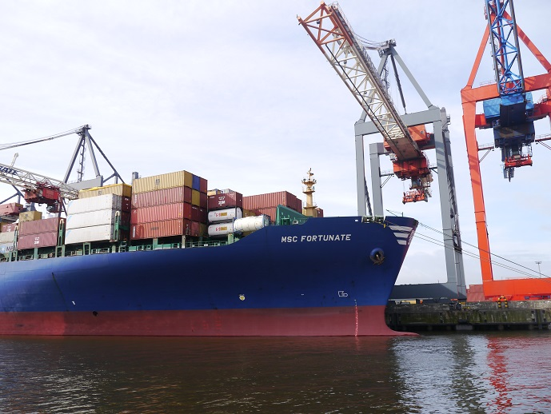
Jurisdiction and Arbitration Clauses in Bills of Lading and Other Sea Carriage Documents in Japan
Tomotaka Fujita (Japanese MLA)
Graduate Schools for Law and Politics
University of Tokyo

Slide 2
Background
No statutory regulation directly addressing the international jurisdiction of Japanese courts until recently.
The question of whether the Japanese court had jurisdiction over a specific dispute, including the validity of the jurisdiction and arbitration clauses in bills of lading, has been developed as case law.

Slide 3
Supreme Court Decision* of November 28, 1975
*A translation of the decision is available in Japanese Annual of International Law, No.20, pp.106-118 (1976). The volume is available Hein Online: http://home.heinonline.org/
Shipper (Seller)
Consignee (Buyer)
B/L
Compensation
Carrier
Subrogation
Insurer
Goods damaged
Santos (Brazil)
Kobe (Japan)

Slide 4
Supreme Court Decision of November 28, 1975
A jurisdiction clause in the bill of lading
“Any and all suits under this contract of carriage shall be brought before the court of Amsterdam and no other court shall have jurisdiction over any other suit unless the carrier brings such suit before a court of other jurisdiction or voluntarily accepts the jurisdiction of such court.”

Slide 5
Supreme Court Decision of November 28, 1975
Four conditions
The formalities for the agreement: At least a court of a certain country is expressly designated in the document prepared by either of the parties and if the existence of such an agreement between the parties and the contents thereof are explicit.
(2) The case is not subject to the exclusive jurisdiction of Japan.

Slide 6
Supreme Court Decision of November 28, 1975
Four conditions
(3) The designated foreign court has jurisdiction over such cases under the laws of that foreign country.
(4) Unless such an agreement is very unreasonable and against the law of public policy.

Slide 7
Tokyo District Court, September 13, 1999
Shipper
B/L Holder
B/L
Carrier
Third Party
Delivery w/o B/L
Tawau (Malaysia)
Tokyo (Japan)
7

Slide 8
Tokyo District Court, September 13, 1999
Followed the framework of 1975 Supreme Court Decision
Jurisdiction clause was held invalid as
“very unreasonable and against the law of public policy” under the specific circumstances of the case.

Slide 9
Tokyo District Court, September 13, 1999
The court found
(1) the dispute related to the (mis)delivery of the cargo in Japan,
(2) many relevant parties involved were Japanese who lived in Japan, and
(3) the relevant facts in the dispute had nothing to do with Malaysia.

Slide 10
Arbitration Clause Incorporated by Reference
Rotterdam Rules
Article 76(2)
“Notwithstanding paragraph 1 of this article, an arbitration agreement in a transport document or electronic transport record to which this Convention applies by reason of the application of article 7 is subject to this chapter unless such a transport document or electronic transport record:
(a) Identifies the parties to and the date of the charterparty or other contract excluded from the application of this Convention by reason of the application of article 6; and
(b) Incorporates by specific reference the clause in the charterparty or other contract that contains the terms of the arbitration agreement.”

Slide 11
Arbitration Clause Incorporated by Reference
Osaka District Court, May 11, 1959
Arbitration clause in the charterparty: “any dispute arising out of this charterparty is referred to arbitration in London.”
Incorporation provision in the B/L : “all the terms, conditions, and exceptions contained in which Charter are herewith incorporated.”
Court dismissed the claim. Arbitration clause incorporated by reference effectively prevented the B/L holder’s suit.

Slide 12
Statutes
Code of Civil Procedure included provisions concerning the international jurisdiction of Japanese courts in 2011.
Article 3-7 of the Revised Code provides for the validity of the choice of court agreement.
The provision is, essentially, based on the 1975 Decision.
No special rule for jurisdiction/ arbitration clauses in B/L
The 1975 Decision still remains as a precedent today.

Slide 13
A Possible Change in Statutes or Case Law?
The new legislation is unlikely.
The framework of 1975 Supreme Court Decision will be stable.
Developments may be seen in the area where ambiguities remain.
-When exclusive jurisdiction clause is “very unreasonable and against the law of public policy”
- Validity of arbitration clauses incorporated by reference to charterparty provisions

Slide 14
Responses to the Rotterdam Rules
Japan is unlikely to opt-in Chapters 14 (Jurisdiction) and 15 (Arbitration) of the Rotterdam Rules
However……..
There may be indirect influence by the Rotterdam Rules
E.g, Article 76(2) of the Rotterdam Rules, which regulates the effect of an arbitration clause incorporated by reference. If many states choose to opt-in Chapter 15 and Article 76 becomes a globally accepted rule, it might have some influence on Japanese courts.

Slide 15
Jurisdiction and Arbitration Clauses in Bills of Lading and Other Sea Carriage Documents in Japan
Tomotaka Fujita (Japanese MLA)
Graduate Schools for Law and Politics
University of Tokyo

