Slide 1
Subchapter M – Industry Perspective
René Cheramie
A.R. Cheramie Marine Management, Inc

Slide 2
TSMS based on ISM Model - 46 CFR 138.215
46 CFR 138.205 Purpose of a TSMS
(a) The purpose of a TSMS is to establish policies, procedures, and required documentation to ensure the owner or managing operator meets its established goals while ensuring continuous compliance with all regulatory requirements.… [at] all levels of the organization… .
46 CFR 138.215 Functional requirements of a TSMS
The functional requirements of a TSMS include: (a) Policies and procedures to provide direction for the safe operation of towing vessels and protection of the marine environment… .

Slide 3
ISM Code compliant SMS may meet Subchapter M TSMS requirement
46 CFR 138.225 Existing safety management systems (SMSs). (a) A safety management system (SMS) which is fully compliant with the International Safety Management (ISM) Code requirements, implemented in 33 CFR part 96, will be deemed in compliance with TSMS-related requirements in this subchapter. (b) Other existing SMSs [e.g.,AWO Responsible Carrier Program] may be considered for acceptance as meeting the TSMS requirements of this part. The Coast Guard may: (1) Accept such system in full; (2) Require modifications to the system as a condition of acceptance; or (3) Reject the system.

Slide 4
ISM Code SMS requirements
33 CFR 96.230 describes the objectives that a safety management system under the ISMC must meet.
The safety management system must: (a) Provide for safe practices in vessel operation and a safe work environment onboard the type of vessel the system is developed for; (b) Establish and implement safeguards against all identified risks.
…..

Slide 5
Elements of the ISM Code SMS
General
Safety and Environmental Protection Policy
Company Responsibilities and Authority
Designated Person(s)
Master’s Responsibility and Authority
Resources and Personnel
Shipboard Operations
Emergency Preparedness
Reports and Analysis of Non Conformities, Accidents, and Hazardous Occurences
Maintenance of the Ship and Equipment
Documentation
Company Verification, Review and Evaluation
Certification and Periodical Verification

Slide 6
Element 1 - General
Definitions used within the code
Objectives of the ISM Code
Application (SOLAS Reg 1X2 – Application)
Functional Requirements for a Safety Management System - 33 CFR 96.240

Slide 7
Element 2 – Safety and Environmental Protection Policy
The Company should establish a Safety and Environmental protection policy.
The Company should ensure that the policy is implemented and maintained at all levels of the organization both ship based as well as shore based.

Slide 9
Element 3 – Company Responsibilities and Authority
Identification of the operator if the entity who is responsible for the operation of the ship is other than the owner, the owner must report the full name and details of such entity to the Administration.
The Company should define and document the responsibility, authority and interrelation of all personnel who manage, perform and verify work relating to and affecting safety and pollution prevention.
Provision for adequate resources. The Company is responsible for ensuring that adequate resources and shore based support are provided to enable the designated person or persons to carry out their functions.

Slide 11
Element 4 – Designated Person (s)
To ensure the safe operation of each ship and to provide a link between the company and those on board, every company, as appropriate, should designate a person or persons ashore having direct access to the highest level of management.
The responsibility and authority of the Designated Person or persons should include monitoring the safety and pollution prevention aspects of the operation of each ship and to ensure that adequate resources and shore based support are applied, as required.

Slide 12
Element 5 – Master’s Responsibility and Authority
The Company should clearly define and document the Master’s responsibility with regard to:
Implementing the Safety and Quality and Environmental protection policy of the Company
Motivating the crew in the observation of that policy
Issuing appropriate orders and instructions in a clear and simple manner.
Verifying that specified requirements are observed, and
Reviewing the SMS and reporting its deficiencies to the shore based management

Slide 13
Element 6 – Resources and Personnel
The Company should ensure that the Master is:
Properly qualified for command;
Fully conversant with the Company’s SMS; and
Given the necessary support so that the Master’s duties can be safely performed.
The company should ensure that each ship is manned with qualified, certificated and medically fit seafarers in accordance with national and international requirements.

Slide 14
Element 7 – Shipboard Operations
The Company should establish procedures for the preparation of plans and instructions, including checklists as appropriate, for key shipboard operations concerning the safety of the ship and the prevention of pollution. The various tasks involved should be defined and assigned to qualified Personnel.

Slide 15
Element 8 – Emergency Preparedness
The Company should establish procedures to identify, describe and respond to potential emergency shipboard situations.
The Company should establish a program for drills and exercises to prepare for emergency actions.
The SMS should provide for measures ensuring that the Company’s organization can respond at any time to hazards, accidents and emergency situations involving its vessels.

Slide 16
Element 9 – Reports and Analysis Nonconformities, Accidents, and Hazardous Occurrences
The SMS should include procedures ensuring that non conformities, accidents and hazardous situations are reported to the Company, investigated and analyzed with the objective of improving safety and pollution prevention.
The Company should establish procedures for the implementation of corrective action, including measures intended to prevent recurrence.

Slide 18
Element 10 – Maintenance of Ship and Equipment
The Company should establish procedures to ensure that the ship is maintained in conformity with the provisions of the relevant rules and regulations and with any additional requirements which may be established by the Company.
In meeting these requirements, the Company should ensure that:
Inspections are held at appropriate intervals
Any nonconformity is reported with its possible cause if known
Appropriate corrective action is taken; and
Records of these activities are maintained.

Slide 19
Element 11 – Documentation - 33 CFR 96.250 Table of documents and reports
The Company should establish and maintain procedures to control all documents and data which are relevant to the SMS.
The Company should ensure that:
Valid documents are available at all relevant locations;
Changes to documents are reviewed and approved by authorized personnel; and
Obsolete documents are promptly removed.

Slide 20
Element 12 – Company Verification, Review and Evaluation
The Company should carry out internal safety audits to verify whether safety and pollution prevention activities comply with the SMS.
Internal Audits should be conducted in order to verify that the SMS is functioning effectively.
While there is no stated period for audit, most Companies opt to audit each office or vessel annually.
The Company should periodically evaluate the efficiency of and, when needed, review the SMS in accordance with procedures established by the Company.

Slide 21
Element 13 – Certification and Periodic Review
The ship should be operated by a company which has been issued with a Document of Compliance (DOC)
The Safety Management Certificate should be issued to a ship for a period which should not exceed five years.
Masters Review of Elements:
The Master is to submit to the Designated Person Ashore the Masters Review
Designated Person to review submitted elements and provide written feedback to the Master.

Slide 22
Hypothetical deckhand injury
Deckhand Charlie, eight years experience on assist tugs and line haul tugs working New Orleans to Baton Rouge
Takes new assignment on offshore tug towing container barge between New Orleans and Puerto Rico
Three days out, tug encounters heavy weather, 20 foot seas, tug experiences rolling as much as 30°
Charlie tells fellow deckhand over breakfast he is going to take a shower before joining the master at the start of their next watch.
Charlie reports to watch, complaining that he slipped in the shower and “tweaked” his back. Completes watch and completes all remaining watches during voyage.

Slide 23
Cheramie SMS §080 – identify and initiate nonconformity procedure
NON-CONFORMITY REPORT (NCR)/CORRECTIVE ACTION REQUEST (CAR)
3. Non-conformity identified through:
X - Day to Day Operation - Internal Audit - Other
4. Description of nonconformity (or attachment):
July 1, 2016, deckhand Charlie reported he slipped and fell in the shower while off watch and tweaked his back. Reports he took ibuprofen. Completed watch, and completed remaining watches on voyage leg returning to New Orleans
Affected Document or Procedure and Clause No.: SMS 010-Cheramie Safety And Environmental Policy; Cheramie SAF 050 Near Miss (Illness or Injury)

Slide 24
Cheramie SMS §080 – identify and initiate nonconformity procedure
Does this nonconformity require further action? X - Yes - No
6. Disposition -- Action taken locally to eliminate or minimize the consequences pending a final answer from the DP:
Discussed with crew member circumstances of fall and ways to prevent recurrence. Deckhand Charlie reports he will continue to take ibuprofen and if it gets worse, go see Dr. on return to New Orleans
**************
After discharge, Charlie reports back pain is increasing, cannot work, diagnosed with compression fracture of L5 lumbar vertebrae

Slide 25
Deckhand Charlie – Subchapter M regulations implicated
46 CFR 140.210 –Responsibilities of the master and crew
(a) The safety of the towing vessel is the responsibility of the master and includes: ….
(4) supervision of all persons on board in carrying out their assigned duties.
(b) If the master … believes it is unsafe for the vessel to proceed, that an operation endangers the vessel or crew, or that an unsafe condition exists, he or she must ensure that adequate corrective action is taken and must not proceed until it is safe to do so.
(d) It is the responsibility of the crew to:
(6) report unsafe conditions to the master … and take effective action to prevent accidents

Slide 26
Deckhand Charlie –Subchapter M regulations implicated
46 CFR § 140.410 Safety orientation. … (b) Prior to getting underway for the first time on a particular towing vessel, each crewmember must receive a safety orientation on: …
(4) Personal safety measures; …
(10) Awareness of, and expected response to, any other hazards inherent to the operation of the towing vessel which may pose a threat to life, property, or the environment. …
46 CFR § 140.510 Identification and mitigation of health and safety hazards
(a) the owner … must implement procedures to identify and mitigate health and safety hazards, including but not limited to: …
(2) Slips, trips, and the falls; …

Slide 27
New Hire Vessel Familiarity/Orientation Checklist
Covers Security items , Station bill, Fire equipment, Abandon-Ship
Covers Generalitems, including introduction to Cheramie Policy Letters and SMS
“objectives of the Cheramie SMS are: to ensure safety at sea, prevention of human injury or loss of life and avoidance of damage to the environment, and also assess all identified risks to its ships, personnel and the environment, and establish appropriate safeguards.”
Crewmember written acknowledgment

Slide 28
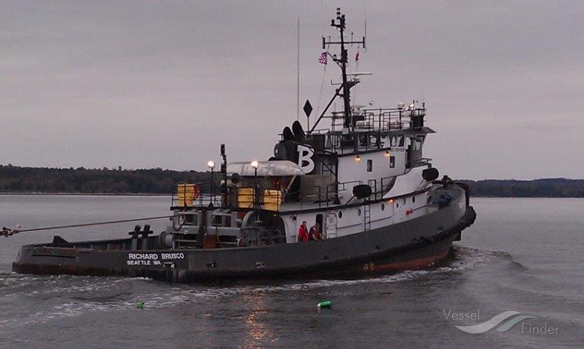
Deckhand Charlie??

