Slide 1
CyberSafety/CyberSecurity &
Smart/Autonomous Vessels
Robert G. Clyne
Sr. Vice President, General Counsel and Secretary
© Anatoly Menzhiliy / Shutterstock.com

Slide 2
Today’s Class: Integrated Closed Loop Process
Establish recognized technical standards
Review designs against Rules and standards
Confirm the vessel is built in accordance with approved plans
Verify the vessel is maintained to the accepted standards
© goodluz/Shutterstock

Slide 3
What Does Tomorrow Look Like?
Classification Becomes Wider and Deeper
CyberSafety and security
Energy and environment
Asset integrity
Data Centric Future
New inspection technologies
Smart assets
Adaptive to Changing Business Environment
Marriage of asset health, performance and class
New tools, methods and predictive analytics
Systems engineering and process design will accelerate this achievement

Slide 4
CyberSafety/CyberSecurity

Slide 5
Safety Continuum
Adding A New Dimension
Hull: Structure
Mechanical: Electrical
Cyber, Software and Smart

Slide 6
Definition: Cybersafety
Cybersafety: Guidelines and standards for computerized, automated, and autonomous systems that verify those systems are designed, built, operated, and maintained so as to allow only predictable, repeatable behaviors, especially in those areas of operation or maintenance that can affect human, system, enterprise or environmental safety.
Cybersafety depends on the deterministic behaviors that characterize well-engineered systems and enhance functional safety.
Cybersafety requires management of software integrity to reduce technical risk in software-intensive systems.

Slide 7
Class and Maritime Cybersecurity
Classification and survey are natural methods to include cybersecurity in conventional risk assessment and inspection work efforts
The maritime environment requires clear, measurable, uniform objectives – similar to Rules – for understanding and adoption
The ABS CyberSafety® program includes new methods for both Engineering and Survey to assess the safety and security of cyber-enabled systems aboard ships, at-sea assets, and shoreside facilities that serve or service those assets.

Slide 8
Value Proposition
Only 38% of global organizations claim they are prepared to handle a sophisticated cyberattack
Most cyber-related threats are preventable with the right risk-based approach and systems in place
Critical to perform risk assessments for IT and OT systems to protect vessel, crew, property and the environment
Client tools to continue self assessments
The ABS CyberSafety® program identifies risks and increases awareness of and protection from cyber threats to:
Enhance safety
Minimize productivity loss
Limit operational impact
Notes:
Speaker Notes:
ABS is focused on increasing your organization’s capabilities in defending against cyber-related threats to minimize productivity loss and limit operational impact
The statistic of 38% is sourced from 2015 Global Cybersecurity Status Report” | ISACA International
Risks in the marine environment are distinctly different from those in the onshore world and have serious consequences
The right risk-based approach can enable your organization to prevent most of the cyber-related threats
Speaker Background:
Benefits of ABS CyberSafety:
Greater assurance of reliability/integrity (and a way to measure!)
Mitigate risk to reputation, people and financial performance
Increased confidence in crew – increased awareness
Potential compliance to new regulations
Owner/investor confidence in asset and crew
Defend your operation from internal and external Cyber Threats
Share situational awareness of threats
Gain knowledge of legislation, compliance requirements and consequences of breaches
Know best practice strategy and policies
Understand Cyber Security roles and responsibilities throughout the organization
Optimize Cyber Security as a business-enabler

Slide 9
ABS CyberSafety® Simplified Process
Gap Remediation (by Client)
ABS CS1 Class Optional Notation
(ABS re-assessed)
ABS assessment
Safety

Slide 10
ABS Process
Documentation Review
Cyber Policies
Training
Incident Response Plan
Assess Crew and ship to above
Mapping of findings to ABS CyberSafety® CS levels
Non-Conformance report,
or
Provide notation/certification, if in conformance
© nopporn suntornpasert /123rf.com

Slide 11
CyberSafety Notation/Certificate
CS2 Rigorous CyberSafety Implementation
Formal systematic management of risks. Global enterprise policies and procedures implemented. The organization is fully resourced to manage the OT and/or IT cybersecurity threats and technology landscape. Effective responses to changes in risk.
CS3 Adaptive CyberSafety Implementation
(Highest Level of Readiness) Formal systematic management of risks. Global enterprise policies and procedures with demonstrable continuous improvement processes. Fully resourced to manage the IT and/or OT cybersecurity threats and technology landscape. Effective proactive responses to changes in risk.
Baseline – Limited Cybersecurity Awareness Implementation Management of risks, policies, procedures and external participation for shoreside facilities and asset not formalized.
CS1 Informed CyberSafety Implementation Informal management of risks, policies and procedures. Informal management of the OT and/or IT cybersecurity threats and technology landscape.
NOTE:
A plus appended to the notation, e.g. CS1+, matches the shoreside facility with the ship in compliance with ABS Cyber Guide

Slide 12
ABS CyberSafety® Series
Helps mitigate risks connected to cybersecurity, software quality and data integrity
ABS offers a suite of services developed specifically for the marine industry that assess levels of cyber-related risk and provides actionable guidance on ways to improve
Links OT and IT standards, and includes the company processes needed to build uniform and unified organizational security
ABS CyberSafety® series includes Guidance Notes, Guides with Optional Notations, Advisory Notes and related Publications
ABS CyberSafety®
Data Integrity
System and Cyber Test
Cybersecurity
Software Integrity
Automated and Robotic Systems Safety
Autonomous Systems Safety
Strategy, Policy and Templates
Cyber-Enabled System Processes
System Safety Assessment
Notes:
Speaker Notes:
ABS is addressing the entire Software Life Cycle, ISQM Software Development will be added this year
CyberSafety: Guidelines and standards for computerized, automated, and autonomous systems that ensure those systems are designed, built, operated, and maintained so as to allow only predictable, repeatable behaviors, especially in those areas of operation or maintenance that can affect human, system, enterprise or environmental safety.
Programs (pillars) include cybersecurity, cyber-systems test, data integrity, software integrity, automated and robotic system safety, and autonomous system safety. These consist of guides and guidance notes providing best practices and requirements for each “program”.
Foundation ‘steps’ for the programs include templates and procedures for cyber strategy and policy generation; cyber-enabled process development; and system safety assessment procedures. These documents will support the implementation, operation and assessment for each program.
(Details on the pillars are on the following slide)

Slide 13
Regulatory Cyber Initiatives
Current | Marine | Offshore
ABS CyberSafety Guides and Guidance Notes | ü | ü
USCG CG5P Policy Letter – December 14, 2016 | ü | ü
IMO Maritime Safety Committee 98 – June 7, 2017 | ü
TMSA3 Compliance for Cybersecurity | ü
BIMCO's Cybersecurity Guidelines - June 2017 | ü
UK Code of Practice, Cyber Security for Ships – Sep 2017 | ü
Increase in cyber related incidents | ü | ü
IACS Cyber Panel | ü | ü
Emerging or Evolving | Marine | Offshore
USCG regulatory guidance (e.g., draft NVIC 05-17) | ü | ü
Oil Majors/ Operator Requirements | ü | ü
Insurers | ü | ü

Slide 14
Smart/Autonomous Vessels

Slide 15
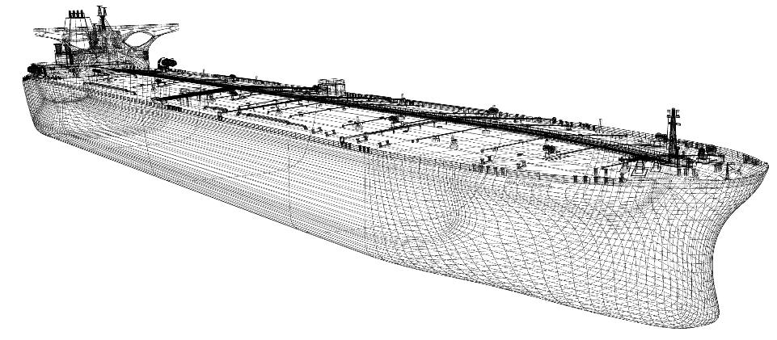
What is a SMART Vessel?
Marine Ship or offshore unit with critical function automation that supplements and augments human effort in multiple functional domains.
Significant processes include sensing in several dimensions; sensor stream processing that contributes to real-time health diagnosis/prognosis, performance management and optimization, or security management; and networking across some or all critical functions.
Automation capability provides simultaneous system control and management as well as necessary data streams to enable analytics and reporting for better and faster decisions by humans.
May have some entirely automated, or even semi-to-fully autonomous, processes that operate without human intervention. (ABS)

Slide 16
Smart Vessel Components
Smart Vessel
Technologies
Sensors and Measurement
Onboard Data Infrastructure
Data Processing and analytics
System Integration
Vessel-Shore Communication
Information System Integrity
Smart Functionalities
Structure Health Monitoring
Machinery Health Monitoring
Asset Efficiency Monitoring
Operation Performance Management

Slide 17
Definition of Autonomous Ship
Autonomous ship: marine vessel with sensors, automated navigation, propulsion and auxiliary systems, with the decision logic to follow mission plans, sense the environment, adjust mission execution for the environment, and potentially operate without human intervention.

Slide 18
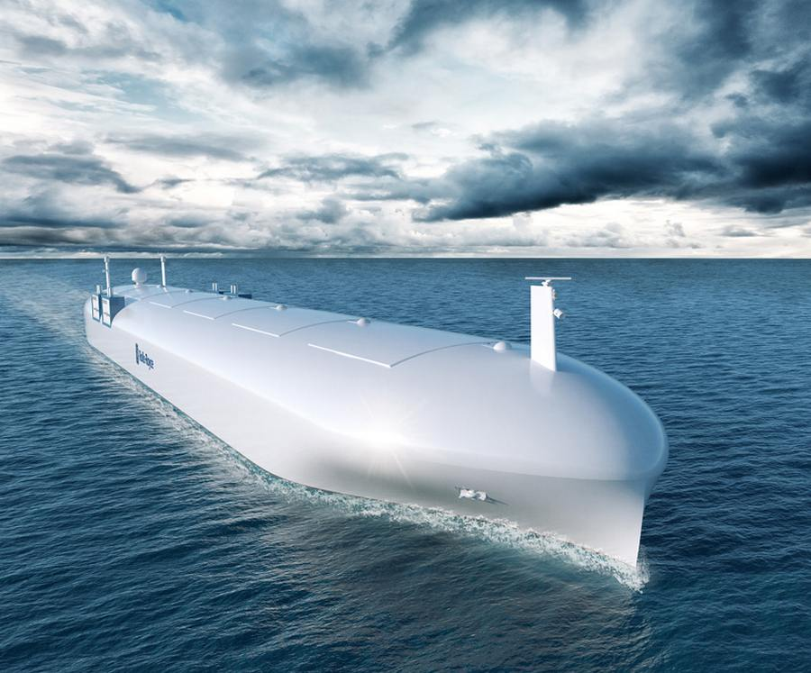
Evolution of Marine Automation
Regulatory Evolution (2002): 46 CFR 15.715 - Automated vessels
Coast Guard acceptance of automated systems to replace specific personnel or to reduce overall crew requirements is predicated upon the capabilities of the automation system, the system's demonstrated and continuing reliability, and a planned maintenance program that ensures continued safe operation of the vessel
Before 1970
1980-1995
1990-2005
2000-onwards
1970-1985
Manual Control. Manning levels are based on continuous watch requirements
Analogue Control. Manning levels reduced for US flag vessels from 45 to 21
Digital Control. 8 bit EEPROM chips with 16K of assembly code. Single motherboards that are very difficult to troubleshoot in operation
Distributed Control. Serial fieldbuses and plug in modules allowed automation of more ship processes and less disruptive troubleshooting
Networked Closed Loop Control. Real-Time Ethernet reduces control and IT network integration efforts. Unmanned machinery spaces are the norm
Courtesy of Rolls-Royce
Notes:
So the 2035 challenge, as I call it, is my personal forecast when such functionality will be present in most active vessels of the global fleet. It may be very sooner. Although many fellow engineers may argue that the technology at this level is commercially available today, artificial condition-awareness and artificial situation-awareness at vessel level, are not covered currently by IACS Unified Rules.

Slide 19
Why Autonomous Ships?
Maritime Autonomous Systems (MAS) may provide:
Reduced crew costs
Reduced at-sea accidents
Attractive work environment for the “mariner”
Potential for streamlined operations: faster port turnarounds
More efficient designs
More effective operations
Notes:
Potential reasons may include:
Completely new designs possible
Expansion of service functions beyond existing or projected organizational capabilities

Slide 20
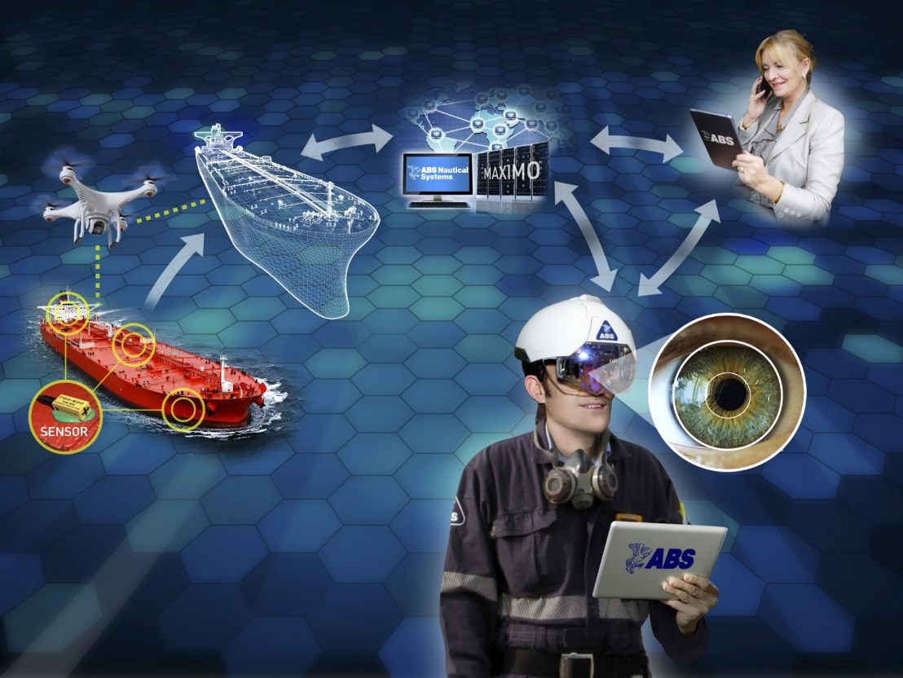
Autonomy in Three Categories
Human augmentation, doing more routine tasks with humans available for reference, supervision or override; or
Human replacement, expecting the systems to be self-sufficient without ready human capability to override
Completely new functions that implement processes outside the current organization’s abilities

Slide 21
Industry Path: Smart to Autonomous
Sensing and Monitoring
Automated
Health and Performance Monitoring
Performance Optimization
Smart
Software Integrity
Semi-
Autonomous
Cybersecurity
Machine Learning and Decision Making
Autonomy
Autonomy

Slide 22
Who is Working on it?
ABS ‘Smart Ship’ development effort
EU - Maritime Unmanned Navigation through Intelligent Networks (MUNIN)
Rolls Royce – TEKES “Advanced Autonomous Waterborne Applications Initiative”
China’s Maritime Safety Administration and Wuhan University of Technology - “Uncrewed Multifunctional Maritime Ships Research and Development Project”
DARPA ASW Continuous Trail Unmanned Vessel (ACTUV)
Marine Board

Slide 23
Smart/Autonomous Regulatory Developments
IMO regulations or recommendations for unmanned vessel operation are in beginning stages:
IMO MSC 98/20/2 (Feb 2017)L: MAAS WORK PROGRAMME (Maritime Autonomous Surface Ships)
ISO TC8 Working Group 10 “Smart Shipping”. Covers “standardization in the field of computer applications (big data and processing, IoT, sensor etc.) in shipbuilding, operation of ships and marine technology”
Testing of unmanned vessels currently limited to areas with local regulatory approval
Until global regulatory acceptance:
Near-term: short-sea travel routes
Long-term: international voyages
Notes:
MASRWG (Maritime Autonomous Systems Regulatory Working Group) based in UK aims to draft best practice regulatory framework

Slide 24
Classification Role Evolution in Smart Vessel Era
Trusted Advisor
Work with industry for smart vessel applications
Independent Verifier
Verification and validation of implementation
Quality assessment of the vendors, software, data and data analytics and AI algorithms and equipment in the aspects of functionality and quality
Data-centric, condition and prediction based, less-intrusive survey
Life-Cycle Partner
Work with owners and operators for the life-cycle asset management

Slide 25
Data-Centric Maintenance Strategy
Smart vessel function provides the condition awareness and prediction and evolves to continuous condition and prediction based maintenance strategy
- Maintenance optimization to increase the reliability and availability with potential cost savings

Slide 26
Thank you

