Slide 1
Brian Newton v. Parker Drilling Management Services, Ltd. U.S. Court of Appeals for the Ninth Circuit, No. 15-56352 Opinion entered February 5, 2018

Slide 2
FACTS OF CASE
Brian Newton was employed by Houston based Parker Drilling
Newton worked as “Roustabout” laborer and painter
Worked on drilling platforms in the Santa Barbara Channel
Undisputed the drilling platforms were fixed to the seabed of the outer Continental Shelf more than three miles offshore

Slide 3
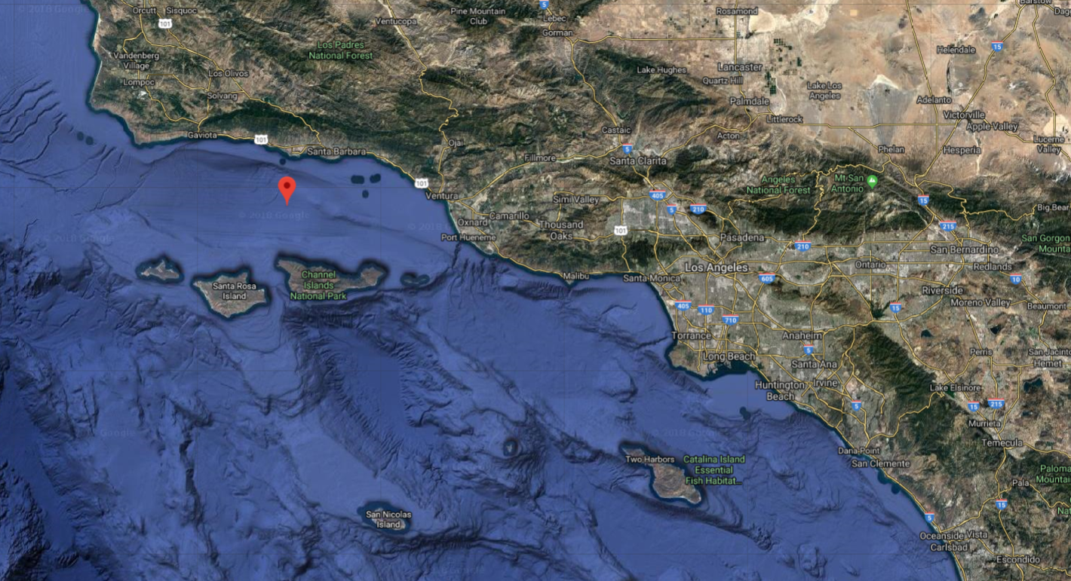
Santa Barbara Ship Channel

Slide 4
FACTS OF CASE
Newton assigned to 14 day hitches
12 hours on duty
12 hours of “controlled standby” on the platform
Paid over minimum wage for the 12 hours on duty
Not provided 30 minute lunch breaks every 5 hours per California law

Slide 5
STATE COURT ACTION
After being terminated, Newton filed a putative class action on behalf of himself and 25 others against Parker Drilling in California State Court
Alleging wage and hour violations under California law
Newton’s final paycheck did not include “overtime/doubletime and meal period wages”

Slide 6
REMOVAL AND DISTRICT COURT PROCEEDINGS
Parker Drilling removes the case to the U.S. District Court Central District of California on federal question jurisdiction – OCSLA
Assigned to U.S. District Judge R. Gary Klausner
Parker Drilling’s Motion for Judgment on the Pleadings is granted

Slide 7
DISTRICT COURT OPINION
OCSLA precludes the application of California’s minimum wage law as inconsistent with FLSA’s comprehensive statutory scheme
OCSLA is exclusively governed by federal law unless “applicable and not inconsistent” state law is needed to fill a “significant void or gap” in federal law
There are not gaps in FLSA that need to be filled with California law

Slide 8
NEWTON’S APPEAL TO THE NINTH CIRCUIT
Newton argues an issue of first impression: OCSLA’s choice of law provisions in a wage and hour dispute
43 U.S.C.§1333(a)(2)(A):
“To the extent they are applicable and not inconsistent with this … or other Federal laws… the civil and criminal laws of each adjacent State… are declared to be the law of the United States for that portion of the subsoil and seabed of the outer Continental Shelf, and artificial island and fixed structures erected thereon, which would be within the area of the State if its boundaries were extended seaward…”

Slide 9
PRIOR AUTHORITY
Newton:
Union Texas Petroleum Corp. v. PLT Engineering, Inc., 895 F.2d 1043 (5th Cir. 1990)
Parker Drilling:
Continental Oil Co. v. London S.S. Owners’ Mut. Ins. Ass’n, 417 F.2d 1030 (5th Cir. 1969)

Slide 10
FLSA SAVINGS CLAUSE
29 U.S.C.§ 218(a)
“No provision of [FLSA] excuse[s] noncompliance with any Federal or State law … establishing a minimum wage higher than the minimum wage established under [FLSA] or a maximum workweek lower than the maximum workweek established under [FLSA].”

Slide 11
9th CIRCUIT ANALYSIS
Text and legislative history of OCSLA
The meaning of “not inconsistent”
Whether California minimum wage and overtime laws are inconsistent with federal law

Slide 12
9th CIRCUIT HOLDING
“we hold that state wage and hour laws are adopted as surrogate federal law on the OCS as long as they are ‘applicable and not inconsistent’ with existing federal law.”
“the absence of a federal law is not, as the district court concluded, a prerequisite to adopting state law as surrogate federal law under [OCSLA]”
FLSA’s savings clause permits more protective state wage and hour laws

Slide 13
9th CIRCUIT HOLDING
“Applicable” does not equate to “necessary”
“significant void or gap does not mean the complete absence of any federal law as a prerequisite to the application of state law”
California’s wage and hour laws apply to platforms subject to OCSLA
9th Circuit vacates the order dismissing Newton’s claims and remands to the district court

Slide 14
SUBSEQUENT HISTORY
Pending petition for rehearing en banc, filed on March 22, 2018 by Parker Drilling
Numerous amicus briefs submitted in conjunction with petition for rehearing

Slide 15
IMPACTS OF RULING
Practical considerations for employers
Possibility of additional class actions
Circuit Split

Slide 16
Questions or Comments?
Barrett Hails Phelps Dunbar LLP barrett.hails@phelps.com 251-441-8215

