Slide 1
Superyacht Purchase Contracts: There’s A New Kid In Town
Robert N. Allen Jr.
Robert Allen Law
Miami | Palm Beach | Fort Lauderdale | New York | Texas
October 18, 2018

Slide 13
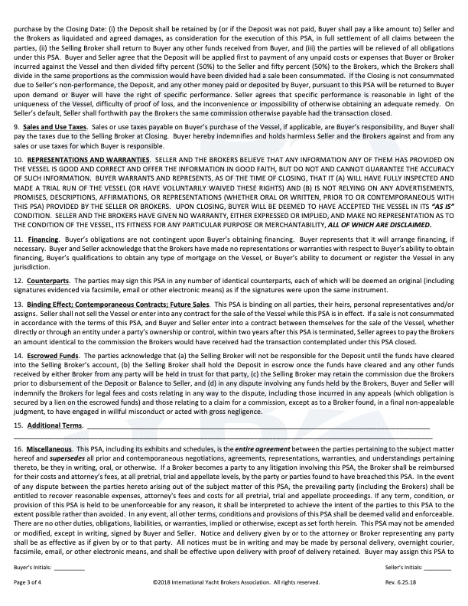

Slide 14
