Slide 1
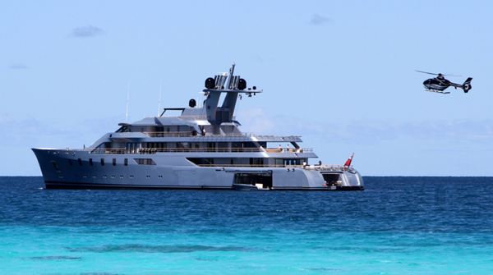
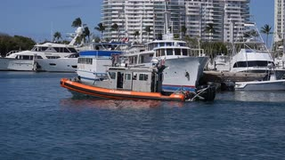
Super Yachts
(Recreational vessels over 300 GT)
Presentation for the Maritime Law Association
2018
Mr. Jeff Bray
Deputy, Office of Maritime and International Law (CG-LMI)

Slide 2
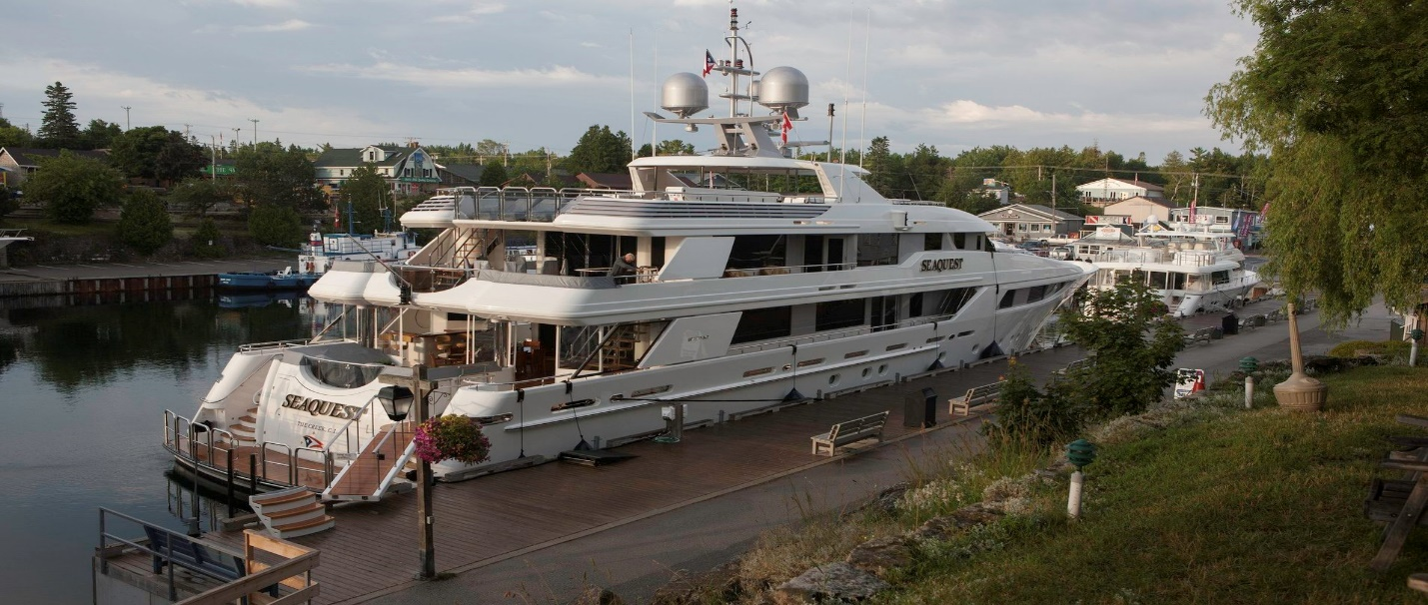
National Defense Authorization Act FY2019: “Super Yacht” section 3529
In the NDAA Congress required the US Coast Guard:
to issue new regulations for “large recreational vessels” that are over 300 gross tons (or measured under alternative tonnage standards under Title 46);
Report has been made that at least one vessel planning on using this new provision is planned to be 4,000 GT

Slide 3
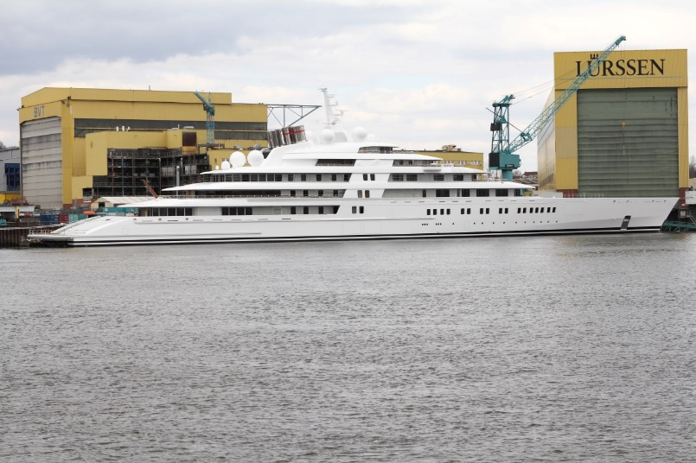
These “large recreational vessels” will be statutorily exempted from inspection under 46 USC s 3302
Congress also required that vessel owner’s disclose their identification and place of residence to the Coast Guard
Prior to the issuance of any final regulations, the Coast Guard these vessels remain exempt from inspection, and the Coast Guard is instructed to apply the U.K.’s “Large Commercial Yacht Code, 2013” or an “equivalent” code, regulation or standard.

Slide 4
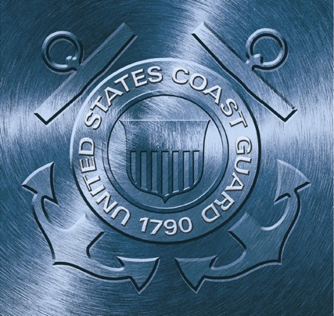
Questions?
Thank you!

