Slide 1
PUNITIVE DAMAGES FOR SEAMAN UNSEAWORTHINESS CLAIMS
Batterton v. Dutra Group
880 F.3d 1089 (9th Cir. 2018)
Greg Singer
GSinger@BoatingLaw.com
443-716-4400
Lochner Law Firm, P.C.
www.BoatingLaw.com
Notes:
Attorney @ Todd’s
Spent mid-20’s living, cruising, working on boats in Caribbean

Slide 2
Batterton v. Dutra
Dutra Holding and Case Evaluation
Case History Leading to Circuit Split
Practice Points
Supreme Court Prognostication
Notes:
Here are the topics we’re going to cover in this section

Slide 3
Batterton v. Dutra
Punchline: Punitive Damages Available for Seaman
…
On GML Unseaworthiness Claims
…
(Depending on your Circuit)
Notes:
Here are the topics we’re going to cover in this section

Slide 4
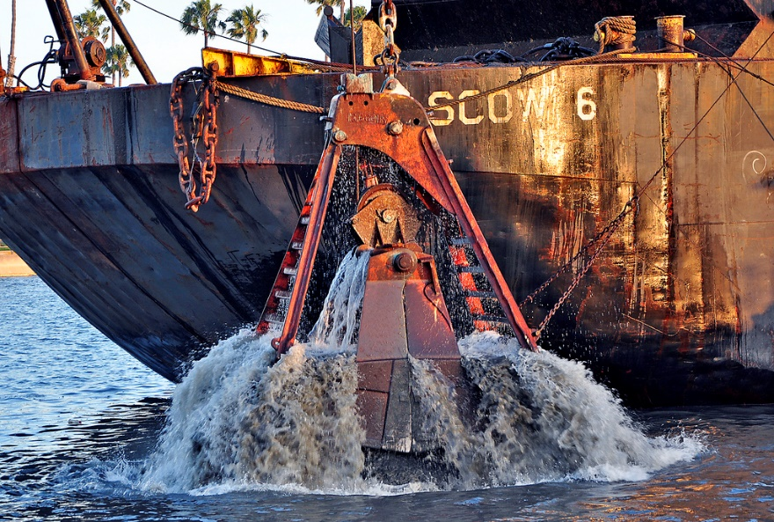
Dutra – Case Facts
Plaintiff Batterton worked as seaman deckhand on Dutra fleet
Working on Scow 3, pumping air into compartment
Notes:
Here are the topics we’re going to cover in this section

Slide 5
Dutra – Case Facts
Compartment being compressed lacked exhaust system
Hatch blew open, hand crushed
Sued Dutra in C.D. California for 1- Jones Act Negligence 2- M&C 3- Unseaworthiness
With Punitive Damages for Unseaworthiness
Notes:
Punitive damages was on grounds that the compartment should have had an exhaust system; pumping air into closed compartment without proper ventilation/exhaust system is pretty much putting a bomb

Slide 6
Dutra – Procedural History
Defendant Dutra moves to strike/dismiss punitive damages from complaint
Argues that Miles ’90 bars non-pecuniary damages
Plaintiff Batterton argues that Miles restricted to wrongful death
District Court finds punitive available, affirmed by 9th Cir.
Notes:
Defendant argues that that Miles ’90 is unequivocal that seaman can’t get non-pecuniary damages. Miles only addressed death but McBride ‘14 extended that analysis to seaman injuries
Plaintiff argues Miles restricted to wrongful death – and there’s pre-Miles case law in the 9th that allows punitives for seaman injuries

Slide 7
History of Remedies
Moragne v. States Marine Lines, Inc., 398 U.S. 375 (1970)
Longshoreman killed in state waters, widow sues for wrongful death on unseaworthiness claim
SCOTUS overrules The Harrisburg to create GML unseaworthiness wrongful death action in territorial waters
Does not state what remedies are available, or who may recover as beneficiary – leaves to percolate in the circuits
Notes:
9th Circuit didn’t wake up one morning and decide to push Atlantic Sounding to unseaworthiness claims. To understand rationale need to wade through history of GML wrongful death/injury remedies
Has anyone had a Yamaha-like case? Territorial waters GML wrongful death claim of non-seaman?
Remedies in such a case are wild west- many circuits haven’t decided issue, some circuits limited to funeral expenses, some give loss of society, some future earnings even for non-dependents.
Dependency is a huge issue in these cases.
As we briefly go through some landmark cases we see a very expansive remedies structure growing in the 9th Circuit which in some ways is on a collision course with the 5th.

Slide 8
History of Remedies
Evich v. Morris, 819 F. 2d 256 (9th Cir. 1987)
Seaman killed in Alaska state waters
Non-dependent brothers sued for future wages and punitive damages on unseaworthiness claim
Ninth Circuit ruled non-dependents could recover for future earnings and punitive damages
Notes:
After Moragne, we see circuits struggling with what GML remedies are and which beneficiaries are entitled to them.
Fishing vessel capsized
As of then, no question that punitives available for seamen in 9th Circuit

Slide 9
History of Remedies
Miles v. Apex Marine Corp., 498 U.S. 16 (1990)
Seaman killed by fellow crew member in port, widow sued for wrongful death on unseaworthiness claim
Explicitly held that Moragne action applied to seamen
Held that loss of society (i.e., non-pecuniary) damages not recoverable by widow on Moragne action.
Rationale: Jones Act allows recovery only for pecuniary loss
Notes:
Jones Act precludes recovery for loss of society, so Supreme Court felt it would be inconsistent to sanction more remedies in judicially-created unseaworthiness than Congress
So after Miles, you’ve got a Supreme Court case saying that seamen can only get pecuniary losses on wrongful death suit. But 9th Circuit held that seamen can get punitive damages, which we generally think of us non-pecuniary damages. So is Evich overruled? That’s the question that subtends Dutra and will be issue before Supreme Court if cert granted.

Slide 10
History of Remedies
Sutton v. Earles, 26 F.3d 903 (9th Cir. 1994)
Teenagers on jetski boat struck Navy mooring, died
Held that loss of society (i.e., non-pecuniary) damages and future earnings recoverable by parents on Moragne action.
Distinguished Miles as applying only to seamen
Notes:
Following the 9th circuit “down the rabbithole” from Evich we see hugely expansive remedies in the 9th.
The “Whiskey Runner” – unsurprising that driver had been drinking over the limit.
This is probably high-water mark for plaintiff’s damages on Moragne action – full non-pecuniary and even future earnings for non-dependent parents

Slide 11
History of Remedies
Atlantic Sounding Co., Inc. v. Townsend 557 U.S. 4040 (2009)
Deckhand on tugboat injured, employer refused to pay Maintenance and Cure
District court allowed punitive damages on M&C claim, following pre-Miles 11th Cir. precedent.
Reasoned that Miles restriction to Jones Act remedies does not apply to M&C, because it predates and is not addressed by Jones Act
Dissent on grounds that Court should give strong deference to policy choices reflected in statutes on closely related claims.
Notes:
Supreme Court took the case to resolve post-Miles split with 5th Cir.
Supreme Court found that the point of the Jones Act was to create a maritime wrongful death claim for seaman, so in Miles, where congress created the wrongful death claim, the courts would have to follow congress’s limitations on the claim in Moragne seaman actions. Wrongful death claim under Moragne was years after Jones Act, so the new action looks to the statute for remedies guidance.
But Maintenance and Cure (a) predated the Jones Act, and (b) the Jones Act doesn’t address M&C or its remedies. So since Jones Act is essentially remedy-granting in nature, it did not take away from age-old M&C and punitives
5-4 decision, strong dissent is that where congress said Jones Act doesn’t get punitives for Jones Act claims, that should be applied uniformly to all seaman’s claims.

Slide 12
History of Remedies
McBride v. Estis Well Service, 768 F.3d 382 (2014)
Seaman killed and others injured on oil rig in territorial waters
All brought GML unseaworthiness actions seeking punitive damages
En Banc panel followed Townsend and found that Miles restriction did not apply to unseaworthiness claims
Second En Banc panel reversed, leaning heavily on FELA for proposition that Jones Act controls remedies for wrongful death of seaman
Basic tension is whether to defer to Congress on seaman remedies
Also denied “throw-away” argument on whether punitives are “pecuniary”
Notes:
Remember that in Townsend, court’s rationale was that M&C and Punitive damages both predated Jones Act and so are not addressed by JA, so they were not abrogated by it.
First en banc Apply the same analysis – unseaworthiness predates and is not addressed by JA, so it does not abrogate it.
Second en banc said shouldn’t look at this under the rubric of unseaworthiness, but rather the rubric of wrongful death. Wrongful death did not predate JA and is addressed by JA, so it precludes punitive damages

Slide 13
Dutra – 9th Circuit Appeal
Primarily guided by Evich ’87
Holds that punitive damages are not “non-pecuniary” under Miles
Declined to follow 5th Circuit’s first En Banc holding
Applies equally to wrongful death and injury
Notes:
Primarily guided by Evich ’87 – non-dependent brothers could get punitive damages
Miles was about loss of society – Dutra wasn’t even sure that extended to all non-pecuniary, but was certain it didn’t extend to non-compensatory. Distinguish between pecuniary and punitives via compensatory.
Delcined to follow 5th Circuit’s en banc - that unseaworthiness predated and was not abrogated by Jones Act
Court agreed that Miles taken alone might be read to suggest bar to punitives, but Townsend means we need to read Miles narrowly and “non-pecuniary” does not include punitive damages

Slide 14
Dutra – 9th Circuit Appeal
Holding: Seamen may recover punitive damages on unseaworthiness claims, whether wrongful death or injury.
Explicitly considered and split with 5th Circuit on this issue
Notes:
Throwing down gauntlet to 5th circuit and begging court for cert. to resolve split

Slide 15
Practice Points
Forum shopping: 9th and 11th vs. 1st, 5th, 6th
Insurance coverage of punitive damages
Some states bar insurability of punitive damages
Increased risk assessment and remedy
Notes:
Plaintiffs- if have choice, probably malpractice to sue in 1st, 5th or 6th if punitives on the table and other venues available. 9th firm and 11th weakly in support of punitive damages on these claims.
Insurance policies – haven’t looked at many but I’m guessing Jones Act-specific policies probably don’t provide for punitives. Maritime employers in 9th, 11th will want to get coverage if possible. If plaintiff, find out early if defendant can’t pay award
In many states it’s against public policy to insure punitive damages – and states also distinguish between directly assessed and vicariously assessed punitives. Wilburn boat would most likely control, look to state law. Don’t want to win a case to find out it’s against public policy for insurance to pay out the punitives

Slide 16
Supreme Court Prediction
Dutra has not filed for cert but likely will
SCOTUS already denied cert in appeals of McBride and Tabingo, January 2018
Ninth Circuit avoided Constitutional issue by parsing “pecuniary”
Fifth Circuit En Banc deeply split on McBride, SCOTUS split 5-4 on Tabingo
Constitutional questions – Congress v. Courts
Notes:
Plaintiffs- if have choice, probably malpractice to sue in 1st, 2nd, 5th or 6th if punitives on the table and other venues available
Insurance policies – haven’t looked at many but I’m guessing Jones Act-specific policies probably don’t provide for punitives. Maritime employers in 9th, 11th will want to get coverage if possible. If plaintiff, find out early if defendant can’t pay award
In many states it’s against public policy to insure punitive damages – and states also distinguish between directly assessed and vicariously assessed punitives.
Wilburn boat would most likely control, look to state law. Don’t want to win a case to find out it’s against public policy for insurance to pay out the punitives

Slide 17
Townsend - Justices
Opinion
Dissent
Notes:
Trying to guess what SCOTUS might do, helpful to look at Townsend
Opinion: Thomas, Souter, Stevens, Ginsburg, Breyer
Dissent: Roberts, Kennedy, Alito, Scalia

Slide 18
Townsend - Justices
Opinion
Dissent
Notes:
Opinion: Thomas, Ginsburg, Breyer
Dissent: Roberts, Kennedy, Alito,
Unknown: Sotomayor, Kagan, Gorsuch
Sotomayor actually knows some maritime law from serving on SDNY and 2nd circuit.
Gorsuch may want to stand with more conservative brethren .
If court takes it they could either:
1- Take up 5th Circuit en banc argument that unseaworthiness predates and isn’t affected by Jones Act
2- Punt with 9th Circuit’s parsing of pecuniary to not encompass punitive damages (and open door wide for punitives where not expressly disallowed)
3- Hold that congress’s remedies should be followed in GML actions (broad, possibly overturn Townsend?

