Slide 1
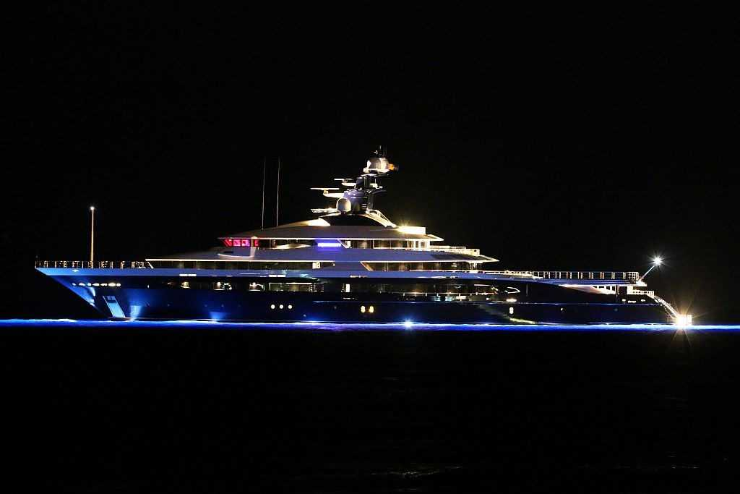
Yacht Finance Market Update Maritime Law Association
G. Robert Toney
Co-Chair, Yacht Finance Committee
May, 2019
Source: CharterWorld.com

Slide 2
NMLA Reports
Marine Lending Now Stable to Growing Since 2012
National Banks
Regional Lenders Expanding
Credit Unions
FinTechs/Online Lenders

Slide 3
New Entries/Market Changes
Flagstar Bank (MI) re-entered boat lending in early 2018
Wells Fargo and Bank of America still show an interest to re-enter retail boat lending
SunTrust/BB&T Merger
MB Financial/Fifth Third Merger

Slide 4
Today’s Marine Lenders
Aqua Finance
BankOZK (formally Bank of the Ozarks)
Bank of the West
Banterra Bank
Branch Banking & Trust Company (BB&T is acquiring SunTrust)
Community First Bank
Georgia's Own Credit Union
Huntington Bank
Independent Bank Corporation
L-H Finance
MB Financial Bank (merging with Fifth Third Bank)
M&T Bank
Medallion Bank
Merrick Bank
North Cascades Bank
Radius Bank
Shore Premier Finance (Centennial Bank)
SunTrust Bank (Marine & RV Finance; merging with BB&T)
US Alliance Federal Credit Union
US Bank

Slide 5
Floorplan Lenders
Wells Fargo Dealer Finance-Market Leader
Bank of the West
BB&T
L-H Finance
M&T Bank
Shore Premier (Centennial Bank)

Slide 6
NMBA 2017 Survey
88% Reported Increased Loan Activity
Pre-owned yachts were 66% of Loan Volume ($)
2018 “Boat” sales up 4% over 2017 (NMMA)
Yacht Sales Increases Reported higher (Broker Reports)
-Burgess +10%
-IYC +25%

Slide 7
Economic/Regulatory
Tax Cuts/Employment
Tariffs
Regulations
Delinquency 0.45%/Charge offs 0.26%

Slide 8
NMLA Update
2018 Report Due July 2019 www.marinelenders.org/annual-report
2019 Annual “40th” Annual Conference
Ocean Reef Club, Key Largo
November 10-12, 2019
2020 Marine Lending Workshop
Spring 2020 (Dates/Venue TBD)
Thank you to Jim Coburn & the National Marine Lenders Association

