Slide 1
Choice of law and liability considerations arising from the 2015 Dauphin Island Race
Barrett Hails Phelps Dunbar LLP 101 Dauphin Street, Suite 1000 Mobile, AL 36602 Direct: 251-441-8215 Email: barrett.hails@phelps.com

Slide 2
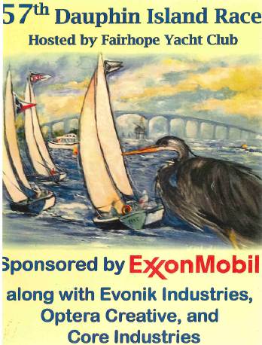

Slide 3
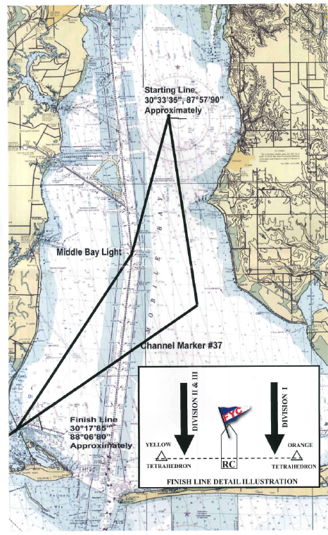

Slide 4
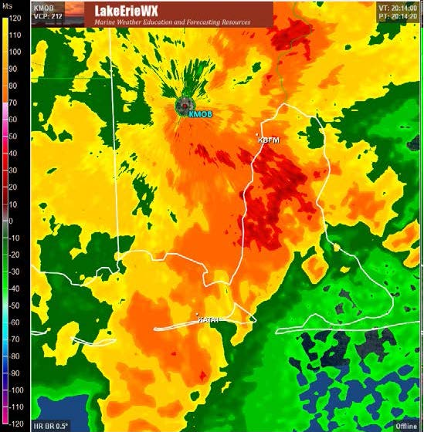

Slide 5
Factual Background of the Henry v. FYC Litigation
Vessel: NONO9 - CAL 24 owned by Robert Delaney
5 souls aboard
Encountered thunderstorm with full main, partially furled jib, companionway open
Vessel was knocked down, rolled, and lost
2 with life jackets perished, 3 without survived

Slide 6
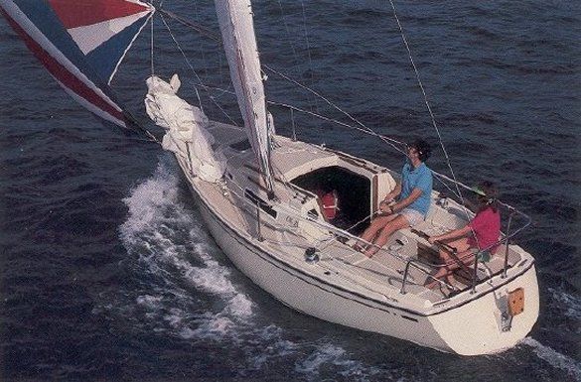

Slide 7
Factual Background of the Henry v. FYC Litigation

Slide 8
Factual Background of the Henry v. FYC Litigation
Non-seafarer
Killed in the territorial waters of the State of Alabama
No DOHSA, No Jones Act, No LHWCA

Slide 9
Legal Background of the Henry v. FYC Litigation
Suit filed in Circuit Court of Mobile County, Alabama
Asserting wrongful death claims against FYC
Alabama’s Wrongful Death Statute—Ala. Code§6-5-410
No general maritime law claims

Slide 10
Legal Background of the Henry v. FYC Litigation
Alabama’s wrongful death statute is unique in that it:
“is the only one of all the fifty states that provides for punitive damages only…and allows for the recovery of punitive damages on a showing of mere negligence.”
In re Amtrak Sunset Ltd., 121 F.3d 1421, 1425 (11th Cir. 1997)

Slide 11
Legal Background of the Henry v. FYC Litigation
In re Amtrak Sunset Ltd., 121 F.3d 1421, 1426-27 (11th Cir. 1997)
Alabama’s Wrongful Death Statute conflicts with general maritime law:
“insofar as such Alabama statute provides for the recovery of punitive damages for simple negligence only and prohibits apportionment of fault and damages among joint tortfeasors.”
Yamaha Motor Corp., U.S.A. v. Calhoun, 516 U.S. 199 (1996)
Choat v. Kawasaki Motors Corp., 675 So. 2d 879 (Ala. 1996)

Slide 12
FYC’s Motion for Partial Summary Judgment
The case is subject to maritime law which conflicts with substantive Alabama state law
Conflicting Alabama state law cannot supplement maritime law
The available damages are only those provided by maritime law
Claims for punitive damages based on “mere negligence” under Alabama’s Wrongful Death Statute are to be dismissed

Slide 13
The Court’s Order

Slide 14
The Court’s Order
The case is subject to maritime law
Conflicting Alabama state law CAN supplement maritime law
The available damages are those provided by maritime law and by Alabama’s Wrongful Death Statute, including punitive damages
Loss of society damages are not recoverable for a non-seafarer killed in territorial waters under maritime law

Slide 15
Considerations for Yacht Clubs
U.S.C.G. Permit
Support vessels
“Safety Plan”
“Weather plan”
Skipper’s meeting
Communications with competitors during the race

Slide 16
Considerations for Yacht Clubs
Role of the U.S. Sailing Association’s Racing Rules of Sailing
Rule 1.2 – “Each competitor is individually responsible…”
Rule 4 – “responsibility for a boat’s decision to participate in a race or to continue racing is hers alone”
Role of the U.S. Sailing Association’s Race Management Handbook
Role of Rule 82 of the Racing Rules of Sailing

Slide 17
Final Thoughts:
Do bad facts make bad law in the recreational context?
Are the historical obligations of the skipper/master eroded in the recreational context?

