Slide 1
What You Need to Know About the Jones Act
Stephen B. Johnson Marjorie F. Krumholz
Erin L. Eliasen Thompson Coburn LLP
Garvey Schubert Barer
October 22, 2015

Slide 2

The “Coastwise Laws”
Vessels operating within the territorial boundaries of the United States (and sometimes beyond!) must be “coastwise qualified”
  Movement of “merchandise”
  Movement of people: “passengers”
  Towing
  Dredging

Slide 3

Coastwise Qualified Vessels
    Owned by United States citizens
    Built in the United States
    Documented under U.S. flag with a Coastwise Endorsement (or, if exempt, otherwise eligible)

Slide 4
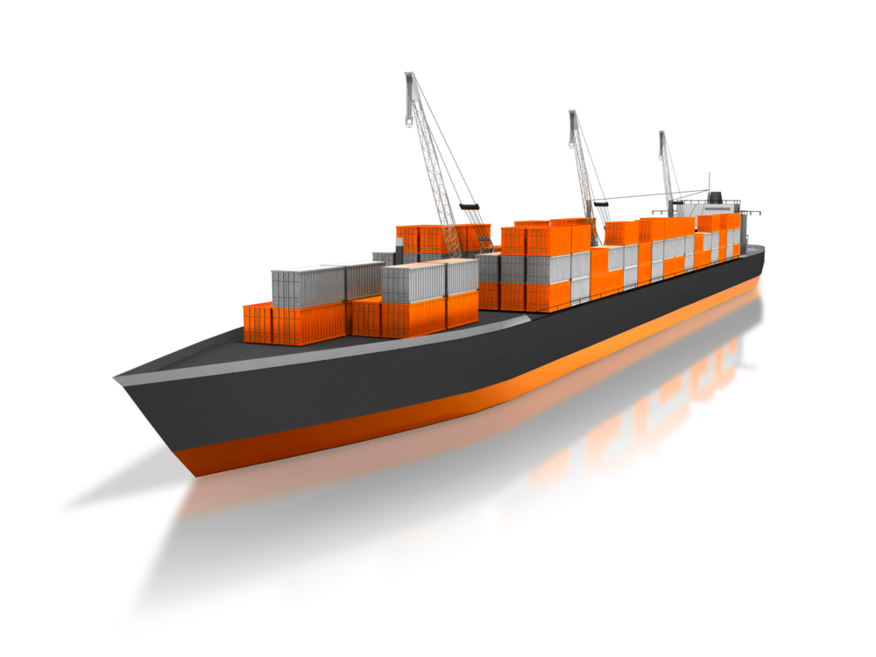
Movement of Merchandise
The Jones Act -- Section 27 of the Merchant Marine Act of 1920 – now codified at 46 U.S.C. 55102(b)
  The model for all of the “coastwise laws”
  Governs the movement of “merchandise”

Slide 5
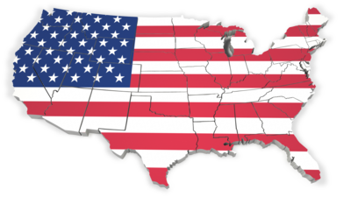

The Jones Act Text
“[A] vessel may not provide any part of the transportation of merchandise by water, or by land and water, between points in the United States to which the coastwise laws apply, either directly or via a foreign port, unless the vessel – (1) is owned by citizens of the United States for purposes of engaging in the coastwise trade; and (2) has been issued a certificate of documentation with a coastwise endorsement . . . or is exempt from documentation but would otherwise be eligible for such certificate and endorsement.

Slide 6

What does it mean?
"When I use a word," Humpty Dumpty said, in rather a scornful tone, "it means just what I choose it to mean—neither more nor less.“
  Through the Looking Glass, Lewis Carroll
You cannot understand the Jones Act’s words simply by reading them; you have to know what the agencies say the words mean.

Slide 7

Agencies Responsible for Interpretation of the Jones Act
U.S. Coast Guard: Which vessels are “coastwise qualified”
Customs & Border Protection: Which activities are restricted by the Jones Act

Slide 8
“Merchandise”
As a practical matter, any tangible item except:
  Vessel equipment
  Personal effects of crew
  Ship’s stores (consumables used aboard the vessel)
Includes “valueless material”

Slide 9
“U.S. Points”
U.S. “Coastwise Points”: All points within the United States
  All points within the “territorial sea” (within the 3-mile limit)
  All “internal” and “inland” waters
  Generally does not include points within the Exclusive Economic Zone (197-mile zone adjacent to the territorial sea)
    Except (1) valueless or dredged material; and (2) facilities affixed to the Outer Continental Shelf for the purpose of resource exploration

Slide 10
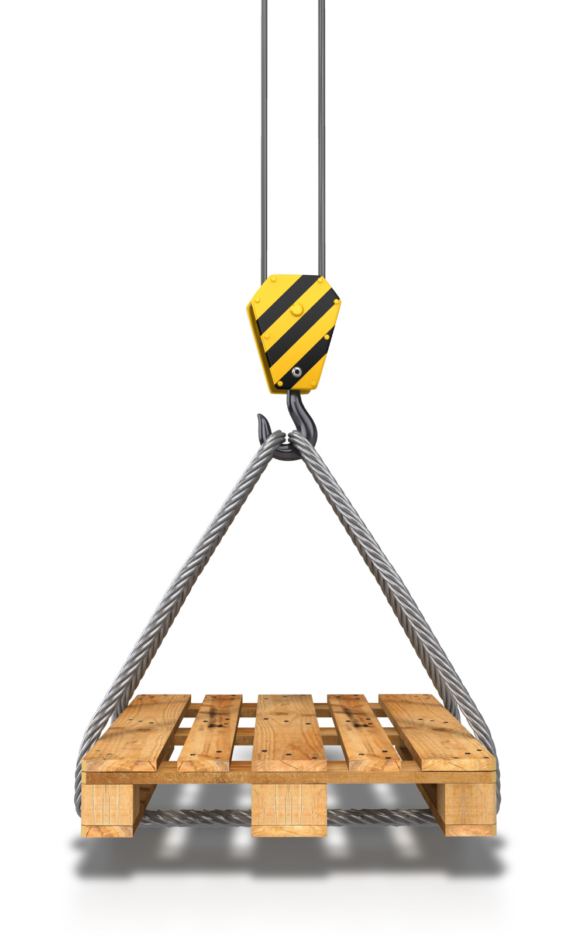
“Transportation”
“A coastwise transportation of merchandise takes place, within the meaning of the coastwise laws, when merchandise laden at a point embraced within the coastwise laws (‘coastwise point’) is unladen at another coastwise point, regardless of the origin or ultimate destination of the merchandise.”
    CBP: 19 CFR 4.80b.
Some exceptions

Slide 11
Exceptions to “Transportation”
Substantial Transformation
Fuel Blending rulings
Break in Transit
Canadian Rail Lines

Slide 12
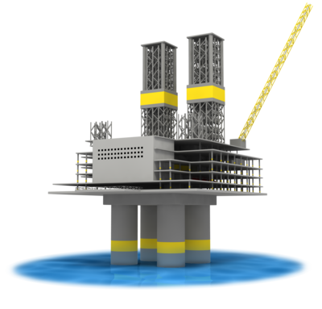
Distinguish Work Platforms, Crane Barges, Pile Drivers
So long as no “merchandise” is moved between U.S. points on the vessel, the Jones Act does not apply

Slide 13

“U.S. Citizen"
To be “coastwise qualified,” a vessel must be “wholly owned by citizens of the United States for purposes of engaging in the coastwise trade.”
Entities can be “U.S. citizens”

Slide 14
Citizenship of Entities
A partnership or corporation formed under U.S. law is a citizen if 75% of its equity is owned by U.S. citizens, and:
  Partnerships: All general partners are U.S. citizens
  Corporations: President/CEO and Chairman are to be U.S. citizens; no more than a minority of the directors necessary for a quorum of the Board are non-U.S. citizens
Non-citizens may not “control”

Slide 15
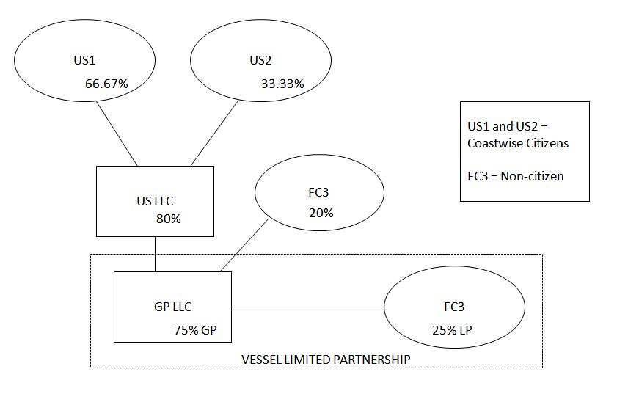
Non-Citizen JV Partners in Marine Construction

Slide 16
Effect of Warrants Issued to Noncitizens
Non-citizens may acquire warrants that allow them to realize more than 25% of the economic value of a Coastwise Citizen entity
May mimic equity in some circumstances

Slide 17

Lease Financing
Since 1996, but revamped in 2004 because of loopholes
Allows leasing companies, banks and financial institutions that do not qualify under §50501 to own vessels that operate in the coastwise trade
Vessels documented pre-2004
have certain grandfathered rights

Slide 18
Requirements for Lease Financing
Lessors
  Must be “documentation citizens”
  Must own or hold a beneficial interest in the vessels solely as a passive investment
  Cannot operate vessels for hire and cannot be affiliated with a person that operates vessels for hire
  Must be independent from, and not an affiliate of, any charterer of the vessels or any other person that has the right to directly or indirectly control or direct the movement or use of the vessels

Slide 19
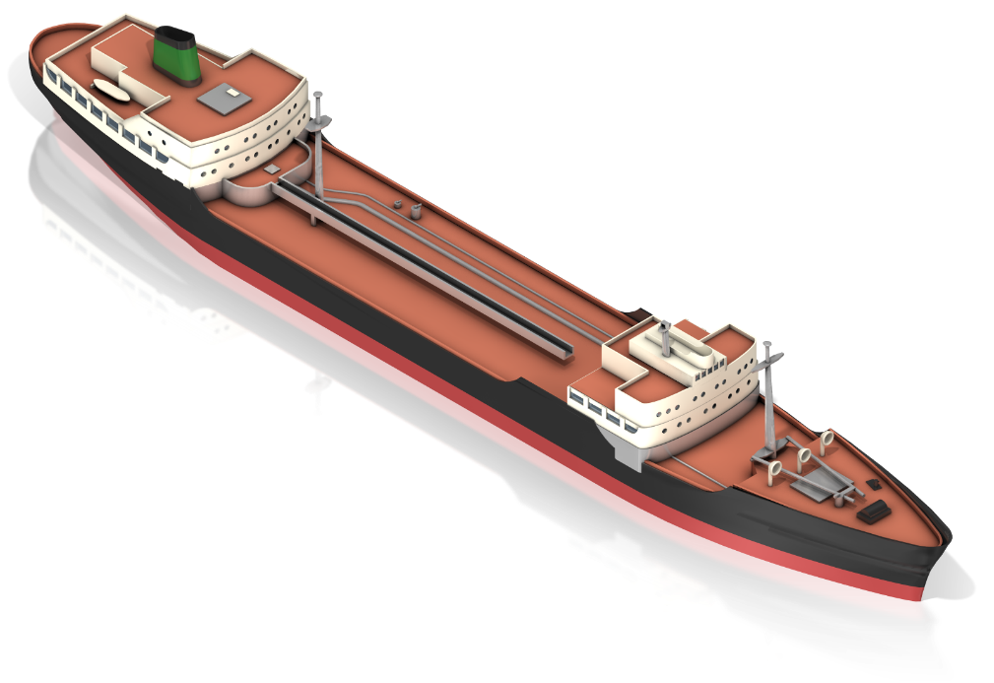
Requirements for Lease Financing
Additional requirements
  Bareboat charters must be for a term of at least three years
  Bareboat charterer must be considered the owner of the vessel pro hac vice

Slide 20

Requirements for Lease Financing
Under lease financing, the “non-affiliation” test is applied world-wide
What does it mean to “operate” a vessel
under lease financing?
  Defined as “all activities related to the use of vessels to provide services” (46 CFR §68.55)
  Includes ship brokerage, crewing, vessel maintenance, and time charters
  Does not include activities associated with making financial investments in vessels

Slide 21

“U.S. Built”
“To be considered built in the United States a vessel must meet both of the following criteria:
  (a) All major components of its hull and superstructure are fabricated in the United States; and
  (b) The vessel is assembled entirely in the United States.”
  46 CFR 67.97

Slide 22
How Much Foreign Work is Too Much?
Extent of Permitted Foreign Shipyard Work?
Extent that foreign modules/components may be installed in the U.S.?
See 46 CFR 67.177
See CG U.S. Build and Foreign Rebuild Determinations (now published on the NVDC website)

Slide 23
Impermissible Foreign Work
A major component of the hull or superstructure, not fabricated in the U.S., is added to the vessel (the “major component test”)
Any considerable part of the hull or superstructure is built upon or substantially altered outside the U.S. (the “considerable part test”)

Slide 24

The Major Component Test
What is a “component”?
  “Separable;” built apart from the vessel and installed as a completely constructed unit (distinguish piece by piece steel work)
What makes it “major”?
  Weight exceeds 1.5% of
  the vessel’s steelweight

Slide 25
The Considerable Part Test
Alteration of the hull or superstructure that adds steel = more than 10% of the vessel’s prior steelweight
  Vessel is considered rebuilt
Alteration of the hull or superstructure that adds steel = more than 7.5% but not more than 10% of the vessel’s prior steelweight
  CG “may” deem the vessel rebuilt

Slide 26
The Considerable Part Test (cont’d)
Alteration of the hull or superstructure that adds up to 7.5% of the vessel’s prior steelweight
  Vessel is not considered rebuilt
46 CFR 67.177(b)
Shipbuilders Council of America case

Slide 27

Assembled Entirely in the U.S.
Applies to the total vessel, not its components
Components that are not structural parts of the hull and superstructure may be fabricated outside the U.S.
Philadelphia Metal Trades Council case

Slide 28
Shipbuilders Council of America v. US Coast Guard (4th Cir.2009)
Applied major component & considerable part tests
Challenge to Coast Guard pre-construction review and determination that installing a double hull in China on a Jones Act qualified vessel did not result in the vessel being rebuilt foreign
Court reversed Coast Guard ruling

Slide 29
Philadelphia Metal Trades Council v. Allen (E.D.Pa. 2008)
Court upheld a Coast Guard determination that installing foreign built engine room related macro modules would not cause a vessel to be ineligible for coastwise endorsement
Relevant regulation: 46 C.F.R. 67.97 – “entirely assembled”
Philadelphia Metal and Shipbuilders Council illustrates that Coast Guard determinations on several issues are subject to judicial review and though courts typically give substantial deference, it is not unlimited

Slide 30
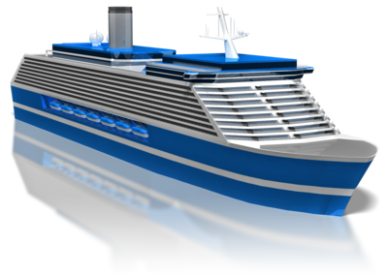
Other Coastwise Laws
Passenger Vessel Services Act
  Transportation of “passengers”
  between “ports or places
  in the United States”
Towing Statute
  Valueless or dredged material: EEZ is a U.S. point
  (Contrast Ship Escort/Ship Assist Statute)
Dredging Statute

Slide 31

Civil Penalties
Jones Act Penalties
  $15,000/day
  Seizure and forfeiture of the vessel
    Operation without a coastwise endorsement
    Operation with a coastwise endorsement obtained as a result of the knowing falsification or concealment of a material fact by the owner or its representative

Slide 32

Civil Penalties
Passenger Vessel Services Act Penalties
  $300/passenger
Towing Statute
  $350 minimum; $1,100 maximum penalty imposed on owner and master
  $60/ton measured by the tonnage of each vessel towed imposed on the towing vessel
Dredging Statute
  Seizure and forfeiture of the vessel

Slide 33

Application of Penalties
Customs & Border Protection
has provided guidelines for
penalties and the mitigation
thereof.
  In cases of emergency to a vessel (such as a hurricane), the Guidelines provide that no penalty will be higher than $100,000
  If neither distress nor humanitarian reason is present, the violation will be deemed to be for “commercial expediency” and no limit will be applied, except by statute.

Slide 34
Mitigation Guidelines (Jones Act)
Mitigation of a penalty normally 10% for a first violation that is not “aggravated”.
Examples of aggravating factors:
  A second or subsequent violation, a violation that occurred after being informed that the anticipated transportation would constitute a violation, or premeditation.

Slide 35
Mitigation Guidelines (Jones Act) Cont’d
CBP reserves the right to impose a penalty that would offset any economic gain that the violator received as a result of the violation.
Example, “if the normal mitigated penalty amount were 10% of the domestic value of the cargo illegally transported, or $15,000, but the vessel avoided costs of $30,000 by committing the violation as a commercial expedient, then CBP could take a mitigated penalty of $30,000, rather than $15,000.”

Slide 36


Imposition of a Penalty
Agency penalty mitigation decisions are unreviewable by courts
Furie case, (D. Alaska July 6, 2015)
  Held that the court did not have power to review CBP’s decision not to mitigate the $15 million penalty

Slide 37
Thank you
Stephen B. Johnson
Garvey Schubert Barer
sjohnson@gsblaw.com
206.816.1309
Erin L. Eliasen
Garvey Schubert Barer
eeliasen@gsblaw.com
206.816.1468
Marjorie F. Krumholz
Thompson Coburn LLP
mkrumholz@thompsoncoburn.com
202.585.6913

